Slide 1
Train the Trainer Session
District 6
Friday, 18th October, 2019
Online Zoom Meeting

Slide 2
Agenda
How to report training
Promoting club officers training
Format of club officers training
Content Options
Remember
Sneak peak of the deck

Slide 3
How to report training
Collect attendance of all participants
Full name
Club/s along with district, division and area
Club role/s they are serving
Email a legible copy of the attendance to
Respective Division Director
District Admin Manager
District Program Quality Director Susan D. Rajbhandari
Notes:
Note: Add a picture of the hand out. http://www.d6tm.org/officertraining/

Slide 4
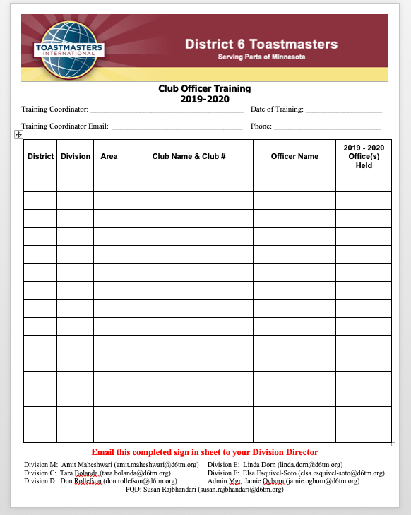

Slide 5
Promoting club officers training
District 6 website
District 6 Facebook
Email to the club officers
Club visits
Area news letter
Division news letter

Slide 6
Format of Club Officers training
At least 60 minutes.
Invite speakers who can present on multiple topics or single topic depending on your situation
In person and NOT over the phone
Customize presentation as you seem fit

Slide 7
Content Options
Officer roles and impact to club
Distinguished Club Program
Pathways
Open house with quality meetings
Effective Evaluations
Marketing the club to potential members

Slide 8
Remember
Publicize
Report
Verify

Slide 9
^{2nd} Round Club Officer Training
Enter date, time and location

Slide 10
Toastmaster Club Mission:
We provide a supportive and positive learning experience in which members are empowered to develop communication and leadership skills, resulting in greater self-confidence and personal growth.

Slide 11
Greetings!!
Thank you so much for coming to today’s Club Review, Education, and Training Event!
By working together we can
CREATE
stronger, high-quality clubs!

Slide 12
Agenda
Officer roles and impact to club
Distinguished Club Program
Pathways
Open house with quality meetings
Effective Evaluations
Marketing the club to potential members
Wrap-up

Slide 13
Agenda
Officer roles and impact to club
Distinguished Club Program
Pathways
Open house with quality meetings
Effective Evaluations
Marketing the club to potential members
Wrap-up

Slide 14
President

Slide 15
Role as President
Preside over meeting
Earn Distinguish Club Recognition
Lead and Guide
Base Camp Manager

Slide 16
Next Steps as President
Evaluate how the year is going
Define what needs to be done to finish the year strong
Start mentoring your replacement

Slide 17
Vice President Education

Slide 18
Role of the VP Education
Maintains a schedule of club meetings
At least 3 to 4 meetings in advance
Submits education awards
Manages mentor program
Base Camp

Slide 19
Next Steps as VP Education
Evaluate how the year is going
Ask the members what else they need for their goals
Start mentoring your replacement

Slide 20
Vice President Membership

Slide 21
Role of the VP Membership
Assists guests
Recruit new members

Slide 22
Next Steps as VP Membership
Evaluate how the year is going
Schedule open houses for the next few months to finish the year strong
Start mentoring your replacement

Slide 23
Vice President Public Relations

Slide 24
Role of VP Public Relations
Publicizes the club
Keep club website current

Slide 25
Next Steps as VP Public Relations
Evaluate how the year is going
Look for new ways to promote your club
Start mentoring your replacement

Slide 26
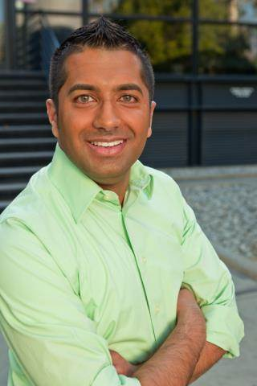
Secretary

Slide 27
Role of the Secretary
Takes minutes at all meetings
Maintains files and make any changes needed
Base Camp

Slide 28
Next Steps as Secretary
Evaluate how the year is going
Make sure the club roaster is current
Start mentoring your replacement

Slide 29
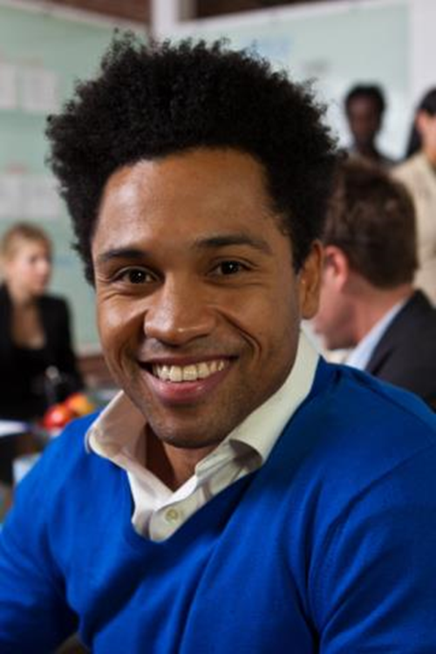
Treasurer

Slide 30
Role of Treasurer
Creates budget
A plan for the club’s income & spending
Maintains bank account(s)
Pay dues on or before October 1st and April 1st.

Slide 31
First Steps as Treasurer
Evaluate how the year is going
Remind members to pay dues
Start mentoring your replacement

Slide 32
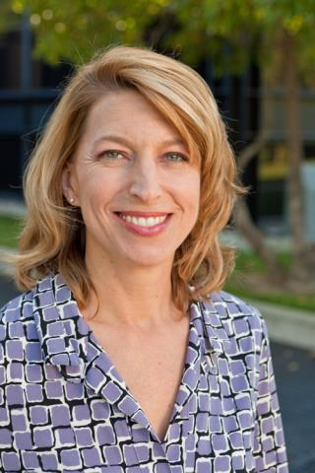
Sergeant at Arms

Slide 33
Role of Sergeant at Arms
Sets up meeting space on time
Responsible for club property

Slide 34
Next Steps as Sergeant at Arms
Evaluate how the year is going
Help with open houses
Start mentoring your replacement

Slide 35
Agenda
Officer roles and impact to club
Distinguished Club Program
Pathways
Open house with quality meetings
Effective Evaluations
Marketing the club to potential members
Wrap-up

Slide 36
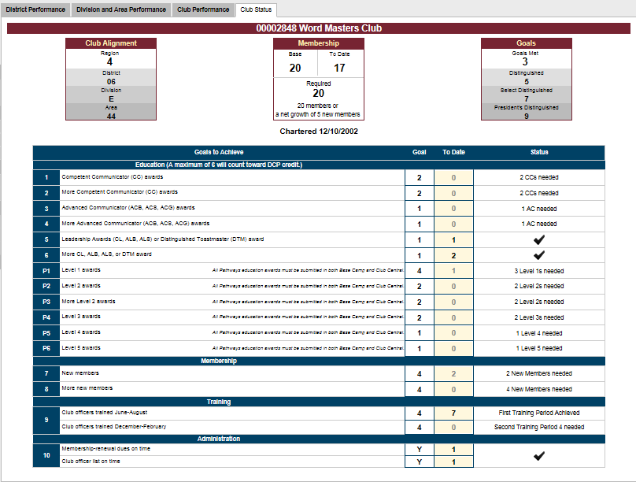
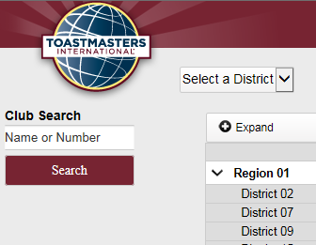
DCP Dashboard
http://dashboards.toastmasters.org/

Slide 37
DCP Program
Traditional Education Program
Two Competent Communicator (CC) awards
Two more CC awards
One Advanced Communicator Bronze (ACB), Advanced Communicator Silver (ACS) or Advanced Communicator Gold (ACG) award
One more ACB, ACS or ACG award
One Competent Leader (CL), Advanced Leader Bronze (ALB), Advanced Leader Silver (ALS) or Distinguished Toastmaster (DTM) award
One more CL, ALB ALS or DTM award

Slide 38
DCP Program
Toastmasters Pathways Learning Experience
P1. Four members complete Level 1
P2. Two members complete Level 2
P3. Two more members complete Level 2
P4. Two members complete Level 3
P5. One member completes Level 4
P6. One member completes Level 5
MEMBERSHIP
Four new members
Four more new members

Slide 39
DCP Program
TRAINING
A minimum of four club officers trained during each of the two training periods*
ADMINISTRATION
On-time payment of membership dues accompanied by the names of eight members (at least three of whom must be renewing members) for one period and on-time submission of one club officer list*

Slide 40
Agenda
Officer roles and impact to club
Distinguished Club Program
Pathways
Open house with quality meetings
Effective Evaluations
Marketing the club to potential members
Wrap-up

Slide 42
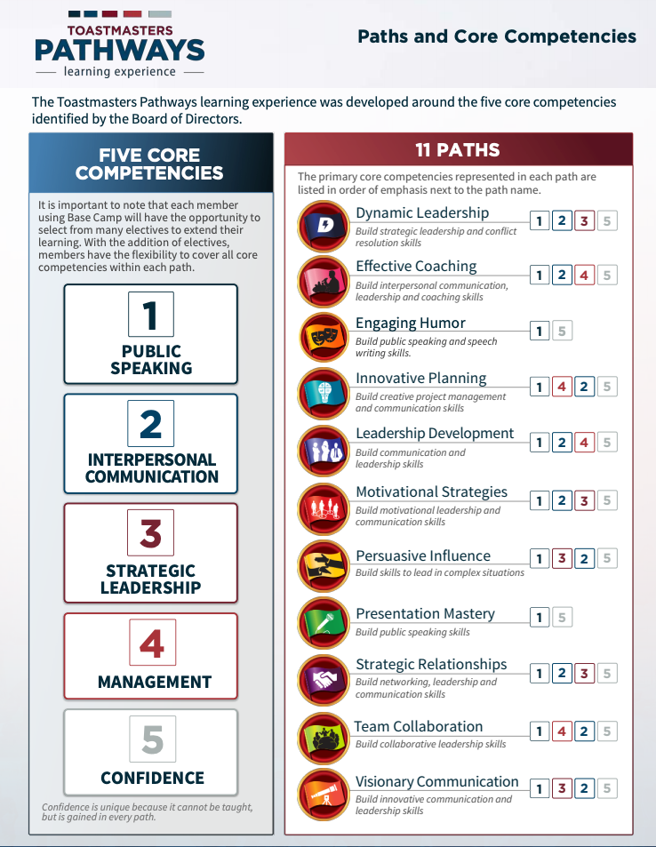

Slide 43
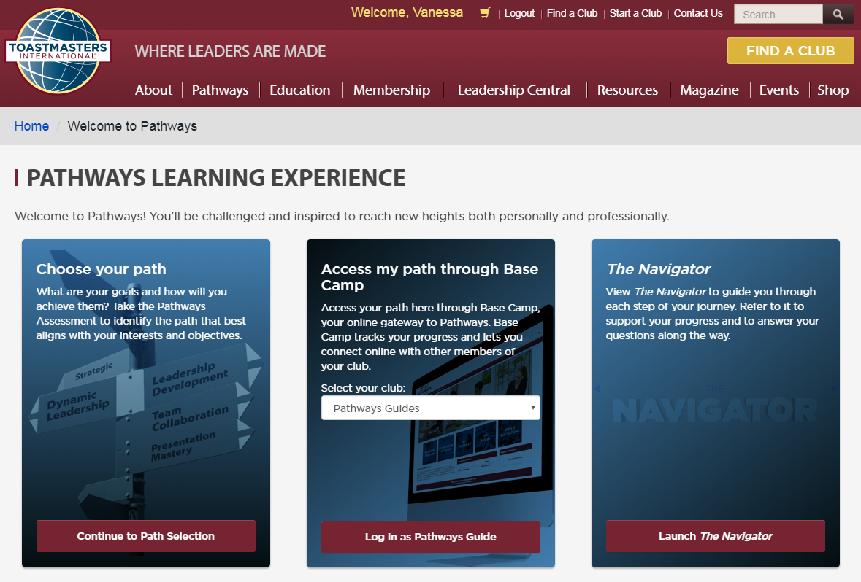
Getting Started

Slide 44
Base Camp Managers
Check frequently for requests from members
Validate each project as it is completed

Slide 45
Base Camp Managers
Validate the level
Printing Certificates when level is completed

Slide 46
Base Camp Managers
For DCP credit enter level into club central

Slide 47
Base Camp Managers
Resources
Resources are fellow club officers
District Officers
Toastmasters International

Slide 48
GROUP ACTIVITY
Split into 3 groups…
1. Presidents and VP/ED
2. VP/M and VP/PR
3. Secretary, Treasurer, and SAA

Slide 49
10 Minute Break

Slide 50
Toastmaster Club Mission:
We provide a supportive and positive learning experience in which members are empowered to develop communication and leadership skills, resulting in greater self-confidence and personal growth.

Slide 51
Agenda
Officer roles and impact to club
Distinguished Club Program
Pathways
Open house with quality meetings
Effective Evaluations
Marketing the club to potential members
Wrap-up

Slide 52
Quality Meetings
Meetings are scheduled in advance
confirm meeting roles (Communication Tree)
Members attend and prepared for their roles
Speeches: Pathways project or manuals
Table Topics
Effective evaluations are given

Slide 53
Open House
Welcome friend to your meeting
Welcome co workers to your meeting
Advertisement of the meeting
Speeches from Pathways projects/manuals
Talk about speeches as presentations
Listen to the guest: What's is in for them?

Slide 54
Large Group Discussion
Why are quality meetings important when you have an open house?

Slide 55
Large Group Discussion
Do you use the “What is in it for me?” method to listen to your guests?

Slide 56
Large Group Discussion
How many guests do you manage to convert to members?

Slide 57
Large Group Discussion
If your conversion rate of guest to member is low. What may be the problem?

Slide 58
Agenda
Officer roles and impact to club
Distinguished Club Program
Pathways
Open house with quality meetings
Effective Evaluations
Marketing the club to potential members
Wrap-up

Slide 59
Effective Evaluations
Treat an evaluation as a short speech
Express things YOU noticed
Pay attention to the objectives of the project

Slide 60
Effective Evaluations
Note use of rhetorical devices (alliteration, triads, etc.), grammar, and unique language
Be sure to provide 1 or 2 items for improvement
Be sure to begin and end with things you liked about the speech

Slide 61
Effective Evaluations
Evaluate as you would want to be evaluated
Remember Evaluations are for member’s growth
View Tutorial in Pathways if you have a question on how to evaluate

Slide 62
Agenda
Officer roles and impact to club
Distinguished Club Program
Pathways
Open house with quality meetings
Effective Evaluations
Marketing the club to potential members
Wrap-up

Slide 63
Small Group Discussion Split into small groups, each group answer one of the following questions:
How are you using Pathways to grow your club?
Discuss ways to invite a guest to your club.

Slide 64
Small Group Discussion Split into small groups, each group answer one of the following questions:
A guest is attending a meeting for the first time and thinking about joining. What do you do?
You’re talking to a guest who doesn’t know a lot about Toastmasters. What is most important for them to know?

Slide 65
Small Group Discussion Split into small groups, each group answer one of the following questions:
There’s a member of your club who just finished their Competent Communicator manual and they may not renew their membership. How do you convince them to stay a member?

Slide 66
Small Group Discussion
Does your club use the “What’s in it for me?” (WIIFM) approach?
One-on-one feedback from visitor
A Club representative LISTENS to the visitor –
“Thank you for attending today – what made you decide to attend today’s meeting?”
Let the visitor tell you what they’re looking for, take note of their “needs,” match what Toastmasters offers to their needs, and then share what we offer and how we can help by putting it in their words.

Slide 67
Bonus Discussion!! If there’s time…
Why should we visit your club?
2 to 3 people (or more…) will be asked to stand and, in 30 seconds or less, share why a guest should visit their club! Table Topic on steroids!

Slide 68
Wrap up
Who can explain impacts their officer role has on success/failure of their club?
What is a part of a quality meeting?
What’s one strategy for helping current members create quality meetings?
How they are using Pathways to strengthen their club?

Slide 69
Thank You!!!
One of the ways your commitment to your club being a club of quality is displayed by attending
Club Officer Training.
We sincerely appreciate you taking time out of your busy schedule to attend!

Slide 70
Questions & Answers

Slide 71
Thank you!
District 6

