Slide 1
2nd Round Club officer Training

Slide 2
Agenda
Officer roles and impact to club
Importance of quality meetings
Effective Evaluations
Toastmasters education paths
Marketing the club to potential members
Wrap-up

Slide 3
Will a guest join
your club?

Slide 5
Clubs = soil for Toastmasters growth
Adding members into bad soil = nothing grows
- Adding members into good black soil with lots of nutrients = amazing growth!

Slide 6
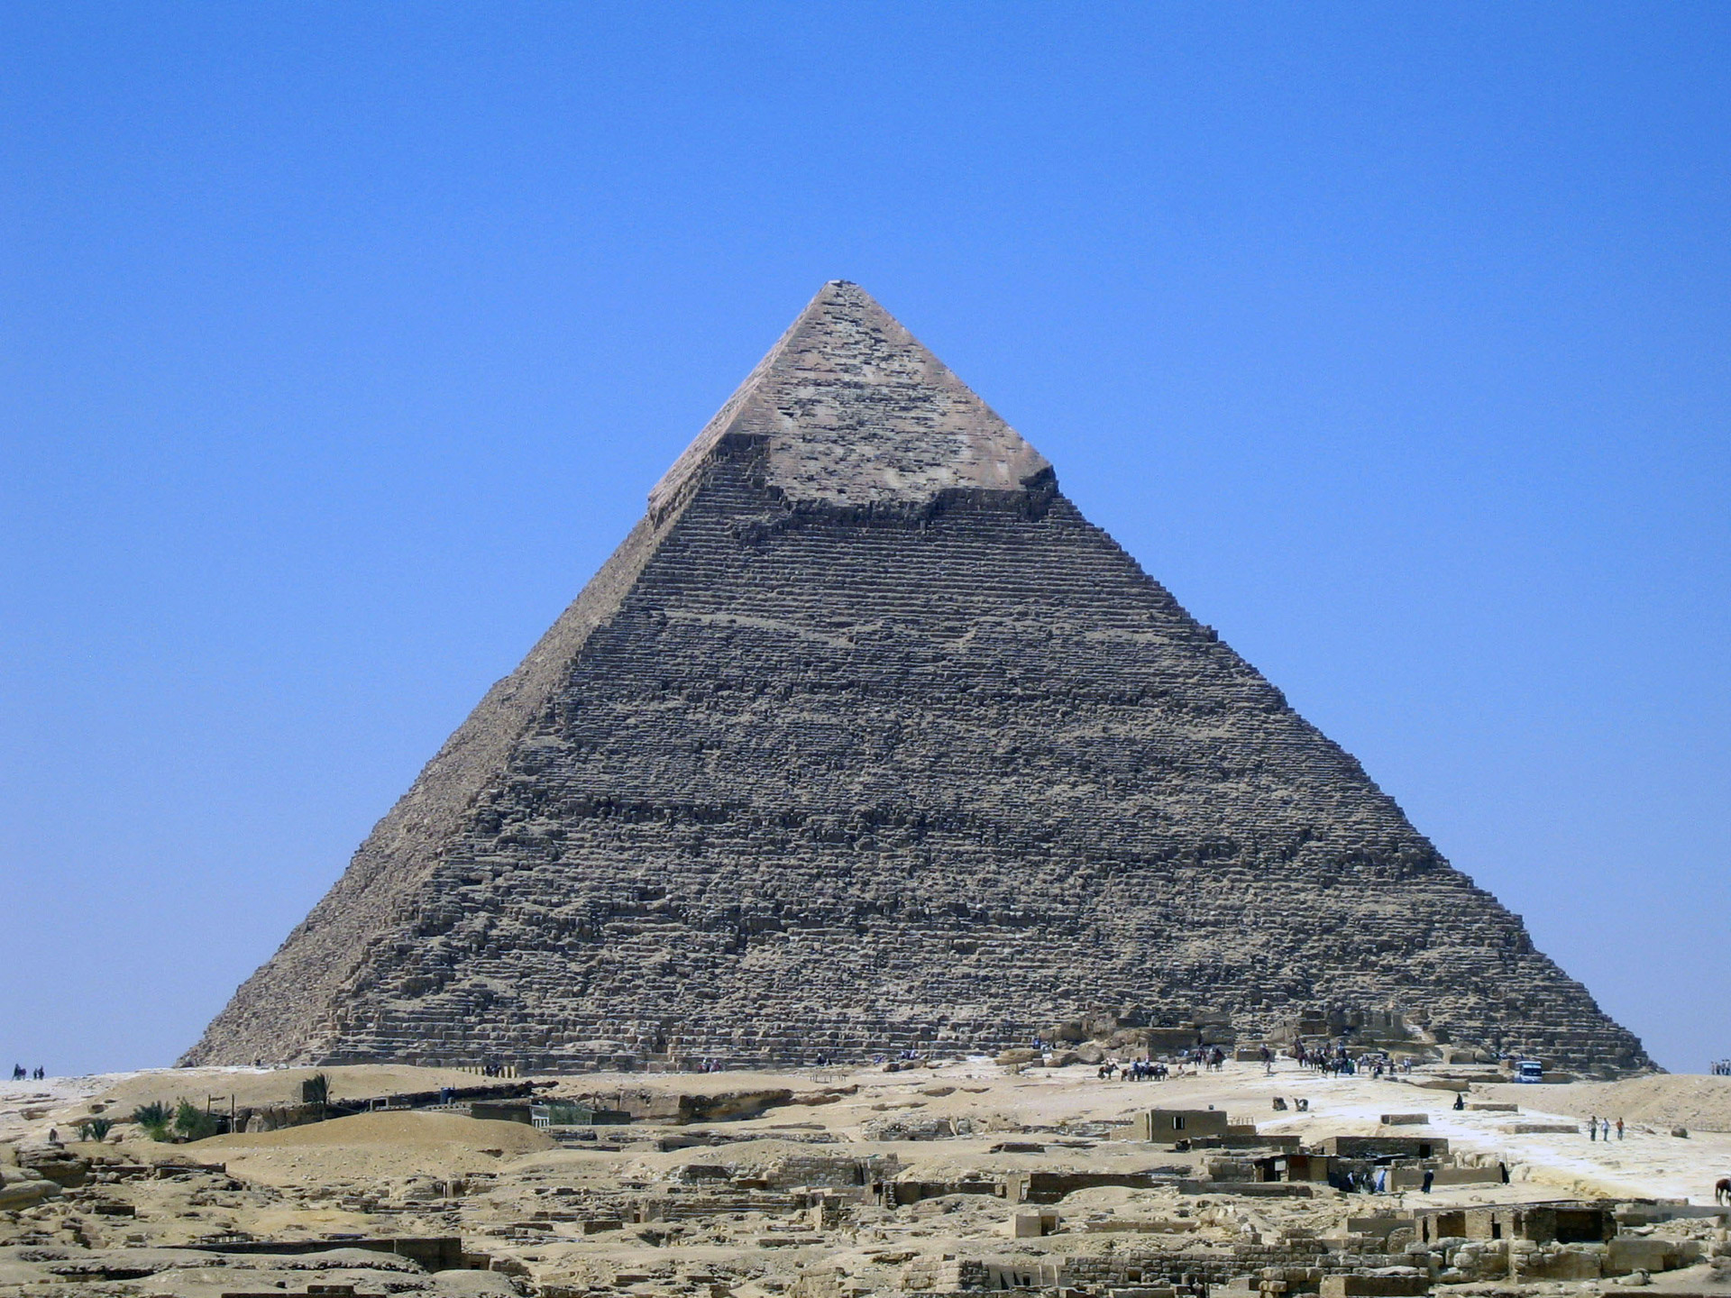

Slide 7
Block 1: Quality Meetings
Meetings are scheduled in advance
Communication Tree is utilized to confirm meeting roles
Members attend and are prepared for their roles
Speeches are from projects in manuals
Table Topics
Effective evaluations are given

Slide 9
Block 2: Effective Evaluations
Treat an evaluation as a short speech
Express things YOU noticed
Pay attention to the objectives of project
Note use of rhetorical devices (alliteration, triads, etc), grammar, and unique language
Be sure to provide 1 or 2 items for improvement
Be sure to begin and end with things you liked about the speech

Slide 13
Wrap up
Who can explain impacts their officer role has on success/failure of their club?
What is a part of a quality meeting?
What’s one strategy for helping current members create quality meetings?
What are the communication and leadership tracks and what are the benefits of each for potential and current members?

Slide 14
Thank You!!!
One of the ways your commitment to your club being a club of quality is displayed by attending Club Officer Training. We appreciate you taking time out of your busy schedule to attend!

