Slide 1
Area Governor Training
August 25, 2012
Still the Best Job Ever

Slide 2
Welcome to Training
Pat Croal
pcroal@juno.com
Joan Watson
toastmasterjoan@hotmail.com

Slide 3
Agenda
Moments of Truth
Speech Contests
Club Visits
SWOT analysis by Division
Days of our District

Slide 4
Moments of Truth
Form 6 groups –we will decide
Each group will have one standard to discuss
Prepare a 1-2 minute report to share to the group …will be clapped down at 2 minutes.

Slide 5
Moments of Truth
First Impressions
Membership Orientation
Fellowship, Variety and Communication
Program Planning and Meeting Organization
Membership Strength
Achievement Recognition

Slide 6
Speech Contests
Judging
Rules
Process

Slide 7
Chief Judge – prepare Judges
Review the rules
Conduct training workshops for speech contest judges
Review Speech Contest Judges Training (Item 1190)
Direct contest judges to online resources: www.toastmasters.org/SpeechContestFAQ and the e-learning speech contest module (www.toastmasters.org/tlc) astern

Slide 8
Chief Judge – prepare Judges
Select contest judges carefully. (Consider experienced members and members from other areas or divisions.)
Ensure contests judges are aware of contest rules, procedures, responsibilities, and duties
Conduct a judges briefing before every contest.
Review the Judge’s Guide and Ballot (Item 1172).
Discuss bias and fairness.

Slide 9
Chief Judge – prepare Judges
It is important for the chief judge to choose fair and impartial judges and train contest officials.
Issues related to judging arise at lower levels of competition, especially at the area level, because of a lack of training.
Many contest judges don’t understand their role.
The chief judge chooses contest judges and prepares them for the role:
How to use the Judge’s Guide and Ballot (Item 1172)
How to choose a winner without evaluating the speeches

Slide 10
Stand Up & Stretch
Sit with your Division

Slide 11
Club Visits
Club Visit Forms
Plan, Prepare, Set dates
Submit the Area Governor's Club Visit Report online. A copy of the form will automatically be sent to your district leaders and the club president. Reports are due twice a year. Deadlines are November 30 and May 31.
To submit an online Area Governor's Club Visit Report log in to toastmasters.org/members. Follow the link to District Central and click "Submit Area Visit Report." (Area Governor's have access to this feature only.)

Slide 12
Club Visits
Plan ahead
Contact Club President
Set a date to attend the club
Indicate information you need

Slide 13
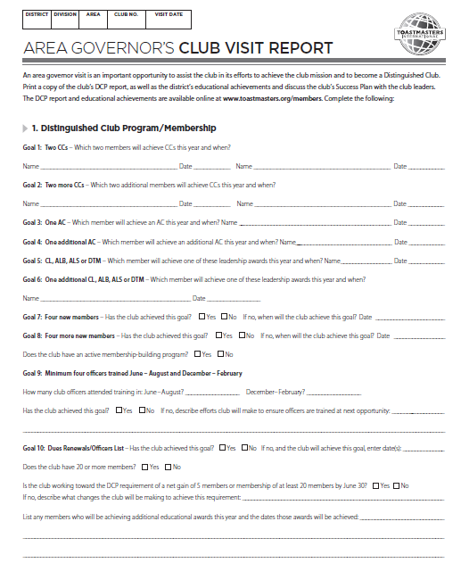

Slide 14
Distinguished Club Program
Review with the Club President

Slide 15
SWOT Analysis
Each Area Governor completes the SWOT worksheet for their Area.
Make sure all Area Governors share within their division 1-2 minutes of their analysis.

Slide 16
Strength, Weakness, Opportunity, Threats
Consider the following areas:
Clubs in danger
New club opportunity
Officer training attendance
Dues, membership
DCP status (past & present)

Slide 17
What’s Next in November
Distinguished Clubs
Area SWOT(strengths, weaknesses, opportunities, threats)
Building new clubs
Area Council meetings

Slide 18
Days of our District
Dues are DUE

Slide 19
Conclusion - Thank you for attending!
With information and encouragement each of us can achieve more than we ever imagined!

