Slide 1
Area Governor Training
June 15, 2013
The Best Job Ever!

Slide 2
Welcome to Area Governor Training We’re glad you’re here!
District Trainers:
Pat Croal
pcroal@juno.com
Joan Watson
toastmasterjoan@hotmail.com
Notes:
Pat to open

Slide 3
Agenda/Objectives
What do I need to do NOW?
What do I need to do NEXT?
What do I need to do in the NEAR FUTURE?
District Recognition Program
District Leadership Handbook
Club Leadership Handbook
Notes:
Joan - NOW

Slide 4
What do I need to do NOW?
Get to Know Clubs
DCP
Area Council
Club Officer Training
Plan Club Visits
Plan Area Contest Date
Learn the Distinguished Area Plan
Notes:
Joan

Slide 5
What do I need to do NOW?
Get to know the clubs in your area
Look at the 2013 District 6 Club Realignment:
www.d6tm.org
Notes:
Joan

Slide 6
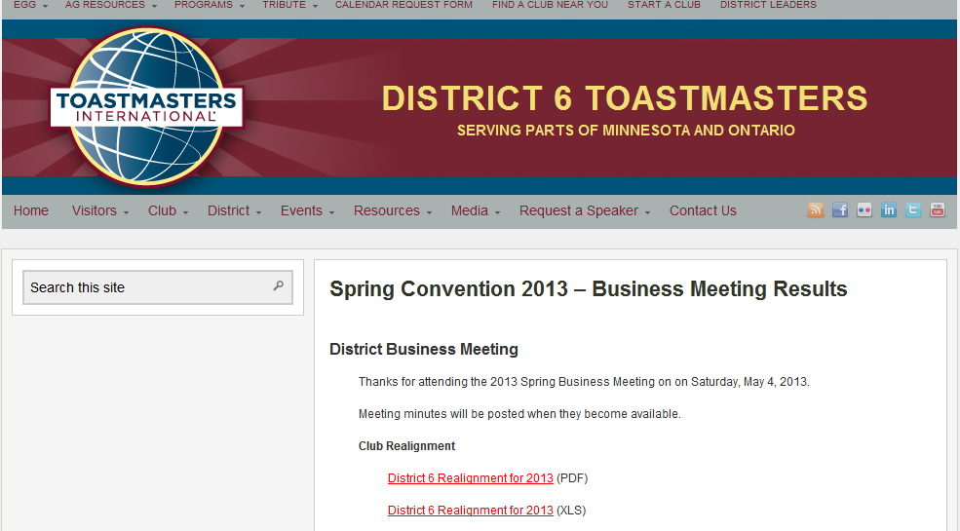
What do I need to do NOW? Know the clubs in your Area
Go to this area of the District 6 web site:
http://www.d6tm.org/springconvention2013/businessmeeting/
Click on District 6 Realignment 2013
Notes:
Joan

Slide 7
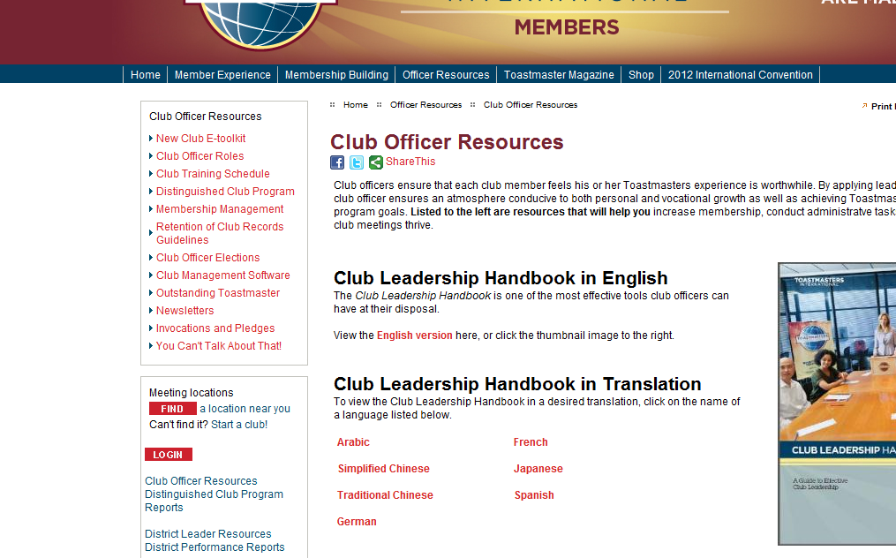
What do I need to do NOW? Know the clubs in your Area members.toastmasters.org (TI site) Click on District Leader Resources
Notes:
Joan

Slide 8
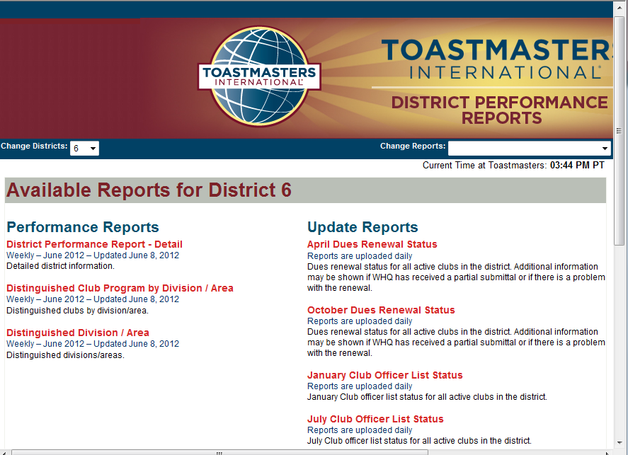
District, Division & Area Reports – enter “6” for District 6 Available reports will show
Notes:
Joan

Slide 9
What do I need to do NOW?
Learn & know the
Distinguished Club Plan
The “DCP”
Resources for learning:
Club Officer Handbook - page 44
District Leadership Handbook - page 40
Notes:
Joan

Slide 10
What do I need to do NOW?
Plan for Area Council meetings-Topics to cover at Area Council meeting:
Officer lists, officer training, club visits, planning for contest, club programming support
Tip:
Review criteria in your District Leadership Handbook page 34
Notes:
Joan

Slide 11
What do I need to do NOW?
Plan your Area Council Meetings
Chose a date, time, location
Communicate early to Club Presidents
Plan date in advance of your Fall Contest (at least 4 weeks in advance)
Create an agenda (see example handout)
Notes:
Joan

Slide 12
---SAMPLE--- Area Council Meeting Agenda Area XX, _______Division 5:30-7 PM July 21, 2013 Location: University Library
Introductions
Club Presidents: 2-3 minute club report on status of Officer training, membership, club activities
Plan dates for Area Governor visit to each club – Aug - Sept
Contest: Area contest date is____. Club contests need to happen prior. Contests for Fall are Humorous & _______.
Plan area contest: Contest chair, Chief Judge, Toastmaster, Site & Refreshment chair, Flyer & Program chair
Plan for dues collection
Club programming/membership discussion (or any topic that Area Council wishes to discuss
Open agenda – time permitting
Notes:
Joan

Slide 13
What do I need to do NOW?
Begin to understand the
“Distinguished Area Plan”
(how your Area progress will be measured and awarded)
Tip:
Review criteria in your District Leadership Handbook - page 39
Notes:
Joan

Slide 14
Distinguished Area Criteria
Qualifying Requirement:
Submit semiannual Area Governor Visit Reports for at least 75% of club base by the due date
No net club loss
Distinguished Area:
Distinguished clubs equal to at least 50% of the club base
An area with a base of 3 or 4 clubs will require 2 Distinguished Clubs
An area with a base of 5 or 6 clubs will require 3 Distinguished Clubs
An area with a base of 7 or 8 clubs will require 4 Distinguished Clubs
Select Distinguished Area:
The same requirements as Distinguished Area, plus one more Distinguished Club
An area with a base of 3 or 4 clubs will require 3 Distinguished Clubs
An area with a base of 5 or 6 clubs will require 4 Distinguished Clubs
An area with a base of 7 or 8 clubs will require 5 Distinguished Clubs
President’s Distinguished Area:
The same requirements as Select Distinguished Area plus net growth of one club
Notes:
Joan

Slide 15
What do I need to do NEXT?
Contact Club Presidents
Area Council
Review District Timeline for July & August
Review Club Visit form
Planning for Area Contest
Notes:
Pat – NEXT Slides 15-

Slide 16
What do I need to do NEXT?
Contact your Club Presidents
Create a Communication plan
See example 1st email to Club Pres
Offer to install New Officers – See script on page 65 of Club Officer Handbook
Notes:
Pat

Slide 17
Example 1st email to club president
Area Governors: Please see below for a sample first email to your club presidents. Please adapt/edit and personalize as your prefer. Plan to send this to the new club president the first week in July OR, send to the current club president in June (asking them to forward to the new club president).
Dear Club President (enter the name if you know it) – Please forward this to the current club president.
My name is ________. I am the Area ___ Governor and am looking forward to meeting you in person. Your club is in my Area and I am excited to be working with you this club year (July 1, 2013 – June 30, 2014). The purpose of this email is to introduce myself briefly to you and give you some information and dates to help you get started in your year as Club President.
As the Area Governor, my role is to work with the 5 clubs in our area and provide a connection to the resources of District 6 (which covers most of the state of MN and a portion of Ontario Canada). My goal is to help you with resources and information to help your club be a thriving and Distinguished Club.
As president, the Distinguished Club Plan (DCP) will be your roadmap to the goals that will help your club thrive for your members. When your club reaches certain milestones of achieving educational awards, membership, training and dues payments then your club can earn the Distinguished Club Award (or other higher awards). See this link for more information on the DCP. Please take time to review your DCP regularly with your officers and club members. You will learn more about the DCP at your club officer training session.
I look forward to serving as your Area Governor this year. Please contact me with any questions. Here’s looking towards a successful and distinguished year for your club this year!
Will you please reply to me to confirm you received this message and give me your contact information?
Sincerely, Name Area __ Governor Telephone: email:
Notes:
Pat

Slide 18
What do I need to do NEXT?
Set Up Club Officer Training Dates:
Work with Division Governor
Attend “Train the Trainer” session
Register location/date/time on District calendar (and tell your clubs about it):
http://d6tm.org/CalendarRequestForm
Enter events on the district calendar including your Area Contest date and Club Officer Training. Enter details as soon as you have them.
Notes:
Pat

Slide 19
Review District Timeline: July
Club officer training
Submit first round club officer training reports to LGET
Contact clubs that have not submitted club officers for 213-2014
Plan for area council meetings
District Leadership Handbook page 18
Notes:
Pat

Slide 20
Review District Timeline: August
End Club officer training
Submit first round club officer training reports to LGET
Plan for area council meetings
Area Speech Contest
District Leadership Handbook page 18
Notes:
Pat

Slide 21
What do I need to do NEXT?
Club Visits:
Learn the club visit form & online reporting
Plan, prepare, set dates with Club President
Submit the Area Governor's Club Visit Report online. A copy of the form will automatically be sent to your district leaders and the club president.
To submit an online Area Governor's Club Visit Report log in to toastmasters.org/members. Follow the link to District Central and click "Submit Area Visit Report." (Area Governor's have access to this feature only.)
Area Visit reports are due twice a year.
Deadlines are November 30 and May 31 – please do them early!
Notes:
Pat

Slide 22
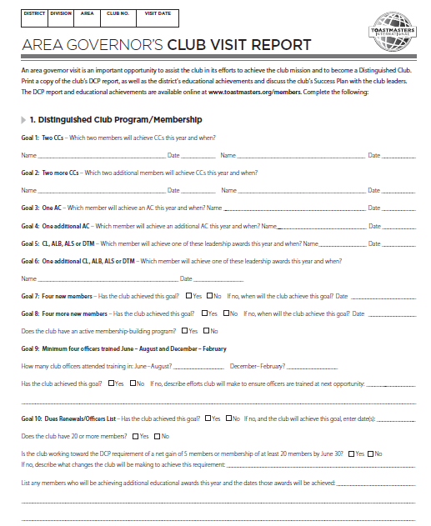
Notes:
Pat

Slide 23
What do I do in the NEAR FUTURE?
Fall Contest Planning
Set your Fall Contest Date
Look for someone in your area to serve as Contest Chair
An experienced TM who knows the rules & understands the process
Work with them to choose an experienced Toastmaster & Chief Judge
Notes:
Joan

Slide 24
Division Contests
Central September 21
Eastern September 26
Frontier October 1
International September 14
Metro September 30
Northern September 24
Prairie September 28
Rivers September 20
Southern October 5
Western September 18
Fall Conference – October 25-26 Thunder Bay
Notes:
Pat

Slide 25
What’s Next for August Training?
Area SWOT (Strengths, Weaknesses, Opportunities, Threats)
Area Council Meeting
Area Contest
Dues
Area Success Plan
District Recognition Program page 21
Notes:
Pat

Slide 26
Stay for Train the Trainer
DCP must be covered at all club officer training sessions
Minimum 4 trained officers/club for DCP goal
First Round Objective: learn officer roles
July 20- TLI: Crowne Plaza – Big training opportunity for club officers
Club Officer Training deadline: August 31
Notes:
Joan

Slide 27
Conclusion
With information and encouragement each of us can achieve more than we ever imagined!
Thank you for serving as an
Area Governor !
Notes:
27

