Slide 1
Area Governor Training
June 16, 2012
The Best Job Ever

Slide 2
Welcome to Area Governor Training We’re glad you’re here!
District Trainers:
Pat Croal
pcroal@juno.com
Joan Watson
toastmasterjoan@hotmail.com

Slide 3
Agenda/Objectives
Meet and Greet
What do I need to do NOW?
What do I need to do NEXT?
What do I need to do in the NEAR FUTURE

Slide 4
Meet & Greet
Each time the bell rings you will…
Find a new person outside your division
Share your name, area # and one or two of your strengths
Record name and strength(s)

Slide 5
Strengths such as…
Learner Achiever Relator Motivator
Fun Smart Educator Socializer
Talented Developer Organizer
Appreciated Sees Potential Committed
Reliable Honesty Loyal Dependable
Knowledge Ideas Strategic Growth
Realist Understanding Empathetic

Slide 6
What do I do NOW
Get to know the clubs in your area
Look at the District 6 Club 2012 Realignment:
www.d6tm.org

Slide 8
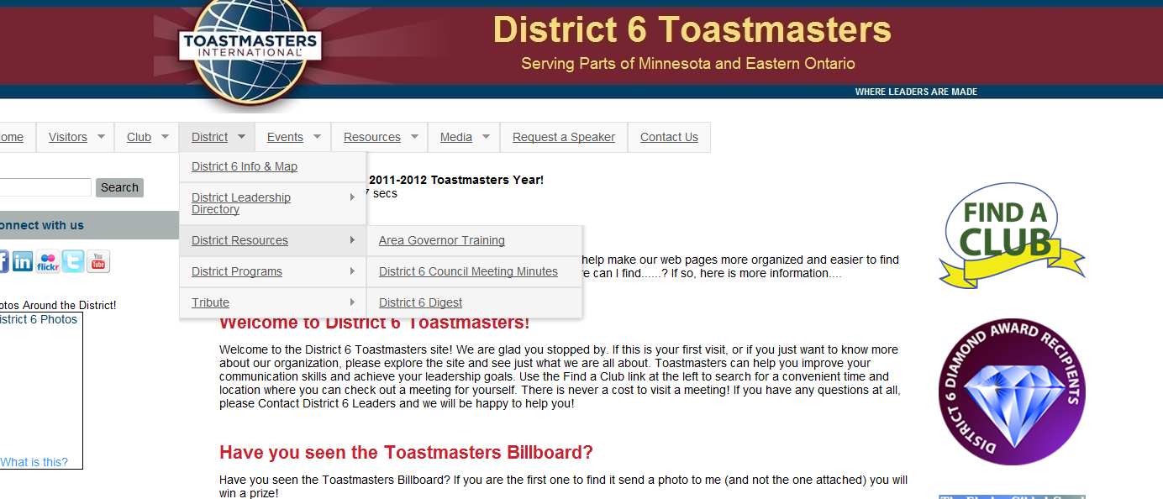

Slide 10
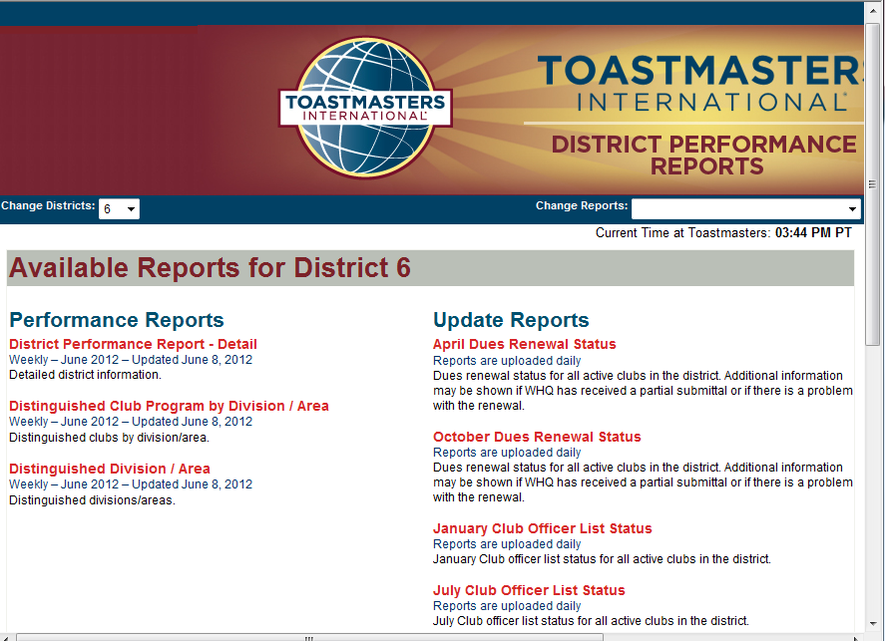

Slide 11
What do I do NOW
Distinguished Club Plan
Let’s Review
(and really learn it!)

Slide 12
What do I do NOW
Distinguished Area Plan
In your packet

Slide 13
Area Program
Qualifying Requirement:
Submit semiannual Area Governor Visit Reports for at least 75% of club base by the due date
No net club loss
Distinguished Area:
Distinguished clubs equal to at least 50% of the club base
An area with a base of 3 or 4 clubs will require 2 Distinguished Clubs
An area with a base of 5 or 6 clubs will require 3 Distinguished Clubs
An area with a base of 7 or 8 clubs will require 4 Distinguished Clubs
Select Distinguished Area:
The same requirements as Distinguished Area, plus one more Distinguished Club
An area with a base of 3 or 4 clubs will require 3 Distinguished Clubs
An area with a base of 5 or 6 clubs will require 4 Distinguished Clubs
An area with a base of 7 or 8 clubs will require 5 Distinguished Clubs
President’s Distinguished Area:
The same requirements as Select Distinguished Area plus net growth of one club

Slide 14
Stand Up & Stretch

Slide 15
What do I do NEXT ?
Contact your Club Presidents
See example 1st email
Offer to install new offices

Slide 16
Area Governors: Please see below for a sample first email to your club presidents. Please adapt/edit and personalize as your prefer. Plan to send this to the new club president the first week in July OR, send to the current club president in June (asking them to forward to the new club president).
Dear Club President (enter the name if you know it) – Please forward this to the current club president.
My name is ________. I am the Area ___ Governor and am looking forward to meeting you in person. Your club is in my Area and I am excited to be working with you this club year (July 1, 2012 – June 30, 2013). The purpose of this email is to introduce myself briefly to you and give you some information and dates to help you get started in your year as Club President.
As the Area Governor, my role is to work with the 5 clubs in our area and provide a connection to the resources of District 6 (which covers most of the state of MN and a portion of Ontario Canada). My goal is to help you with resources and information to help your club be a thriving and Distinguished Club.
As president, the Distinguished Club Plan (DCP) will be your roadmap to the goals that will help your club thrive for your members. When your club reaches certain milestones of achieving educational awards, membership, training and dues payments then your club can earn the Distinguished Club Award (or other higher awards). See this link for more information on the DCP. Please take time to review your DCP regularly with your officers and club members. You will learn more about the DCP at your club officer training session.
I look forward to serving as your Area Governor this year. Please contact me with any questions. Here’s looking towards a successful and distinguished year for your club this year!
Will you please reply to me to confirm you received this message and give me your contact information?
Sincerely, Name Area __ Governor Telephone: email:

Slide 17
What do I do NEXT ?
Work with Division Governor & Set up Club Officer Training
Attend “Train the Trainer”
Register location/date/time on District calendar (and tell your clubs about it):
http://d6tm.org/CalendarRequestForm
Enter events on the district calendar including your Area Contest date and Club Officer Training. Enter details as soon as you have them.

Slide 18
What do I do NEXT ?
Club Visit Forms
Plan, Prepare, Set dates with Club President
Submit the Area Governor's Club Visit Report online. A copy of the form will automatically be sent to your district leaders and the club president.
To submit an online Area Governor's Club Visit Report log in to toastmasters.org/members. Follow the link to District Central and click "Submit Area Visit Report." (Area Governor's have access to this feature only.)
Area Visit reports are due twice a year.
Deadlines are November 30 and May 31 (but do them early!).

Slide 19
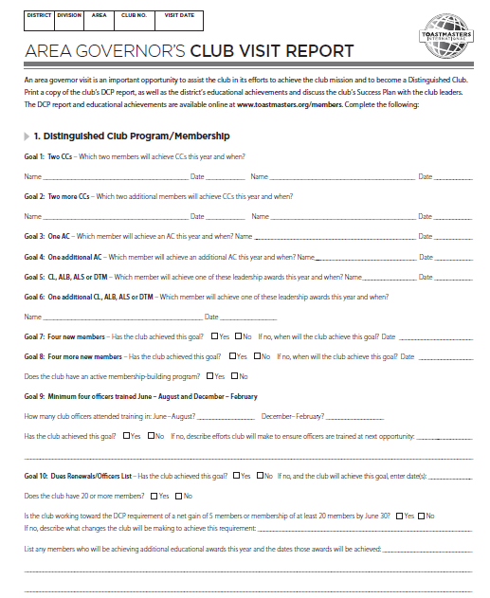

Slide 20
What do I do in the near future?
Set your Fall Contest Date
Look for a someone in your area for Contest Chair
An experienced TM who knows the rules & understands the process
Work with them to choose an experienced Toastmaster & Chief Judge

Slide 21
Division Contests
Central October 2
Eastern September 25
Frontier October 4
International September 29
Metro October 10
Northern September 26
Prairie October 6
Rivers September 27
Southern September 22
Western September 24

Slide 22
What do I do in the near future?
Plan your Area Council Meetings
Chose a Date-Time-Location
Communicate it early to Club Presidents
Plan it in advance of your Fall Contest (at least 4 weeks in advance)

Slide 23
What’s Next for August Training
Area Contests
Area SWOT
Area Council Meetings
Dues

Slide 24
Stay for Train the Trainer
DCP must be covered at all club officer training sessions
Minimum 4 trained officers/club
First Round objective: Officer Roles
July 21 TELI—get them there
Training completed by 8/31 deadline

Slide 25
Conclusion
With information and encouragement each of us can achieve more than we ever imagined!
Thank you for serving as an Area Governor – the best job!

