Slide 1
All Officer Roles
Club Officer Training

Slide 2
President
Club Officer Training

Slide 3

Session Objectives
Identify your role
Fulfill your responsibilities
Find resources that help you
President

Slide 4
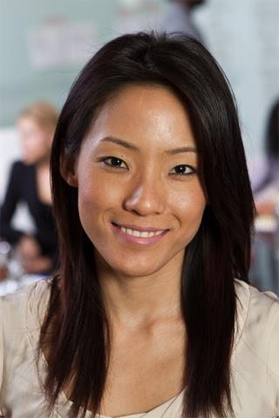
President Role

Slide 5
President Responsibilities
The Club Meeting
Outside the Club Meeting
The Executive Committee
President

Slide 6

The Club Meeting
Before Club Meetings
Upon Arrival at
Club Meetings
During Club Meetings
President

Slide 7

Before Club Meetings
Ask VPE about special recognition or member inductions.
Plan the business portion of the meeting.
Review parliamentary procedure.
President

Slide 8
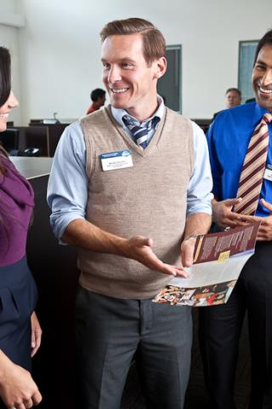
Upon Arrival at Club Meetings
Review the meeting agenda.
Greet guests and members.
President

Slide 9

During Club Meetings
Call the meeting
to order.
Introduce guests.
Explain the
meeting’s events.
Conduct the
business portion
of the meeting.
Provide information for next meeting.
President

Slide 10
During Club Meetings
Make any announcements.
Adjourn the meeting.
President

Slide 11

Outside the Club Meeting
Attend and vote at council meetings.
Attend and vote at
the Annual
Business Meeting.
Appoint and chair
the audit committee.
Appoint the nominating committee.
President

Slide 12
Outside the Club Meeting
Receive official correspondence from World Headquarters.
Schedule and chair executive committee meetings.
Develop and improve club leadership.
Oversee Club administration.
President

Slide 13
Outside the Club Meeting
Advance club and member achievement.
Interact effectively with other organization levels.
President

Slide 14

The Executive Committee
Oversee the
executive committee.
Ensure the
executive committee
completes its duties
President

Slide 15
Executive Committee Duties
  Create a club budget.
  Compete a Club Success Plan.
  Strategize for success in the Distinguished Club Program.
  Create and oversee other club committees as necessary.
President

Slide 16
Getting Started
Attend district-sponsored club-officer
training program.
Read materials.
Meet with outgoing executive committee.
Meet with outgoing president.
Meet with current executive committee.
President

Slide 17
Vice President Education (VPE)
Club Officer Training

Slide 18
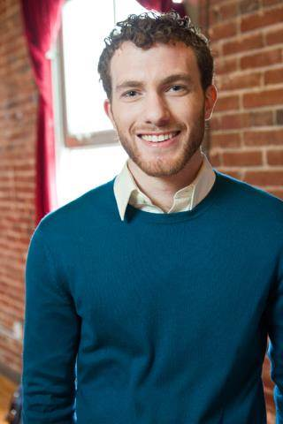
VPE Role

Slide 19
VPE Responsibilities
The Club Meeting
Outside the Club Meeting
The Executive Committee

Slide 20
The Club Meeting
Before Club Meetings
Upon Arrival at
Club Meetings
During Club Meetings
VPE

Slide 21
Before Club Meetings
Review scheduled roles.
Offer support to the Toastmaster.
Schedule education sessions.
VPE

Slide 22
Before Club Meetings
Encourage presentations from The Successful Club Series (Item 289).
Notify the club president of education awards.
VPE

Slide 23
Upon Arrival at Club Meetings
Verify assigned members have arrived and are prepared.
Remind speakers to select an evaluator.
Assist the Toastmaster.
VPE

Slide 24
Upon Arrival at Club Meetings
Greet guests.
Inform Topicsmaster of any guests willing to participate.
VPE

Slide 25
During Club Meetings
Initial project completion records. (old system).
Approve Pathways levels
Ensure members fill out award applications.
Recognize members for achievements.
VPE

Slide 26
During Club Meetings
Preside over meeting when necessary.
Answer education program or speech contest questions.
VPE

Slide 27
Outside the Club Meeting
Plan club meetings.
Promote participation in the education program.
Orient new members.
Encourage new members to participate.
VPE

Slide 28
Outside the Club Meeting
Assign a mentor.
Attend club executive committee meetings.
Attend district council meetings.
VPE

Slide 29
Outside the Club Meeting
Facilitate member progress on Base Camp.
Arrange for your replacement or assistance.
Prepare your successor for office.
VPE

Slide 30
The Executive Committee
Prepare and present education program reports.
Share information on upcoming speech contests.
VPE

Slide 31
Getting Started
Attend district-sponsored club-officer training program
Read materials
Meet with the outgoing executive committee
Meet with the outgoing VPE
Meet with the current executive committee
education committee - 1-3 members to serve
Meet with each member: discuss educational goals
VPE

Slide 32
Vice President Membership (VPM)
Club Officer Training

Slide 33

VPM Role

Slide 34
VPM Responsibilities
The Club Meeting
Outside the Club Meeting
The Executive Committee

Slide 35
Before Club Meetings
Make a list of new members.
Have a few Guest Packets (Item 387).
Contact former guests and members who have not been attending meetings.
VPM

Slide 36
Upon Arrival at Club Meetings
Greet all guests and members.
Provide all guests with Guest Packets (Item 387).
Answer questions guests may have.
VPM

Slide 37
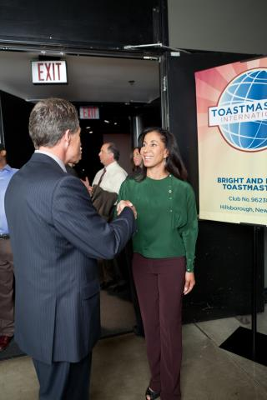
After Club Meetings
Meet with guests to answer questions.
Invite guests to join the club.
Help guests complete the membership application.
VPM

Slide 38
Outside the Club Meeting
Follow up on and keep track of guests.
Conduct membership-building programs.
Promote membership goals.
Promote membership-building contests.
VPM

Slide 39
Outside the Club Meeting
Bring membership applications.
Assist the vice president public relations.
Ensure meeting information is correct.
Attend club executive committee meetings.
VPM

Slide 40
Outside the Club Meeting
Attend and vote at area council meetings.
Arrange for your replacement or assistance.
Prepare your successor for office.
VPM

Slide 41
The Executive Committee
Organize and conduct membership contests.
Report on club membership.
VPM

Slide 42
Getting Started
Attend district-sponsored club-officer training program.
Read materials.
Meet with outgoing executive committee.
Meet with outgoing vice president membership.
Meet with current executive committee.
VPM

Slide 43
Getting Started
Invite one to three members to serve on membership committee.
Conduct a member survey on Moments of Truth session.
Create/Revise Guest Welcome kits.
Order any required materials.
VPM

Slide 44
Vice President Public Relations (VPPR)
Club Officer Training

Slide 45

VPPR Role

Slide 46
VPPR Responsibilities
The Club Meeting
Outside the Club Meeting
The Executive Committee

Slide 47
The Club Meeting
Before Club Meetings
Upon Arrival at
Club Meetings
During Club Meetings
VPPR

Slide 48
Before Club Meetings
Verify that information on website and social media is correct.
Order promotional materials.
VPPR

Slide 49

During Club Meetings
Distribute promotional materials.
Report results of public relations efforts.
Announce public relations campaigns.
Solicit volunteers.
VPPR

Slide 50
Outside the Club Meeting
Publicize the Toastmasters brand.
Promote the club.
Maintain the club website.
Join a Toastmasters-moderated social networking website.
VPPR

Slide 51
Outside the Club Meeting
Produce and distribute a club newsletter.
Promote membership programs.
Attend club executive committee meetings.
Attend other Toastmasters events.
VPPR

Slide 52
Outside the Club Meeting
Arrange your replacement or assistance.
Prepare your successor for office.
VPPR

Slide 53
The Executive Committee
Provide a public relations report.
Propose new promotion ideas.
VPPR

Slide 54
Getting Started
Attend district-sponsored club-officer training program.
Read materials.
Meet with outgoing executive committee.
Meet with outgoing VPPR.
Meet with current executive committee.
Public relations committee: 1-3 members.
VPPR

Slide 55
Getting Started
Review and order public relations materials.
Solicit articles for website.
Develop media list.
VPPR

Slide 56
Secretary
Club Officer Training

Slide 57
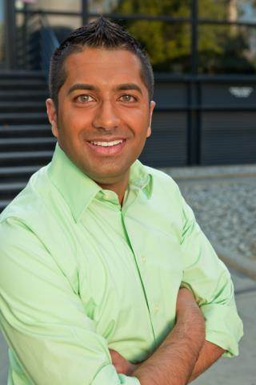
Secretary Role

Slide 58
Secretary Responsibilities
The Club Meeting
Outside the Club Meeting
The Executive Committee

Slide 59
The Club Meeting
Before Club Meetings
Upon Arrival at
Club Meetings
During Club Meetings
Secretary

Slide 60
Before Club Meetings
Post the previous minutes.
Prepare a list of actions for the president.
Update the club’s officer list.
Secretary

Slide 61
Upon Arrival at Club Meetings
Circulate attendance sheet and guest book.
Secretary

Slide 62
During Club Meetings
Read previous minutes, note amendments, record current meeting minutes.
Secretary

Slide 63
Outside the Club Meeting
Maintain accurate roster.
Submit club officer list.
Handle correspondence.
Keep club files.
Attend club executive committee meetings.
Secretary

Slide 64
Outside the Club Meeting
Vote at international business meetings.
Facilitate member progress in Base Camp.
Arrange for your replacement or assistance.
Prepare your successor for office.
Secretary

Slide 65
The Executive Committee
Read the previous meeting minutes.
Note amendments.
Record current meeting minutes.
Secretary

Slide 66
Treasurer
Club Officer Training

Slide 67
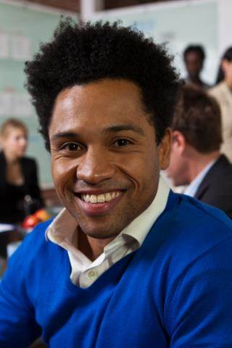
Treasurer Role

Slide 68
Treasurer Responsibilities
The Club Meeting
Outside the Club Meeting
The Executive Committee

Slide 69
The Club Meeting
Before Club Meetings
During Club Meetings
Treasurer

Slide 70
Before Club Meetings
Prepare a financial report.
Treasurer

Slide 71
During Club Meetings
Collect membership dues.
Report on club finances.
Treasurer

Slide 72
Outside the Club Meeting
Prepare a budget.
Provide bank with a bank signatory card.
Collect and pay dues.
Submit new member applications.
Issue checks for club expenses.
Keep financial records.
Treasurer

Slide 73
Outside the Club Meeting
Present financial reports.
Submit club accounts for audit.
Attend executive committee meetings.
Reconcile deposits, expenditures and cash on hand.
Treasurer

Slide 74
Outside the Club Meeting
Ensure club meets government tax regulations.
Receive financial correspondence.
Prepare for audit committee.
Treasurer

Slide 75
The Executive Committee
Prepare a budget.
Present financial reports.
Submit club accounts for audit.
Work with executive committee on Club Success Plan.
Treasurer

Slide 76
Getting Started
Attend district-sponsored club-officer training program.
Read materials.
Meet with outgoing executive committee.
Meet with outgoing treasurer.
Meet with current executive committee.
Review Policies and Protocol.
Prepare a budget.
Treasurer

Slide 77
Getting Started
Review records, financial reports and audit committee’s report.
Provide bank with a signatory card.
Create a record-keeping system, if needed.
Treasurer

Slide 78
Sergeant at Arms (SAA)
Club Officer Training

Slide 79
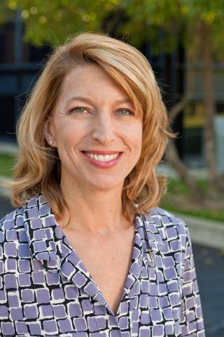
SAA Role

Slide 80
SAA Responsibilities
The Club Meeting
Outside the Club Meeting
The Executive Committee

Slide 81
The Club Meeting
Before Club Meetings
Upon Arrival at
Club Meetings
During Club Meetings
SAA

Slide 82
Before Club Meetings
Confirm room reservation.
Ensure there are club supplies.
SAA

Slide 83
Upon Arrival at Club Meetings
Arrange meeting room early.
Arrange tables and chairs.
Set out meeting materials and promotional materials.
SAA

Slide 84
Upon Arrival at Club Meetings
Check room temperature.
Ask guests to sign the Guest Book.
SAA

Slide 85
During Club Meetings
Welcome late arrivals.
Coordinate food service, if any.
Collect ballots and tally votes when necessary.
SAA

Slide 86
After Club Meetings
Return room to original configuration.
Pack up and store materials.
Dispose of trash.
SAA

Slide 87
Outside the Club Meeting
Schedule meeting location.
Ensure adequate supplies are available.
Attend executive committee meetings.
SAA

Slide 88
Outside the Club Meeting
Arrange your replacement or assistance.
Prepare your successor for office.
SAA

Slide 89
The Executive Committee
Update the executive committee on the club meeting space status.
Work to coordinate meeting space.
Chair social and reception committee.
Replace items as needed.
SAA

Slide 90
Getting Started
Attend district-sponsored club-officer training program.
Read materials.
Meet with outgoing executive committee.
Meet with outgoing SAA.
Meet with current executive committee.
Introduce yourself to meeting space contacts.
Ask for volunteers to assist you.
SAA

Slide 91
This concludes the session.
Club Officer Training

Slide 92


Slide 93
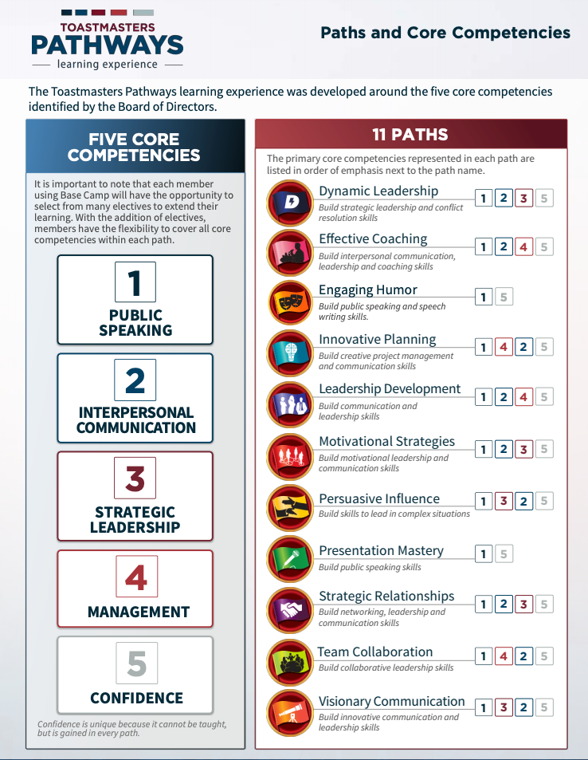

Slide 94
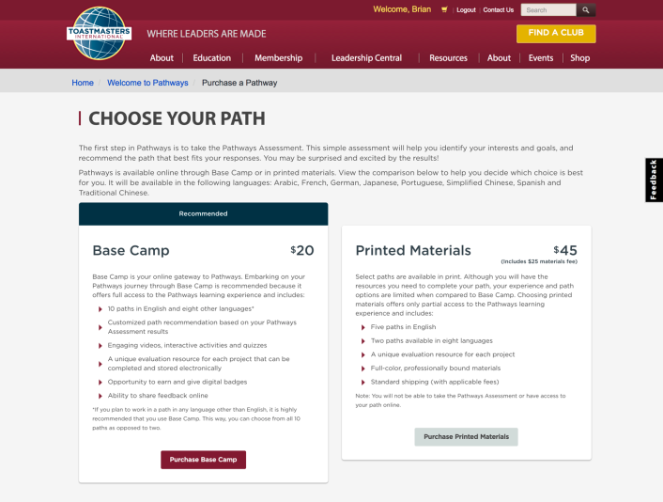
Online or Print

Slide 95
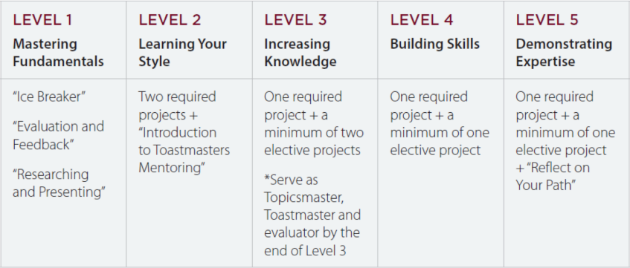
Levels and Project Types

Slide 96
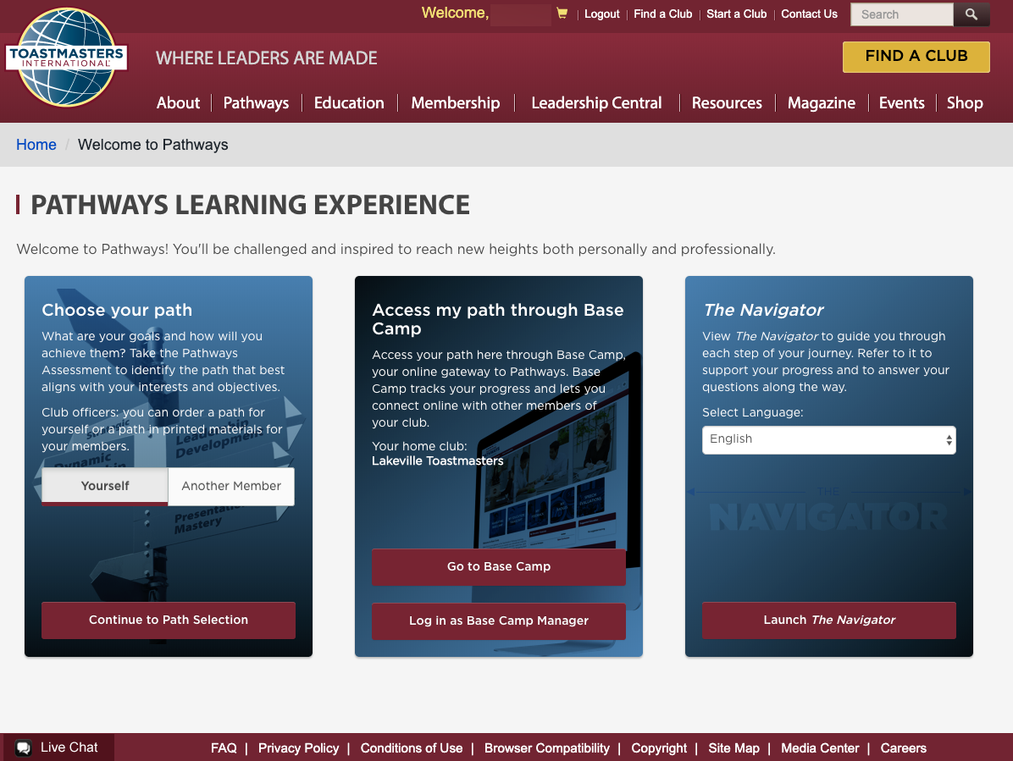

Slide 97
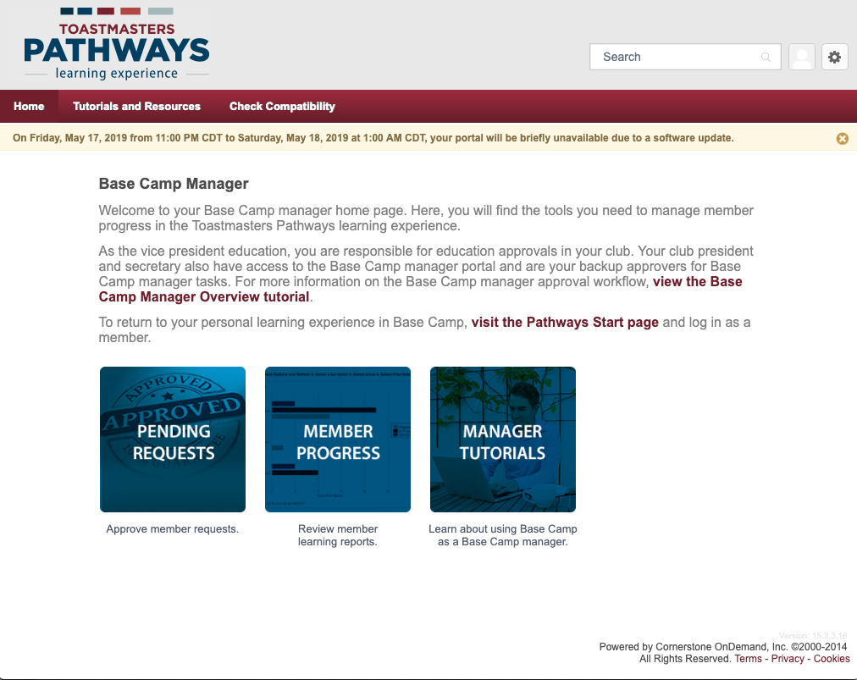

Slide 98
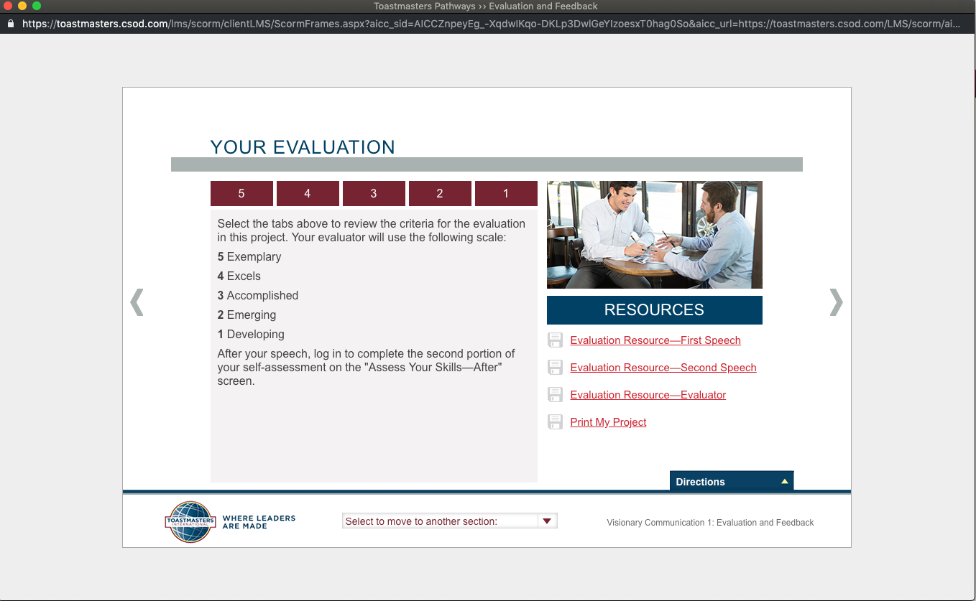

Slide 99
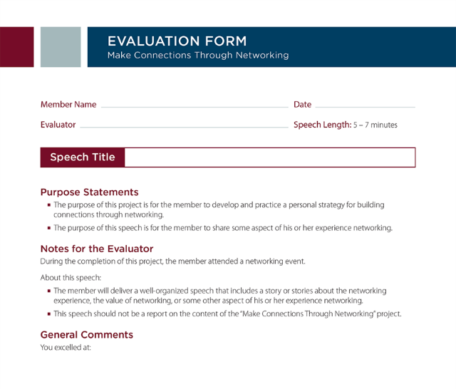
Evaluations

Slide 100
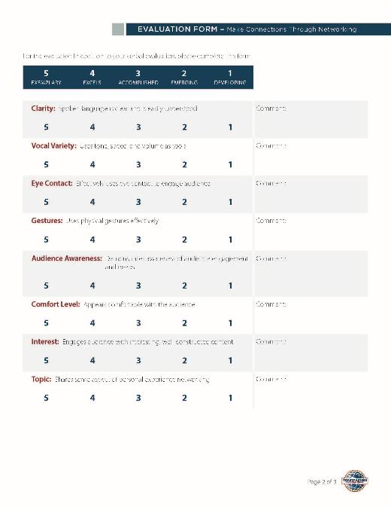


Slide 101
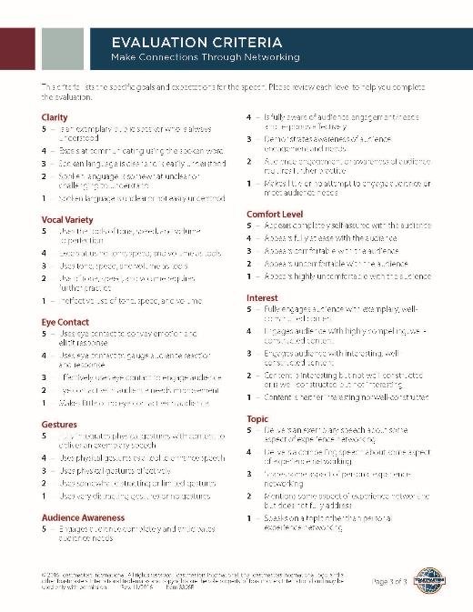
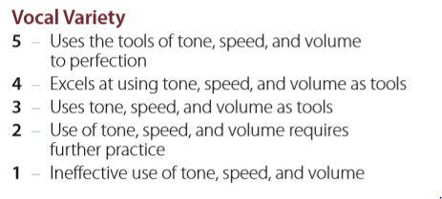

Slide 102
Resources
D6TM: http://www.d6tm.org/pathways/
https://www.toastmasters.org/the-navigator
D6TM Pathways Chair: Rahul Kashyap
Navigating base camp button
Getting started: link
Pathways Overview (handouts: Getting started, Quick Start, Base Camp Manager quick start)

Slide 103
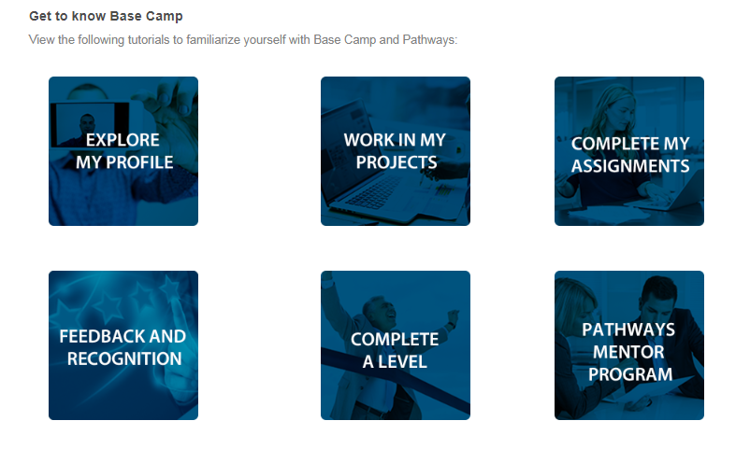
Help with Navigation

