Slide 1
Area Director Training
Part I

Slide 2
Area Director Training
Saturday October 15th, 2016
Theo Black, DTM, International Director 2009 – 2011
District Governor 2005 – 2006
Anne Groetsch, DTM, Prairie Division Governor 2005 – 2006
Notes:
Anne

Slide 3
Agenda
8:15 Delinquent Dues Collection Theo
8:25 Area Council Meetings Anne
8:40 Club Visits and reports Anne
8:55 Break
9:05 Proxies Theo
9:10 Predictions for Distinguished Clubs/Areas Theo
9:25 Plans for Distinguished Clubs Anne
9:35 Assertive Communication Techniques Theo
9:50 Q& A/Wrap Up

Slide 4
Delinquent Dues Collection
Theo Black, DTM, PID

Slide 5
Dues Review
Dues collected for 6 months in advance
Due dates: Fall - 9/30, Spring 3/31
Eight membership payments are required for a club to remain in good standing
New rules
  No grace period
  Once 9/30 passes, members are removed from club membership list

Slide 6
Dues Collection
Club officers begin collecting dues in August or early September
Area Directors work with clubs to ensure dues are paid on-time
On October 1, Division Directors begin helping Area Directors collect dues.
  Create action items and due dates
  Identify key club officers for making contact
On October 15, District Trio beings helping

Slide 7
Area Council Meetings
Anne Groetsch, DTM

Slide 8

Area Council Meetings
Let’s talk!

Slide 9
Area Council Meetings
Why are Area Council Meetings important?
Purpose of Area Council Meetings
  For Relationship Building
  Networking with other club officers
  Credibility for you as an AD
  Sharing Best Practices and Challenges

Slide 10
Area Council Meetings
Walk thru Sample Agenda

Slide 11
Area Council Meetings
How many of you have held an Area Council meeting already?
If you did, how did that go?
  What did you discuss
  What was the format?
  Where did you hold it?

Slide 12
Area Council Meetings Best Practice
Meeting Quarterly is the recommendation
Have a location and time set-include food
Communicate ahead-recommend 3-4 weeks out
Include Pres/VP of Ed/Membership-any other officer with interest
So—when is your next meeting? Get it on the D6 calendar

Slide 13
Club Visits and Reports
Anne Groetsch, DTM

Slide 14
Club Visits and Reports
Let’s talk!

Slide 15
Club Visits and Reports
Club Success Plans
  Failing to Plan is Planning to Fail
Where are you in completing visits?
  Club Base Profiles
Communication Strategies
  What is working?
Filing the Area Director Visit Report
  Keep it Sweet and Simple (KISS)

Slide 16


Break time
10 minutes

Slide 17
Proxies
Theo Black, DTM, PID

Slide 18
Understanding Proxies
At district council business meeting, each club President and VPE in attendance is entitled to one vote.
If either or both officers cannot attend, they may designate, in writing, any other active club member to act as a proxy.
At the district council business meeting, the proxy holder may carry one or both club votes (maximum of two votes with exception of DEC)
No other proxies are valid

Slide 19
Proxy Form
In the event one of the two top officers is not in attendance at the meeting and has not designated, in writing, an active individual member of the club to act as his or her proxy at such meeting,
  the officer or proxyholder in attendance shall be deemed to hold the proxy of the other and may therefore cast two votes at such meeting.

Slide 20
Proxy Form
Each member of the district council in attendance at a council meeting, or his or her proxy as authorized by subparagraph (d) hereof, is entitled to one vote. Any active individual member who carries the proxies of both the club president and vice president education from a member club is entitled to two votes; and any such individual member who is also entitled to a vote as a member of the district executive committee is entitled to three votes. All other members of the district council shall be limited to a maximum of two votes.

Slide 21

Proxy Form

Slide 22
Predictions for Distinguished Clubs/Areas
Theo Black, DTM, PID

Slide 23
DAP Qualifying Requirements
Distinguished Area Program
  No net club loss
  Submit the Area Director’s Club Visit Report for at least 75% of club base
    First round visits by November 30th
    Second round visits by May 31st
12

Slide 24
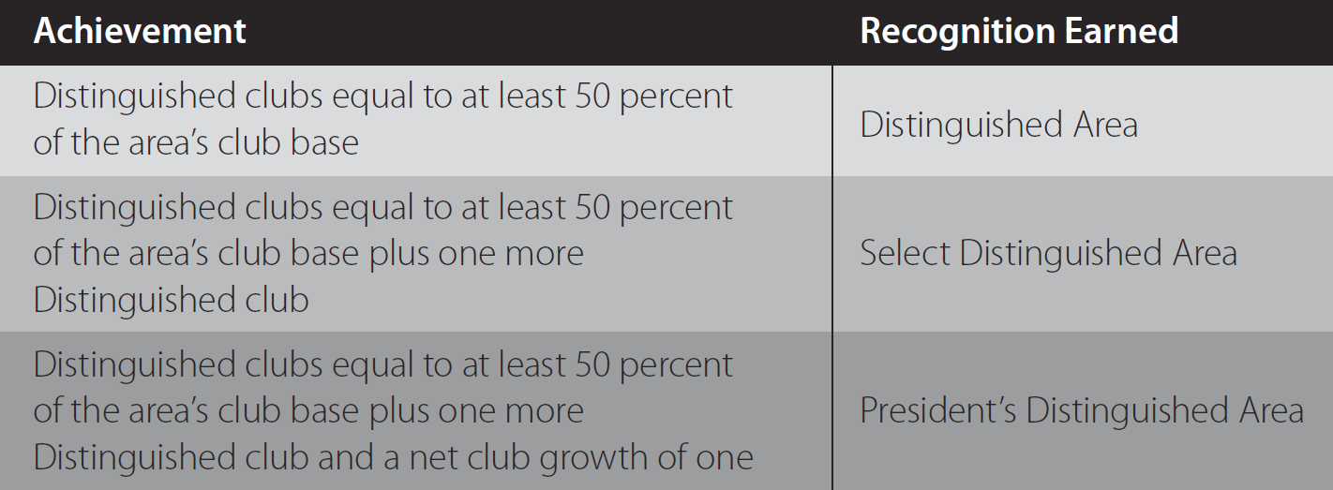
Distinguished Area Program
Distinguished, Select Distinguished, President’s Distinguished
16

Slide 25
Example Dashboard
Goal | Club 1 | Club 2 | Club 3 | Club 4 | Club 5 | Club 6
2 CCs | 1 |  |  |  |  | 1
2 CCs | 0.5
1 AC | 1 | 1
1 AC |  | 1
1 Ldr |  |  | 1 |  | 1
1 Ldr
4 Mbrs | 1 |  | 1 | 0.5 | 1
4 Mbrs |  |  | 0.75
2 x Ofc Training | 0.5 | 0.5 | 0.5 | 0.5 | 0.5
Dues/Ofc List | 1 | 1 | 1 |  | 1 | 1
Total | 4 | 3 | 3 | 0 | 3 | 2
Base | 24 | 20 | 13 | 8 | 17 | 16
Goal | 20 Min | 20 Min | 18 | 13 | 20 Min | 20 Min
Current | 17 | 19 | 14 | 10 | 18 | 16

Slide 26
Plans for Distinguished Clubs
Anne Groetsch, DTM

Slide 27
Plans for Distinguished Clubs
Do your clubs have a DCP/CSP?
  Failing to Plan is Planning to Fail
Use D6 metrics
  Dashboards for club DCPs on TI site
Are they working their plan?
  What is working? Not working?
Share success and challenges with the group

Slide 28
Plans for Distinguished Area
Do your clubs have a DCP/CSP?
  Failing to Plan is Planning to Fail
Use D6 metrics
  Dashboards for club DCPs on TI site
Are they working their plan?
  What is working? Not working?
Share success and challenges with the group

Slide 29
Assertive Communication Techniques
Theo Black, DTM, PID

Slide 30
Assertive Behaviors
Communicating Assertively means being:
  Direct, Open, and Honest
An assertive person is one who loves and respect herself/himself and recognizes the unique value and work of other people!
Behaving assertively means living by the Golden Rule
  Treat others the way you want to be treated.

Slide 31
Assertive Responses to Criticism
Valid
Accept the Criticism
Make a positive statement to self and/or the one criticizing
Try to put the criticism in proper perspective with self talk
Not Valid
Use an assertive response.
Make a positive statement to self and/or the one criticizing
Put the criticism in proper perspective

Slide 32
Common Causes
Non Assertiveness
Fear
False Beliefs
Insecurity (Self Doubt)
Rejection/Retaliation
Hurt Feelings
Rescuers
Rights
Hidden Benefits
Lack of Skills/Information
Aggression
Vulnerable/Unsafe
Need to Win
Insecurity (Powerlessness)
Rubber Band Effect
Underlying Unassertiveness
Rights
Hidden Benefits
Lack of Skills/Information

Slide 33
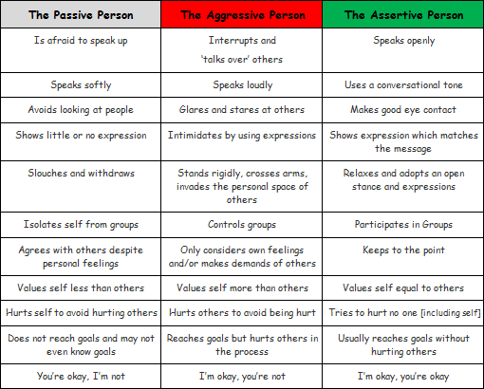
Passive, Aggression, Assertive

Slide 34
Assertive Exercises
Call and invite Club Officers to be:
  Contest Chair, Toastmaster, Chief Judge
Call and let Club Officers know that you expect them to send:
  2 contestants to the area contest
  3 judges/helpers to the are contest
Discuss with a ‘troubled club’ president (directly, openly, honestly) how the club is doing and how it can be helped

Slide 35
Review
Delinquent Dues
Area Council Meetings
Club Visits and Reports
Proxies
Predictions for Distinguished Clubs/Areas
Plans for Distinguished Clubs
Assertive Communication Techniques

Slide 36

What Questions Do You Have?

Slide 37
Train The Trainer
Part II

Slide 38
Train-the-Trainer
Saturday October 15th, 2016
Theo Black, DTM, International Director 2009 – 2011
District Governor 2005-2006
Anne Groetsch, Prairie Division Governor 2005 – 2006
Notes:
Anne

Slide 39
Agenda
1:00 AD Club Officer Training Outline Anne/Theo
1:20 Q & A on outline Anne/Theo
1:25 Break
1:30 Facilitator/Trainer Techniques Anne/Theo
2:10 Role Play Facilitator Techniques
Small groups (15 minutes)
2:25 Q & A/Wrap Up Anne/Theo

Slide 40
Area Director
Club Officer Training Outline

Slide 41
Club Officer Training Outline
DCP/CSP 15 Minutes
MOT and Mentoring 15 Minutes
Membership Building 45 Minutes
  Ideas/Resources (Handout)
  Successes/Challenge (Breakout)
Important Information 15 Minutes
  Proxies
  Key Dates
  Q & A

Slide 42
What Questions Do You Have?
Club Officer Training Outline

Slide 43
Break time
5 minutes

Slide 44
Facilitator/Trainer Techniques for Engagement

Slide 45
Engagement/Trainer Techniques Review
  Not owning the discussion
    Facilitator not offering too many ideas
  Self-discovery thru asking open-ended questions
  Getting everyone to participate
    Managing non-talkers
    Managing those who dominate
  Techniques for eliciting response
  PPT Techniques (blanking screen, not reading slides, having a monitor, screen positioning
  Setting expectations-A (time limits, # of responses, time provided to respond)
Notes:
Review the objectives with the participants.
Transition into the next topic.

Slide 46


Questions Strategies Objectives
  After the completion of this module, you will:
  Learn techniques for fielding questions from the group effectively
  Utilize techniques for dealing with tough Q & A sessions
  Review the five types of questions
  Recognize how you as the trainer / facilitator can ask questions to encourage learning and participation
Notes:
Review the objectives with the participants.
Transition into the next topic.

Slide 47
Purpose of Questions
Create
Understand
Remember
Evaluate
Analyze
Apply

Slide 48

Techniques for Fielding Questions
Keep training modules short
Handle questions during or after
Q&A is for general questions. Individual issues may have to be taken off line.
Take questions from all parts of the group
Actively listen to the question to make sure you understand the question before you begin your answer
Avoid singling out one question as a “good question”
Notes:
Formal Question & Answer Techniques
Talking Points:
Whenever possible, keep your training module short so that you can answer questions at the end. – Your training point is strongest when told without interruption. If you can, have the audience hold their questions until the end or at designated times, or after the completion of main points.
Tell the participants at the beginning of the training session how you will handle questions. – The audience can best follow the rules if told specifically what they are.
Remind the participants that the question and answer session is for general questions. Encourage participants to come and talk to you after the session about concerns outside of the scope of the class.
Take questions from all parts of the audience. – Begin in the back of the room, to welcome participation from those who were less immediate (close) to you. Everyone should have an equal opportunity to ask a question.
Really listen to the question. – Listen naively, as if you don’t know the question being asked. Listen to the whole question and try to identify the true meaning.
Make sure you understand the question before you begin your answer! – Ask for clarification when necessary. “Are you asking me… If I hear you correctly you want to know about…”
Avoid singling out one question as a “good question.” ASK:
What is the down side of saying “good question?”
EXPECTED RESPONSES:
It makes other questions seem inferior.
It makes the question and answer session more competitive.
It is really just buying you thinking time.

Slide 49

Techniques for Answering Questions
Restate all questions- work it into the answer
Paraphrase any hostile or vague questions
Maintain eye contact first with the person who asked the question and then address the answer to the entire group.
Answer the question, directly and succinctly
Only on complicated questions, you may consider “Have I answered your question?”
If you don’t know the answer, say so. Then get it, fast!
Notes:
Techniques for Answering Questions
Restate all questions – Don’t repeat the question, especially if it’s phrased negatively. Feel free to put the question in your words and make it easier to answer positively.
Paraphrase any hostile questions. This will let you set the tone of the question and control the emphasis of your answer. – Take the hostility out of the question so that you can answer in a non-defensive way.
Make eye contact first with the person who asked the question and then address the answer to the entire audience. – Make questions general enough to apply to anyone, then address the answer to everyone. If you look only at the person who asked the question, the rest of the audience will tune out.
Be sure to directly answer the question. Always include a one sentence direct response, even if you elaborate, expand, or qualify your answer. – The audience should always be clear what your answer is. You must always answer the question directly, even if you go on to cushion the answer or if the answer is no.
Don’t go on and on and on and on and on... Learn to answer the question and stop. – The longer you continue, the greater chance you have of making a mistake or put your foot in your mouth.
Also, the strength of your message is diluted over time and with too many words.
Don’t ask the questioner “Have I answered your question?” – If you use the correct techniques including directly answering each question, you can be certain you answered the question. By asking, “Have I answered your question?” you are showing doubt about your abilities as well as inviting the questioner to ask another question. You want to avoid taking two questions in a row from the same questioner.
If you don’t know the answer, say so. Then get it, fast! – It’s okay to occasionally not know something. Tell the audience you don’t know—you can be straightforward or finesse it, then get the answer. Follow through is essential. Always follow-up!
Try to end the question and answer period with a positive question

Slide 50

What to do when…
No one asks you a question
Someone asks about information you’ve covered in detail
Someone repeats a question
Someone asks an irrelevant question
You run out of time
Someone is rude or disruptive
What other tough question and answer situations
have you encountered?
Notes:
SAY:
Use progressive disclosure to focus the audience’s attention on the specific bullet you are discussing.
Talking Points:
No one asks you a question –Ask yourself a question, offer to review or explain something other audiences found difficult or interesting, give them more time.
Someone asks about information you’ve already discussed in detail –Talk about it again. The questions people ask are telling. It means either they are interested in the topic or it is difficult to understand.
Someone repeats a question you’ve already answered – Answer it again. This time, give the abridged answer to protect those who are listening and understand.
Someone asks an irrelevant question – Questions that are truly irrelevant do not need to be answered. Determine how quick an answer you can provide, your comfort answering the question and either answer it or state that it is off the subject. If you want, you can offer to make yourself available following the training to answer the question individually.
You run out of time before you run out of questions – Stop, unless specifically told to continue. Never take more than the time you were allotted. Offer to make yourself available at the back of the room, out front, or by telephone to answer all remaining questions.
Someone is rude or disruptive? Use Proximity…
ASK:
What other tough question and answer situations have you encountered?
If you don’t know what to recommend to a participant’s tough question and answer situation, try opening it up to the group.
Often, the group will have the best suggestion.
Also remember, that there is generally not only one right way to handle these situations.
They will depend upon the trainer and what he/she is comfortable with. However, if you feel an idea may backfire, be sure and discuss that.

Slide 51

Dealing with Non or Incorrect Responses
Keep everyone’s self-esteem and self-confidence intact
Tell a story to relate to the correct answer
Ask in a different way, trigger the prior learning objective
Do not say, “No, you are wrong.”
Acknowledge at least one thing they said that was right, and go right into the correct response
Ask another question to guide them to the proper answer
Notes:
Our united culture- assume positive intent
No responses or incorrect responses are telling. How we respond is important to maintaining our credibility. Others are watching. It could be that we, as the trainer, didn’t deliver the point clearly. It could be that the participants truly didn’t understand.
What have some of you done?

Slide 52

Questions
“The truly humble ask questions that lead to learning and understanding. The prideful
ask questions that are designed to defend
their own position."
Brant Gardner

Slide 53
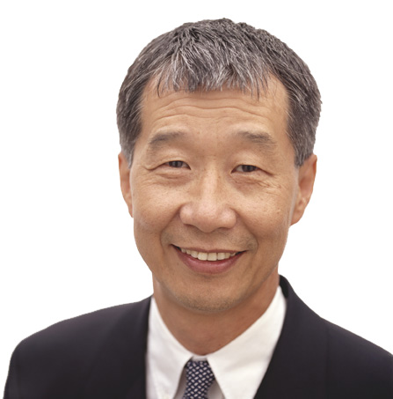
Ask Questions to Encourage Learning
What makes a good question?
  Clear, concise.. to the point
  Single issue
  Ask one at a time
  Challenging
  Provoking
  Relate to discussion at hand
  Has the effect that you intended
Notes:
Rhetorical Question:
What questions do you have about Questions that lead to learning?

Slide 54

“The process of asking questions makes a change in the individual (or system).” or
“Asking about something is changing it!!”
- Unknown
Asking Questions

Slide 55
Types of Questions
Exploring Questions (Gather more information)
  Tell me more about what you mean, when you said…
Confirming Questions (Check for understanding)
  What I hear you say is (paraphrase), is that right?
Clarifying Questions (Who, what, where, when, which, how)
  What are the potential causes?
Redirecting Questions (Acknowledge and redirect)
  Those were some good tips on club visits, now where were we? the DCP?
Decision Questions (Yes/No)
  Are there any other important aspects of club visits?
Getting Agreement Questions (Negative poll)
  Is anyone not in agreement with the Club Officer Training Agenda?
Notes:
SAY:
Let’s discuss the purpose of each type.
Exploring Questions – allows the participant to share information in his/her own style.
Confirming Questions – checks for understanding. These questions begin by summarizing (paraphrasing) what you have heard and asking if that is correct. The participant’s response is either yes or no. If no, we have an opportunity to ask for further explanation.
Give an example and ask, “does anyone have an example? What do you need to know to best serve the participant? How can you ask in a way that the participant feels acknowledged?”
Clarifying Questions – helps you to fill in gaps in the participant’s information to enable you to provide the answer. The participant’s response may be more data or details. Typically begin with Who, What, When, Where, Which and How?
Ask the group for examples. Redirecting Questions – this type of question is useful in those situations where the participant has strayed from the current topic or is giving you more information then is needed. To redirect you first acknowledge where the participant has strayed to by quickly expressing interest or awareness of the new topic followed by a question about the current issue that uses the words “specifically” or “exactly.”
Ask the group for examples.
Decision questions – Yes/No or multiple choice questions.
Example: Are we ready for open enrollment?
SAY:
There is a reason “Why?” is not included on the list. Why can be seen as accusing and often puts the participant on the defensive, raising tension.

Slide 56
Activity – Listening and Questioning
Objective
Practice listening and questioning
At your Division/Area tables:
Identify an observer / evaluator
One person starts a story about their last vacation.
The group will practice asking questions about the vacation using each category.
The evaluator will provide observations during the debrief
Exploring
Confirming
Redirecting
Clarifying
Decision
Agreement
Instructions
Delivery: 10 minutes
Debrief: 5 minutes
Time
Notes:
Option: Ask the “questioner” what type of question was asked.
Option: Have one person tell the story and then call on people to ask a question or have different people take turns telling stories - LISTEN TO THE VOICE OF THE GROUP
Option: Assign 6 people in the group to ask a certain category of question. Have an observer taking notes on the reaction of the story teller to the question and the reaction or response of the questioner.
Tip: Send a messenger to the other team to let them know your group is done.
FEEDBACK from the Observer:
Person asking- type of question-body language/voice of the story teller and the questioner
Exploring
Confirming
Redirecting
Clarifying
Decision
Agreement

Slide 57

Questions to Encourage Learning
  correct response
  review information
  hypothetical comment
  for opinions or information
Before Training
  Keep questions short. Decide to use either open-or close-ended
  Determine the purpose of the question
    checking comprehension
    test assumption
    create discussion
    introduce controversy
  Decide on the type of question that will best get your purpose across
    Exploring
    Confirming
    Redirecting
    Clarifying
    Decision
    Agreement

Slide 58

Questions to Encourage Learning/Participation
Participation
During Training and Facilitation:
  Increase participation by including them early in the session.
  Determine the purpose and type of the question
  Pause for answers
  Use follow-up questions to further clarify or expand the initial response
  Paraphrase responses, especially when the response was not focused
  Use a round robin if you wish to hear from everyone.
Notes:
Powerful questions are provocative queries that put a halt to evasion and confusion. By asking a powerful question, you invite clarity,
action, and discovery at a whole new level. Open-ended questions create greater possibility for expanded learning and fresh perspective.
Laura Whitworth, Coaching

Slide 59

Intelligence
“Intelligence shows itself not so much
in always having the right answers
but in being able to ask the right questions.”
- Dave Meier
Founder of the Center for Accelerated Learning

Slide 60

Summary
Named formal question and answer techniques
Named the types of questions as examples to remember
Identified the techniques to use when dealing with tough questions
Identified the ways to prepare questions prior to training
Identified techniques for designing purposeful questions
Identified the ways to create powerful questions
Notes:
SAY:
We have covered several ideas in this section Before we break let’s review the main ideas and spend a few minutes exploring ways to utilize the information with participants when it’s our turn to train.
Ask the group to review the key ideas presented during session.
Give the group 5 minutes to fill out their personal action planning worksheets on page 43.
Ask for examples of how they plan to incorporate the learning’s into daily performance.

Slide 61
What Questions Do You Have?

