Slide 1
Area Director Transition
Area Director Co-Trainers
Theo Black, DTM, Past International Director
Anne Groetsch, DTM, Past Division Director

Slide 2
Agenda
Area Director Handoff
Area Director Role
Club Officer Lists
Club Profiling
September Dues
Breakout Exercise
Goal Setting
Identifying Potential Area Governors

Slide 3
Area Director Handoff
Notes:
Area Director Handoff

Slide 4
Area Goals
 | Distinguished Area Recognition
Qualifying Requirements | No net club loss
 | Submission of Area Director's Club Visit Report (Item 1471) for 75% of club base: first-round visits by November 30, and second-round visits by May 31
Recognition Requirements
Distinguished | 50% of club base Distinguished
Select Distinguished | 50% of club base plus one Distinguished
Presidents Distinguished | 50% of club base plus one Distinguished and a net club growth of one

Slide 5
Overview of the Area Director Role
Toastmasters Ambassador
Club Mentor
Visit and support clubs
Ensure each club has a Club Success Plan
Help clubs focus on meeting quality
Communicate about upcoming events
Delegator
Appoint key roles for the Area Contest
Notes:
Theo (5 minutes) – Don’t speak for free. Bring manuals to club visits and have someone evaluate your presentation.

Slide 6
Club Officer Lists
Elections should have been held in May
If elections are upcoming, get the date
Officer lists are due by June 30
Work with outgoing Area Director to ensure all are submitted by June 15
This is an easy half point for clubs
Getting them to pay their dues on time in the fall achieves the other half point
Notes:
Anne (5 minutes)

Slide 7
Profile Area Clubs – Know the Past
Understand the club potential
Perform a SWOT analysis (Strengths, Weaknesses, Opportunities, Threats)
Identify key club leaders
Obtain a club membership base and list
Research the club DCP History
How often was the club Distinguished?
Review past Club Visit Reports
Notes:
Tag Team
SWOT - Provide examples of Area 55 (Tic Talkers, Pru Toasters, Sound Bytes, Words of Mouth, Remarkables, LDI Torchmasters)

Slide 8
Profile Area Clubs – Plan for Success
Ensure club information is correct
Verify that TI club listing is current
Determine if the club website is current
Assemble a Club Officer List for 2016-17
Verify that the club meeting frequency and location is current and correct
Plan club visits and start them in July
Offer to install Club Officers when you visit
Establish communications protocols
Notes:
Tag Team – Provide examples of LDI Torch Masters, et al

Slide 9
Plan for September Dues
Dues increase (Minimal impact)
Begin collecting dues September 1st
Have clubs submit at least 8 member dues by 9/15 (or earlier)

Slide 10
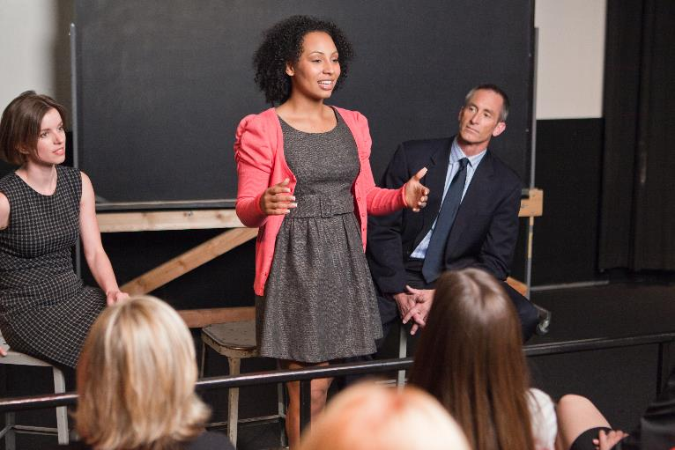
Strategic Planning
Notes:
Area Director Handoff

Slide 11
Strategic Planning
Begin with the End in Mind
All clubs are Distinguished Clubs
Plan for the upcoming year
Strategic plan that is prioritized
Build relationships
Create an area checklist
Document action items/dates/owners

Slide 12
Breakout Activity
Answer the following questions:
Why profile clubs?
What information is important for learning about your clubs?
What else could be added to the checklist?
Identify a recorder and a reporter
Prepare the reporter to debrief what was discussed

Slide 13
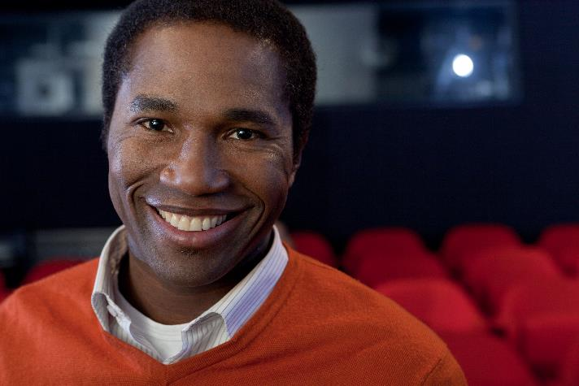
Identify Potential Area Governors
Current openings
Begin to look for your replacement (succession planning)

Slide 14
WHAT QUESTIONS DO YOU HAVE?

