Slide 1
Base Camp Manager Training
Jamie Ogborn, DTM

Slide 2
Who:
President
Responsible for all club officers and club business
Presides over meetings
Tasked with helping members get value out of toastmasters
In charge of finding resources for club needs.
VP of Education
Sets the agenda for meetings
In charge of mentorship program
In charge of getting new members started with educational program
Tasked with helping members move forward in the educational program
Secretary
Charged with club admin and records
Notes:
Toastmasters International provided several online tools to aid the Base Camp Manager. These include approving Levels that allows the Base Camp Manager to review progress prior to allowing access to the next level; the ability to review a member’s curriculum to identify recent activities; and using reports to determine who is on what path and level. These tools allow the Base Camp Manager to better manage and monitor member educational progress and plan for their progression.

Slide 3
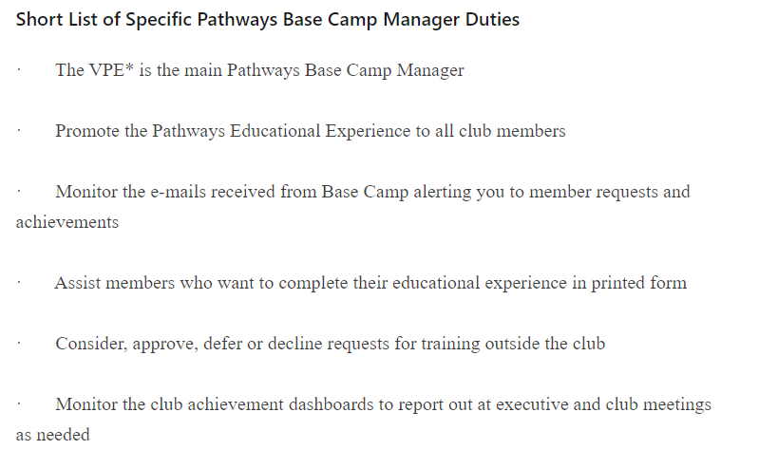

Slide 4
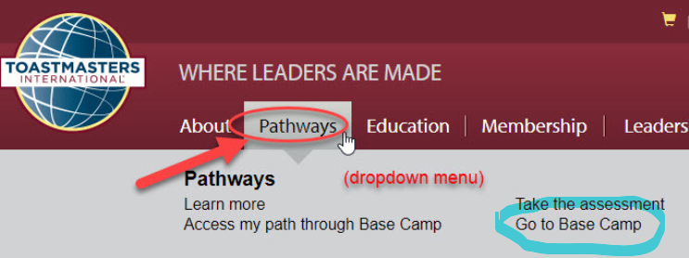
Logging in

Slide 5
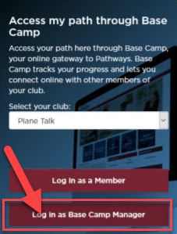

Slide 6
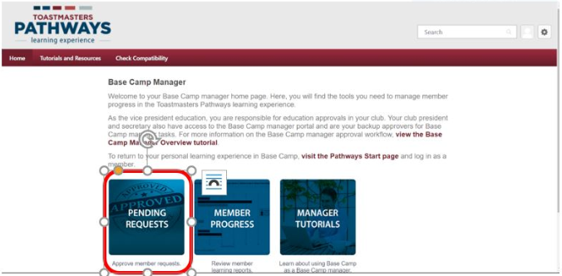
Approving a Pending Level Request
Notes:
In Base Camp, your main task will be to approve pending Level Completion requests. This can be accessed by selecting the “Pending Requests” panel on the Base Camp Manager page when you log in as a Base Camp Manager.

Slide 7
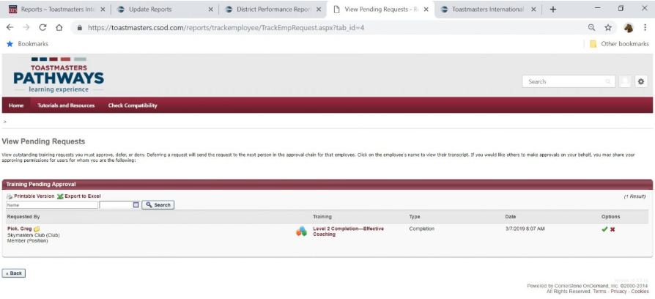
Notes:
The pending level request will look as follows when you open the panel and the request had not yet been approved. At this time, the Base Camp Manager will follow the protocols established by the club for verifying completion of the projects.

Slide 8
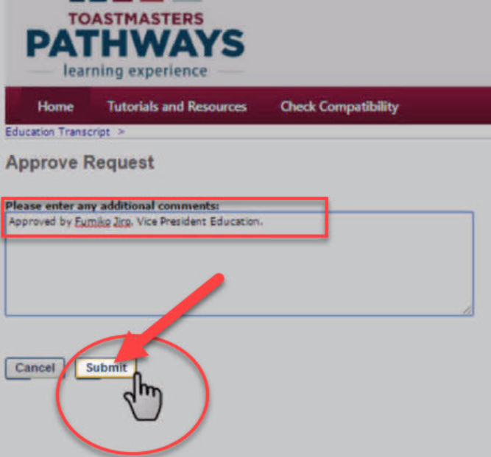
Notes:
You have the option to add additional comments, some people have left blank or added who approved it.
A recommendation that came forward is to have team members send an email with the speeches done and dates that the Base Camp Manager can past in there with the line that states that they were the one that approved it.

Slide 10
Where is the member on Their Path
Notes:
What is the progress of a member along their path? After your login as the Base Camp Manager, you can recall the members profile by beginning to type in the member’s name (as identified below). This selection can be accessed from any page you are on when you are logged in as a Base Camp Manager.

Slide 11
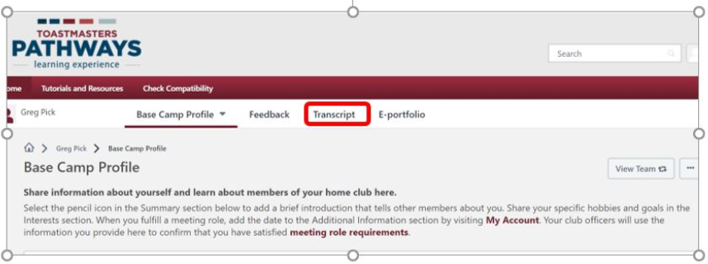
Notes:
Once their Base Camp Profile appears you can select their Transcript to determine their educational activities including gaining access to their path.

Slide 12
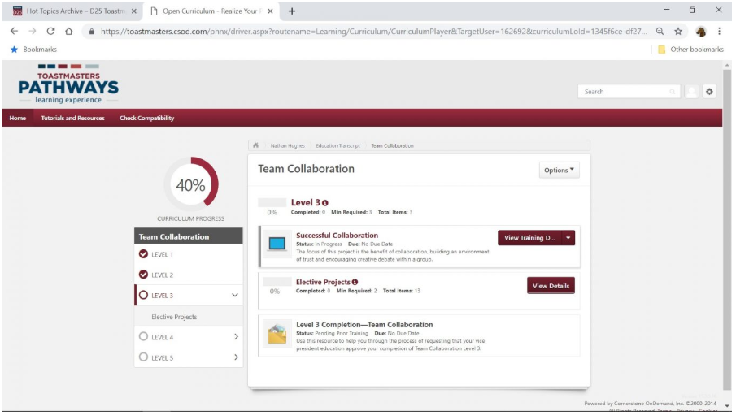
Notes:
After selecting their Transcript, you can select a Path to identify their progress along their Path including what projects have been completed within a level. On this page you can determine if a member has activated their Path or launched a project.
For this member, the Base Camp Manager can determine that the member has (1) completed Levels 1 and 2, (2) begun working the Level 3 Successful Collaboration project, and (3) has not selected any of the Elective Projects.

Slide 13
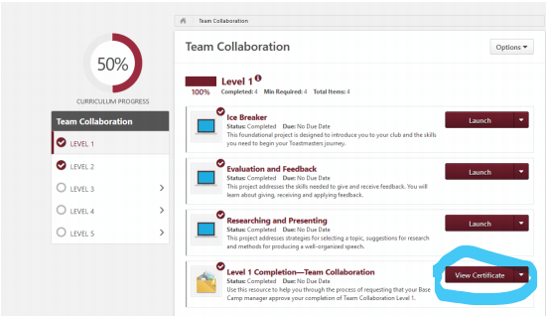
Notes:
You can also pull a certificate to present to members that have achieved levels in Pathways.

Slide 14
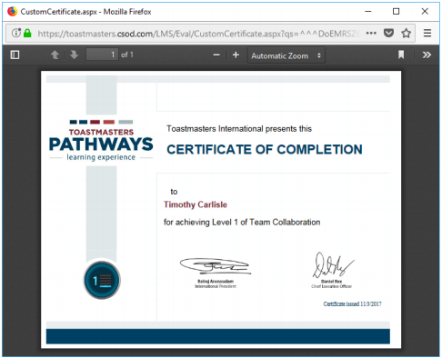

Slide 15
What Levels Have Been Completed by Members?
Notes:
Another task for a club involves determining who will achieve what Distinguished Club Program goals throughout the year. The Base Camp Manager can get a rough idea by using the Dashboard that provides several reports. The Base Camp Manager accesses the dashboard using the middle panel on the Base Camp manager page. The first two types of reports provide useful to determine member progress along a path (Individual Progress) and how many paths are being worked (Path Progress).

Slide 16
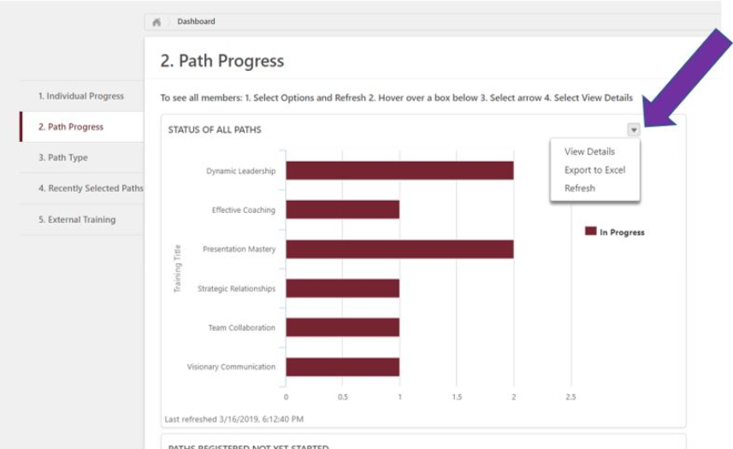
Notes:
When you are on either chart, you can gain detailed information by using the drop-down arrow and selecting the “Export to Excel” option. When you select this option, you get a detailed list of the members and their progress for the chart selected (e.g., Level 1 progress or Path Progress). The Path Progress Excel list for this club included:

Slide 17
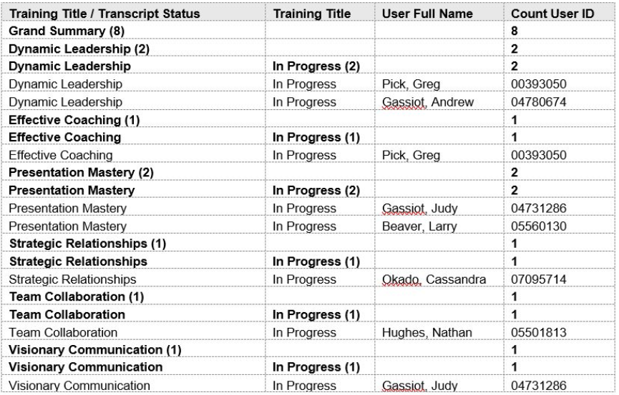

Slide 19
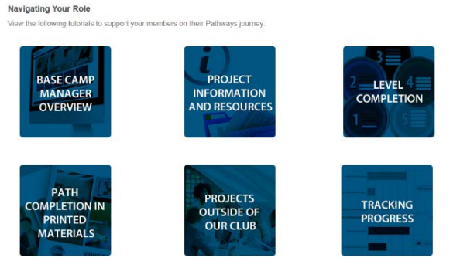

Slide 20
We’re done right??
This Photo by Unknown Author is licensed under CC BY-NC-ND

Slide 22
Club Central
There is a 2nd step, which is recognizing this achievement for the club in Club Central
Confirm with the member that they would like your club to receive credit for this award.
Go back to Toastmasters.org
Click on Leadership Central
Click on Club Central
Click on your club
Click on Submit Education Awards

Slide 24
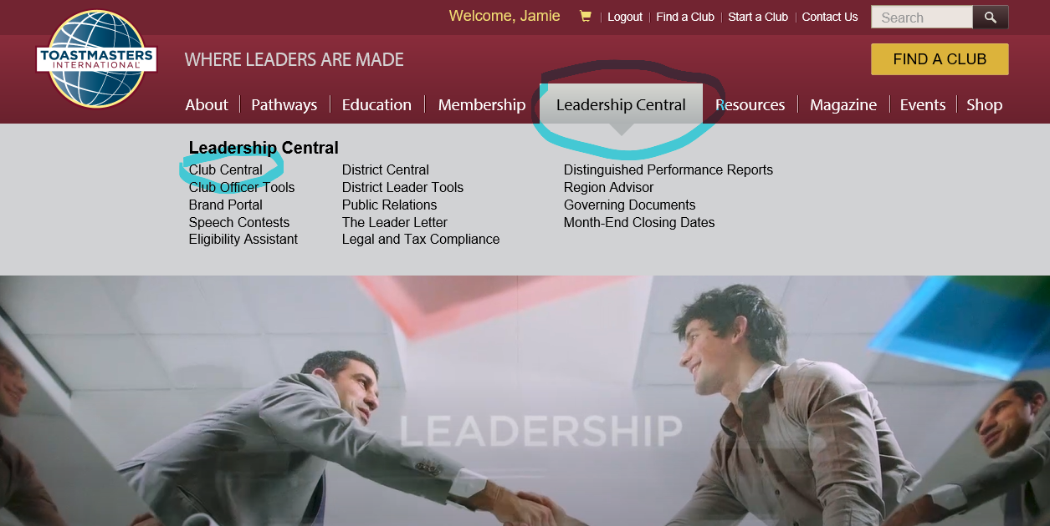

Slide 25
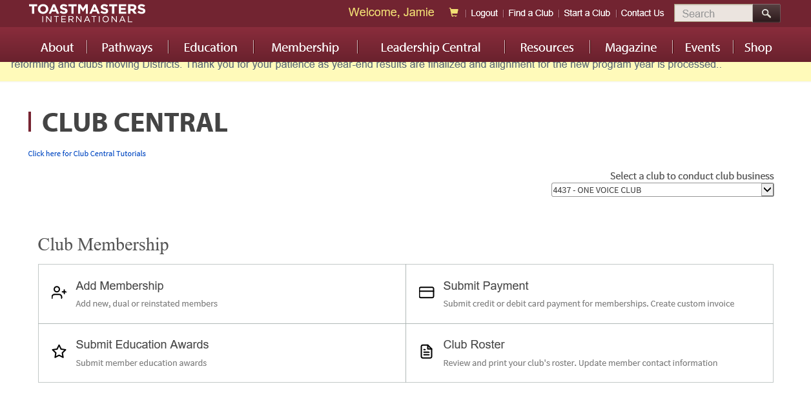
Notes:
Follow the prompts from here to select the member and award.

Slide 26
Now we are done

