Slide 1
Club Officer Training Train the Trainer
Area Director Co-Trainers
Theo Black, DTM, Past International Director
Anne Groetsch, DTM, Past Division Director

Slide 2
Agenda
Assemble a High Performance Training Team
Provide Required Training Content
Using Effective Facilitator and Trainer Techniques
Use Club Officer Training as an Opportunity to Explore Event Management
Communicate District Calendar of Events

Slide 3
Assemble a High Performance Training Team
Notes:
Area Director Handoff

Slide 4
Assemble a High Performance Training Team
Involve clubs in training sessions
Area/Division Directors are qualified to be trainers
Other trainers need to be appointed by the District Director or Club Quality Director
Other trainers need to have attended train the trainer session.
Use professional trainers in your area/division
Notes:
Theo (5 minutes)

Slide 5
Create a Comfortable Training Environment
Provide flip charts/ markers (if available)
Avoid interruptions
Break up content with breaks and other changes
Begin and end on time
Provide handouts and links to important information

Slide 6
Provide required training content
Notes:
Area Director Handoff

Slide 7
Provide Required Training Content
Help club officers understand
Mission, Vision, Values
Distinguished Club Goals
How to create a Club Success Plan
Why presenting Moments of Truth matters
How to use Pledge cards
What individual officer roles entail
How to collect and submit dues
The importance of holding club contests
Key Milestones and Dates
Notes:
Theo (5 minutes)

Slide 8
Toastmasters Club Mission
We provide a supportive and positive learning experience in which members are empowered to develop communication and leadership skills, resulting in greater self-confidence and personal growth.

Slide 9
Toastmasters Values
Integrity
Respect
Service
Excellence
Toastmasters Envisioned Future
To be the first-choice provider of dynamic, high-value, experiential communication and leadership skills development.

Slide 10
Distinguished Club Requirement
Club in Good Standing
Membership Growth
At year end (June 30), a club should have at least 20 members
or…
A net growth of at least five new members for low member clubs (<15)

Slide 11
Ten Distinguished Club Goals
Two CCs
Two more CCs
One ACB, ACS, or ACG
One more ACB, ACS, or ACG
One CL, ALB, ALS, or DTM
One more CL, ALB, ALS, or DTM
Four new members
Four more new members
Minimum of four club officers trained during each of two training periods
October or April renewal report and one club officer list submitted on time

Slide 12
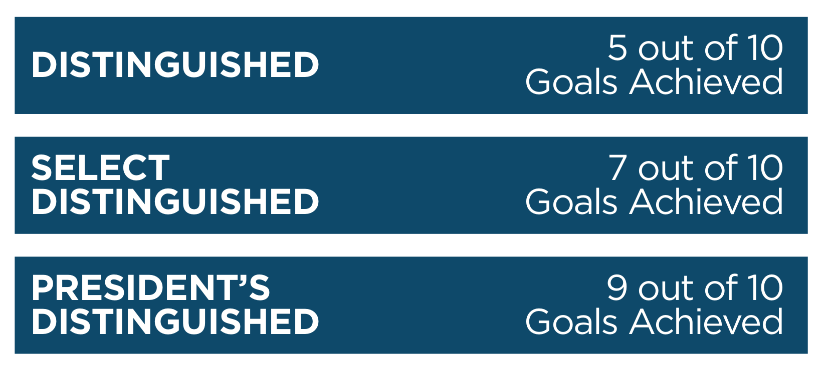
Toastmasters Club Recognition
Distinguished Club Goals

Slide 13
Other Content Resources
DCP/Club Success Plan
Link to D6 Club Officer Training Page*
Link to Distinguished Club Program and Club Success Plan booklet
Link to Moments of Truth
Link to Club Leadership Handbook
Link to all Club Officer Roles (links to four pages)
Notes:
Click through the links to show and tell.

Slide 14
Using Effective Facilitator and Trainer Techniques

Slide 15
3 Ways Information is Processed
Visual (Pictures)
see, look, imagine, envision, picture
Auditory (Words)
Hear, listen, sound, resonate, harmonize
Kinesthetic (Doing)
Feel, touch, grasp, concrete, get hold of

Slide 16
Facilitator and Trainer Techniques
Engage the audience in self discovery: ask questions
Use breakout session with recorders, reporters, and flip charts
Plan for multiple presenters to offer variety
Use quizzes to debrief lessons learned
State up front what the module will do for the trainee
Provide a fun review game at the end with prizes
Notes:
Tag Team – Provide examples of LDI Torch Masters, et al

Slide 17
Event Management

Slide 18
Event Management
Cost/Benefit
Okay to charge for venue if there are costs for the location or refreshments
Begin and end on time
Consider public venues (libraries, city hall)
Consider company meeting spaces
Equipment needs
Notes:
Tag Team – Provide examples of LDI Torch Masters, et al

Slide 19
Communication protocols

Slide 20
Communication Protocols
Submit events to the District 6 Calendar (request)
Send Officer Training Lists to Division Directors
Club Success Plan Template
Links to the DCP Goals/Club Success Plan, Moments of Truth, Club Leadership Handbook

Slide 21
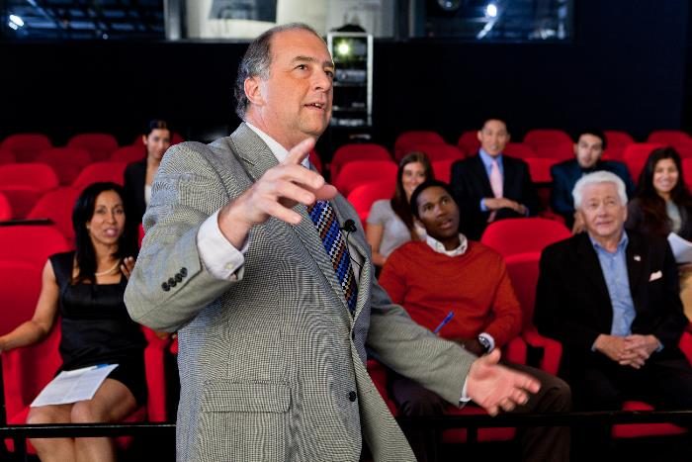
WHAT QUESTIONS DO YOU HAVE?

