Slide 1
Area & Division Director Training
Conduct Quality Speech Contests
206EP

Slide 2
Session Agenda
Types and benefits of speech contests
Speech contest preparation
Speech contest rules

Slide 3
Session Objectives
State types of speech contests
Explain benefits of speech contests
Prepare a speech contest with leadership teams
Solve speech contest challenges and answer questions using the Speech Contest Rulebook (Item 1171)

Slide 4
Type of Speech Contests
International
Evaluation
Humorous
Table Topics™
Tall Tales

Slide 5
District Requirements
Must: International Speech
up to three additional contests per year.

Slide 6
2018-19 D6 Speech Contests
International
Evaluation

Slide 7
Speech Contest Resources for Clubs
Area Directors
Division Directors
Past District Leaders

Slide 8
Role of the contest chair
Secures a place
Sets Date & Time
Food, purchased / pot luck
Fee to cover costs
Finds the role players
Print the Forms
Timer & Lights

Slide 9
Role Players (as per TI)
Contestants
Toastmaster
Chief Judge
Tie Breaker Judge
5 or more judges
3 ballot counters
2 timers
SAA

Slide 10
Role Players (Optional)
Registration
Food Coordinator

Slide 11
Forms
Forms:
Contestants Eligibility & Bio
Judges Eligibility
Timers
Ballot counter
Notification of winners
Certificates of participation
Award certificates

Slide 12
Checklist Game
What should the contest chair order for all contest speakers?
What should the contest chair order for contest winners?
From where should the contest chair order these items?

Slide 13
Checklist Game
May clubs, areas, divisions, or districts produce awards for contestants and winners?

Slide 14
Checklist Game
When should the contest chair notify contestants of the time and place of the contest and pre-contest briefing?

Slide 15
Checklist Game
Where should the chief judge tell the contest judges to sit?
Why should the contest judges sit there?

Slide 16
Checklist Game
What does the chief judge give to the contest chair during the contest?

Slide 17
Checklist Game
What two events must a contestant attend before the contest?

Slide 18
Speech Contest Judges
Chief judge
Selects fair and impartial judges
Trains contest officials
Prepares contest officials for the role
How to use Judge’s Guide and Ballot (Item 1172)
How to choose a winner without evaluating speakers

Slide 19
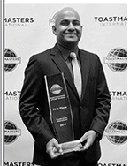
Speech Contest Rules
Speech Contest Rulebook (Item 1171)
The ultimate resource for contest issues

Slide 20
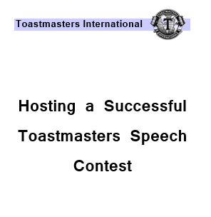
D6 Contest rulebook
Widely used in D6
To be updated.
Has scripts for
Toastmaster
Chief Judge

Slide 21
Review
State types of speech contests
Explain benefits of speech contests
Prepare a speech contest with leadership teams
Solve speech contest challenges and answer questions using the Speech Contest Rulebook (Item 1171)

Slide 22
Conclusion: Closing Remarks
The benefits of speech contests extend to all involved.
Area and division governors must have a thorough understanding of speech contests.
The Speech Contest Rulebook (Item 1171) is an important guide.
It is important to choose fair and impartial judges and train contest officials.

