Slide 1
District Officer Training (DOT)
District 6
Saturday, 12th October, 2019
HealthPartners | 8170 33rd Avenue South, Bloomington, MN 55425

Slide 2

The Pledge of Allegiance
"I pledge allegiance to the Flag of the
United States of America, and to the Republic for which it stands, one Nation under God, indivisible, with liberty and justice for all."

Slide 3
Housekeeping Items / Meeting Guidelines
Restrooms
Be respectful
No Interruptions
No side comments
Work towards consensus
Be open to change
Be present
Be accountable
Be succinct
Cell phones & Electronic Devices
Be prepared
Arrive on time
End on time
In Case of Emergency

Slide 4
Overall Agenda
Call to order, pledge
Welcome message from PQD
Establish and Support New Clubs
BREAK
Thrive in District Recognition Program
Train the Trainer
NETWORKING LUNCH
DEC Meeting
Q & A
Trivia

Slide 5
AREA AND DIVISION DIRECTOR
TRAINING
Deb Luu, DTM, CGD
Establish and Support New Clubs
206DP

Slide 6
Session Agenda
Mission and goals
Club builders
Club-building cycle
1

Slide 7
Session Objectives
  Describe relationship between establishing new clubs and the Toastmasters and district missions.
  Identify which district leader responsibilities help establish new clubs.
  Recognize the support available to establish new clubs.
  Describe the club-building cycle.
  Identify opportunities for new clubs.
2

Slide 8
Toastmasters Mission
We empower individuals to
become more effective
communicators and leaders.
3

Slide 9
District Mission
We build new clubs and support all clubs in achieving excellence.
4

Slide 10
New Clubs
New clubs offer Toastmasters benefits to
more people.
Establishing new clubs provides improved communication and leadership experiences.
Area and division directors have support to
build clubs.
5

Slide 11
Club Builders
All Toastmasters expand the network of clubs, areas, and divisions.
Area and division directors serve as liaisons between districts and clubs.
Area and division directors work with sponsors and mentors.
Area and division directors fulfill duties that support club-building.
6

Slide 12
CLUB BUILDERS RESPONSIBILITIES GAME
Club-building Responsibilities
Serve as contact for demonstration meetings
and pre-charter information meetings
Generate interest and recruit members in
new clubs
Show new clubs how to hold meetings and elect officers
Submit charter paperwork, fees, and dues to World Headquarters
Plan charter presentation meetings
7a
A
DISTRICT
DIRECTOR
B
C
D
CLUB GROWTH DIRECTOR
CLUB
SPONSOR
CLUB
MENTOR

Slide 13
CLUB BUILDERS RESPONSIBILITIES GAME
Club-building Responsibilities
Serve as contact for demonstration meetings and pre-charter information meetings
Generate interest and recruit members in
new clubs
Show new clubs how to hold meetings and elect officers
Submit charter paperwork, fees, and dues to World Headquarters
Plan charter presentation meetings
7b
A
DISTRICT
DIRECTOR
B
C
D
CLUB GROWTH DIRECTOR
CLUB
SPONSOR
CLUB
MENTOR

Slide 14
CLUB BUILDERS RESPONSIBILITIES GAME
Club-building Responsibilities
Recruit, train, and supervise club-building team members, club sponsors, and club mentors
Receive leads from district director and World Headquarters
Assist with prospect visits
Help plan demonstration meetings
Attend demonstration meetings and pre-charter information meetings
8a
A
DISTRICT
DIRECTOR
B
C
D
CLUB GROWTH DIRECTOR
CLUB
SPONSOR
CLUB
MENTOR

Slide 15
CLUB BUILDERS RESPONSIBILITIES GAME
Club-building Responsibilities
Recruit, train, and supervise club-building team members, club sponsors, and club mentors
Receive leads from district director and World Headquarters
Assist with prospect visits
Help plan demonstration meetings
Attend demonstration meetings and pre-charter information meetings
8b
A
DISTRICT
DIRECTOR
B
C
D
CLUB GROWTH DIRECTOR
CLUB
SPONSOR
CLUB
MENTOR

Slide 16
CLUB BUILDERS RESPONSIBILITIES GAME
Club-building Responsibilities
Receive leads from World Headquarters
Confirms alignment of new clubs
9a
A
DISTRICT
DIRECTOR
B
C
D
CLUB GROWTH DIRECTOR
CLUB
SPONSOR
CLUB
MENTOR

Slide 17
CLUB BUILDERS RESPONSIBILITIES GAME
Club-building Responsibilities
Receive leads from World Headquarters
Confirms alignment of new clubs
9b
A
DISTRICT
DIRECTOR
B
C
D
CLUB GROWTH DIRECTOR
CLUB
SPONSOR
CLUB
MENTOR

Slide 18
CLUB BUILDERS RESPONSIBILITIES GAME
Club-building Responsibilities
Guide clubs through first six to 12 months
Ensure club officers understand duties and how to perform them
Familiarize club officers with Toastmasters education program
Familiarize club officers with Distinguished Club Program
10a
A
DISTRICT
DIRECTOR
B
C
D
CLUB GROWTH DIRECTOR
CLUB
SPONSOR
CLUB
MENTOR

Slide 19
CLUB BUILDERS RESPONSIBILITIES GAME
Club-building Responsibilities
Guide clubs through first six to 12 months
Ensure club officers understand duties and how to perform them
Familiarize club officers with Toastmasters education program
Familiarize club officers with Distinguished Club Program
10b
A
DISTRICT
DIRECTOR
B
C
D
CLUB GROWTH DIRECTOR
CLUB
SPONSOR
CLUB
MENTOR

Slide 20
District Director
Club-building Responsibilities
Receive club leads from World Headquarters
Confirms the alignment of new clubs with the district
11

Slide 21
Club Growth Director
Club-building Responsibilities
Recruit, train, and supervise club-building team
Receive leads
  May forward leads to area and division directors
As chair of the district marketing committee
  Assist club-building team
  Assist demonstration meeting team
12

Slide 22
Club Sponsors
Club-building Responsibilities
Follow-up on leads
Serve as contact for demonstration meetings
Recruit members in new clubs
Show new clubs how to hold meetings and elect officers
Submit charter paperwork, fees, and dues
Plan charter presentation meetings
13

Slide 23
Club Mentors
Club-building Responsibilities
Guide clubs through first six to 12 months
Ensure club officers understand duties
Familiarize club officers with Toastmasters education program
Familiarize club officers with Distinguished Club Program
Help recruit and retain members
14

Slide 24
Club-building Team Support
Club-building efforts are supported by:
  Committees and teams
  Area and division directors
  Serve as members of a district committee
      Club extension committee
      Marketing committee
    Generate leads
    Find club sponsors and club mentors
    Facilitate and attend demonstration meetings and pre-charter information meetings
15

Slide 25
Club-building Cycle
Identify leads and prospects
Follow up
Contact and qualify
Club-building Cycle
Charter
Present
Address questions and concerns
16

Slide 26
Identify Leads and Prospects
Leads can come from
  World Headquarters
  Current members
  Neighbors
  Coworkers
  Many other places
Assess existing clubs to identify opportunities for new clubs
Target opportunities
  Communities over 10,000 people
  Corporations over 150 people
17

Slide 27
Contact and Qualify
Follow up leads when requested
Understand business and needs of
each lead
Contact lead promptly
To qualify the lead
  Identify the decision maker
  Explain how Toastmasters can help their corporation
  Ask questions, listen to their needs,
  offer solutions
18

Slide 28
Present
Conduct a demonstration meeting
Demonstration meeting resources
  Demonstration meeting team
  How to Build a Toastmasters Club (Item 121)
  Promotional material
19

Slide 29
Address Questions and Concerns
Address questions and concerns
Ask for opportunity to establish a
new club
20

Slide 30
Charter
How to Build a Toastmasters Club
(Item 121)
Club sponsor responsibilities
  Build membership to 20
  Submit Application to Organize a Toastmasters Club and charter fee
  Assist club in electing officers, adopting a club constitution, and submitting charter forms
  Schedule charter presentation meeting
  Club mentors guide for six to 12 months
21

Slide 31
Follow Up
Club mentor responsibilities
  Ensure officers understand duties
  Maintain membership strength
  Explain Toastmasters education program
  and DCP
Cycle begins again
22

Slide 32
Review
  Describe relationship between establishing new clubs and the Toastmasters and district missions.
  Identify which district leader responsibilities help establish new clubs.
  Recognize the support available to establish new clubs.
  Describe the club-building cycle.
  Identify opportunities for new clubs.
23

Slide 33
Conclusion: Closing Remarks
Club-building is basic to missions of Toastmasters and the district.
District directors, club growth directors, club sponsors, and club mentors have
club-building roles.
The district may establish club-building committees and teams.
The club-building cycle has six steps.
Area and division directors have opportunities to assist club building efforts.
Club leads can come from anywhere.
24

Slide 34
BREAK
10 minutes

Slide 35
AREA AND DIVISION DIRECTOR
TRAINING
Mary Swanson, DTM, PRA
Thrive in the District Recognition Program
206FP

Slide 36
Session Agenda
Distinguished Club Program
District Recognition Program
1

Slide 37
Session Objectives
  Describe how Moments of Truth leads
  to club quality
  Define roles of area and division directors
  Describe the Distinguished Club Program
  Identify goals of Distinguished Area and
  Division programs
  Describe importance of club, area, and division success plans
  Identify District Recognition Program and Distinguished Club Program resources
2

Slide 38
Moments of Truth
First Impressions
Membership Orientation
Fellowship, Variety, and Communication
Program Planning and Meeting Organization
Membership Strength
Achievement Recognition
3

Slide 39
Qualifying Requirements
Distinguished Club Program
  Membership of 20 or a net growth of at least five new members as of June 30
4

Slide 40
Membership Net Growth Definition
Membership net growth occurs when the total number of club members at year-end (June 30) exceeds the base amount.
5

Slide 41
Membership Base Definition
The membership base amount refers
to the number, on July 1, of club members (renewing, new, charter, dual, and reinstated) who paid April dues.
6

Slide 42
DCP Education Goals
  Two CCs
  Two more CCs
  One ACB, ACS, or ACG
  One more ACB, ACS, or ACG
  One CL, ALB, ALS, or DTM
  One more CL, ALB, ALS, or DTM
  Four members complete Level 1
  Two members complete Level 2
  Two more members complete Level 2
  Two members complete Level 3
  One member completes Level 4
  One member completes Level 5
7

Slide 43
Remaining DCP Goals
  Four new members
  Four more new members
  Minimum of four club officers trained during each of two training periods
  One membership dues-renewal report and one club officer list submitted on time
7

Slide 44
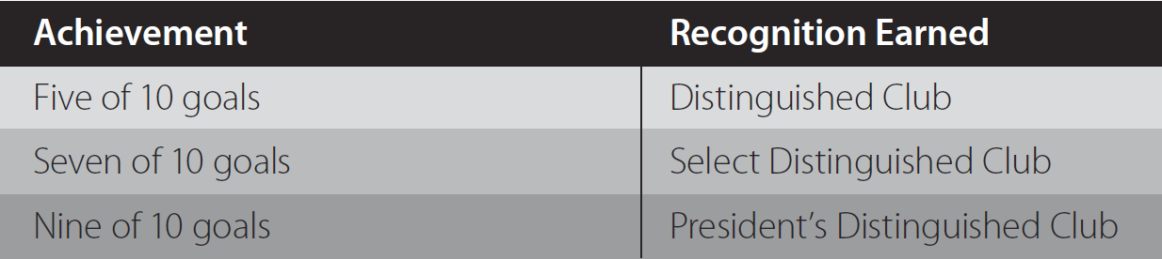
Distinguished Club Program
Distinguished, Select Distinguished, President’s Distinguished
8

Slide 45
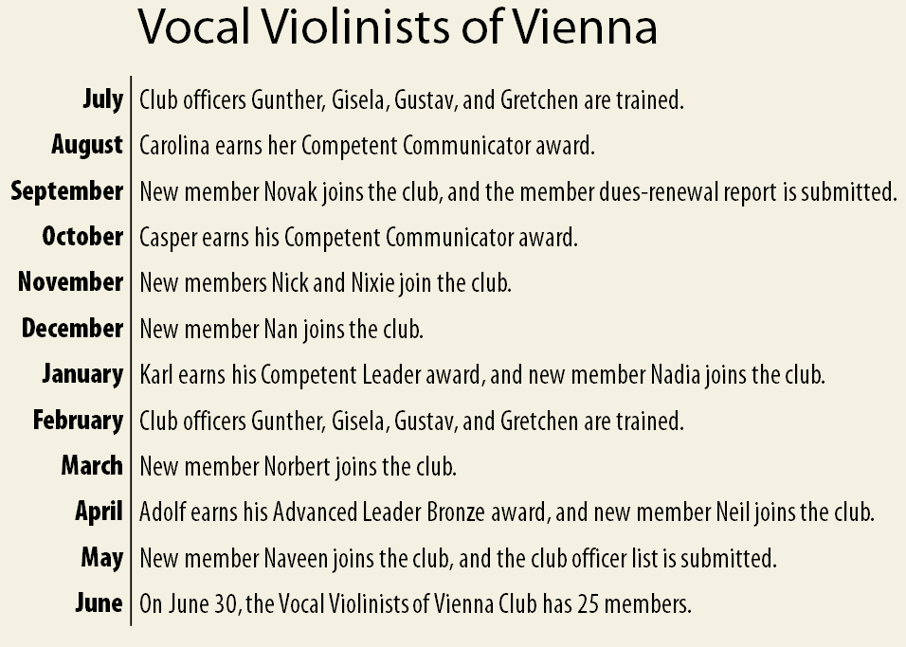
Club Timeline
9

Slide 46
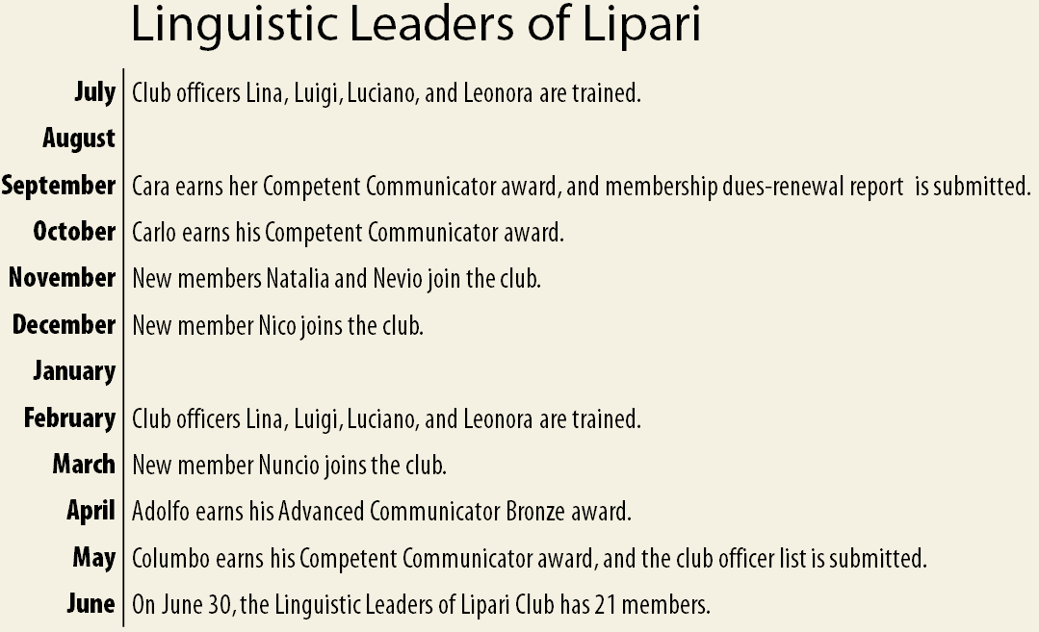
Club Timeline
10

Slide 47
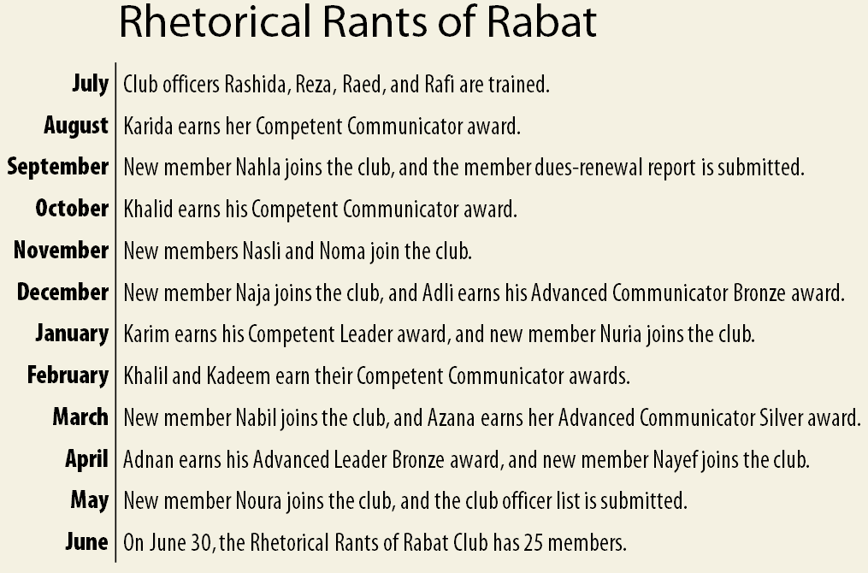
Club Timeline
11

Slide 48
Qualifying Requirements
Distinguished Area Program
  No net club loss
  Submit the Area Director’s Club Visit Report for 75% of club base
    First round visits by November 30th
    Second round visits by May 31st
12

Slide 49
Net Club Loss Definition
Net club loss occurs when the total number of clubs at year-end (June 30) falls below the base amount.
13

Slide 50
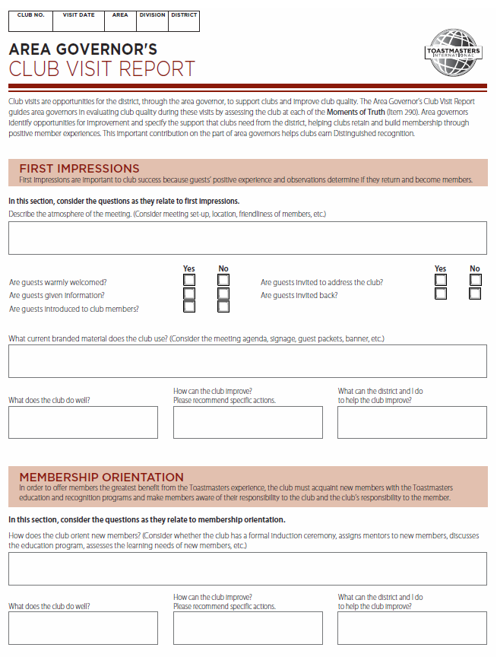
Area Director’s Club Visit Report
14

Slide 51
Area’s Club Base Definition
The area’s club base is the number
of paid clubs assigned to the area as
of July 1.
Clubs are considered to be paid when they have submitted a complete April dues-renewal report.
  These and new clubs chartered between April 1 and June 30 are counted in the club base.
15

Slide 52
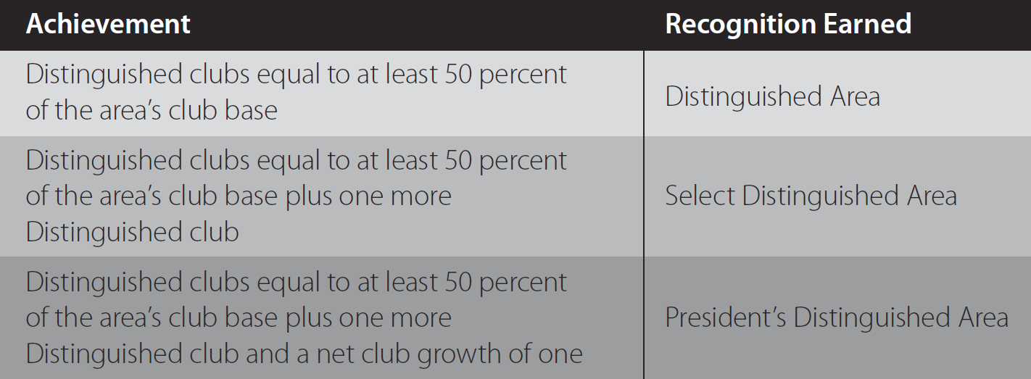
Distinguished Area Program
Distinguished, Select Distinguished, President’s Distinguished
16

Slide 53
Qualifying Requirements
Distinguished Division Program
  No net club loss
17

Slide 54
Net Club Loss Definition
Net club loss occurs when the total number of clubs at year-end (June 30) falls below the base amount.
18

Slide 55
Division’s Club Base Definition
The division’s club base is the number
of paid clubs assigned to the division as
of July 1.
Clubs are considered to be paid when they have submitted a complete April dues-renewal report.
  These and new clubs chartered between April 1 and June 30 are counted in the club base.
19

Slide 56
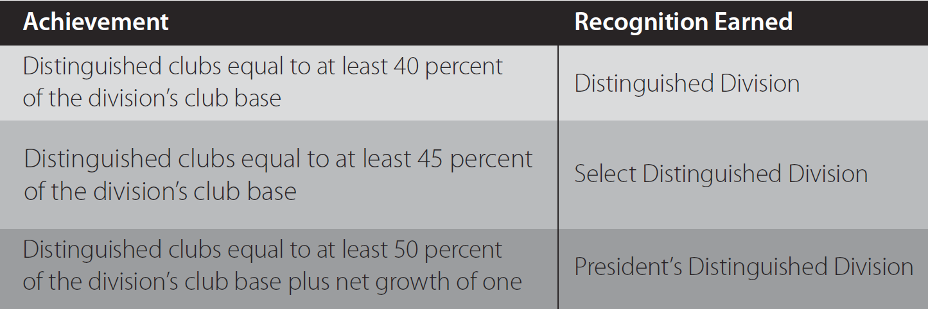
Distinguished Division Program
Distinguished, Select Distinguished, President’s Distinguished
20

Slide 57
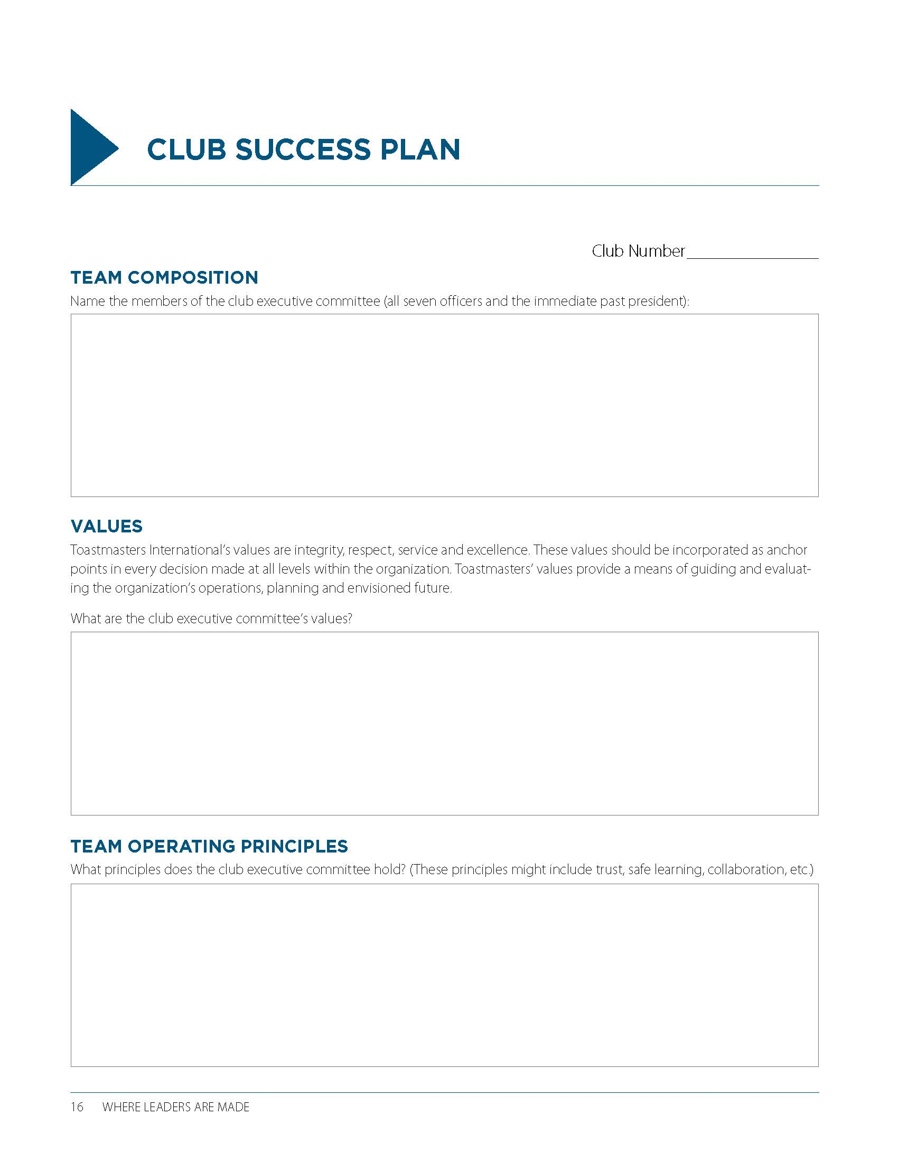
Club Success Plan
www.toastmasters.org/1111_dcp
Distinguished Club Program and Club Success Plan (Item 1111)
21

Slide 58
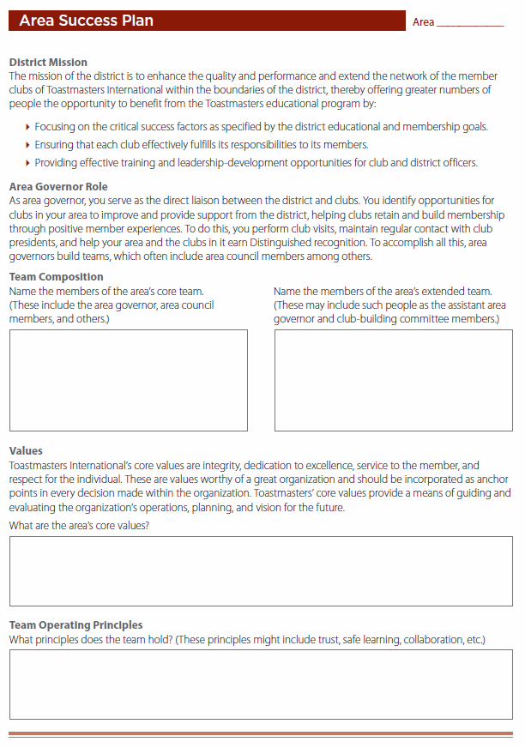
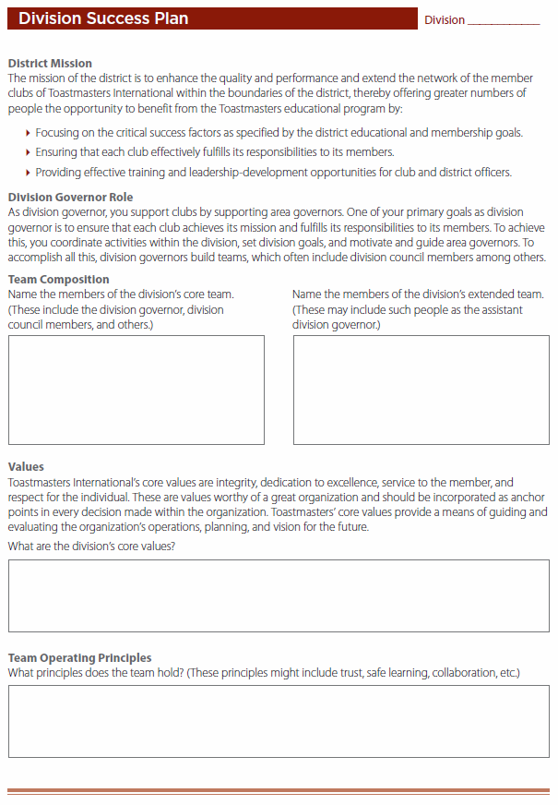
Area and Division Success Plans
www.toastmasters.org/recognitionmanual
Toastmasters International District Recognition Program (Item 1490)
22

Slide 59
Stretch and Additional Goals
Many districts encourage area and division directors to stretch the goals outlined in the Distinguished Area and Division programs or accomplish additional goals.
23

Slide 60
Review
  Describe how Moments of Truth leads
  to club quality
  Define roles of area and division directors
  Describe the Distinguished Club Program
  Identify goals of Distinguished Area and
  Division programs
  Describe importance of club, area, and division success plans
  Identify District Recognition Program and Distinguished Club Program resources
24

Slide 61
Conclusion: Closing Remarks
The DCP is the foundation of the District
Recognition Program.
The Distinguished Area, Division, and District programs align with the DCP.
Area and division directors should be aware of club goals.
Completing success plans helps clubs, areas, and divisions stay on track.
There are resources available for tracking
Distinguished goal progress.
25

Slide 62
Club Officers Training - Train the Trainers
Susan D. Rajbhandari, DTM, PQD

Slide 63
Agenda
How to report training
Promoting club officers training
Format of club officers training
Content Options
Remember
Sneak peak of the deck

Slide 64
How to report training
Collect attendance of all participants
  Full name
  Club/s along with district, division and area
  Club role/s they are serving
Email a legible copy of the attendance to
  Respective Division Director
  District Admin Manager
  District Program Quality Director Susan D. Rajbhandari
Notes:
Note: Add a picture of the hand out. http://www.d6tm.org/officertraining/

Slide 65
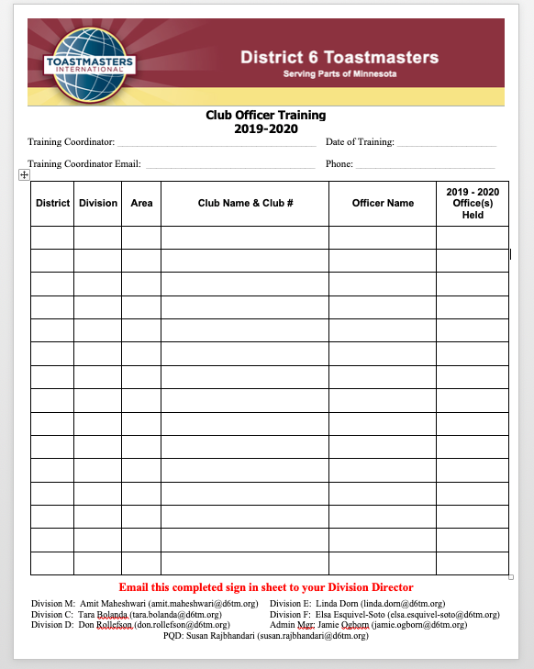

Slide 66
Promoting club officers training
District 6 website
District 6 Facebook
Email to the club officers
Club visits
Area news letter
Division news letter

Slide 67
Format of Club Officers training
At least 60 minutes.
Invite speakers who can present on multiple topics or single topic depending on your situation
In person and NOT over the phone
Customize presentation as you seem fit

Slide 68
Content Options
Officer roles and impact to club
Distinguished Club Program
Pathways
Open house with quality meetings
Effective Evaluations
Marketing the club to potential members

Slide 69
Remember
Publicize
Report
Verify

Slide 70
^{2nd} Round Club Officer Training
Enter date, time and location

Slide 71
Toastmaster Club Mission:
We provide a supportive and positive learning experience in which members are empowered to develop communication and leadership skills, resulting in greater self-confidence and personal growth.

Slide 72
Greetings!!
Thank you so much for coming to today’s Club Review, Education, and Training Event!
By working together we can
CREATE
stronger, high-quality clubs!

Slide 73
Agenda
Officer roles and impact to club
Distinguished Club Program
Pathways
Open house with quality meetings
Effective Evaluations
Marketing the club to potential members
Wrap-up

Slide 74
Agenda
Officer roles and impact to club
Distinguished Club Program
Pathways
Open house with quality meetings
Effective Evaluations
Marketing the club to potential members
Wrap-up

Slide 75
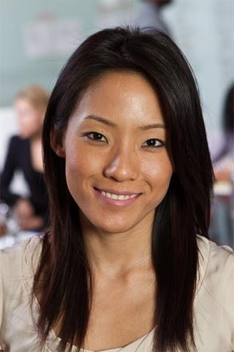
President

Slide 76
Role as President
Preside over meeting
Earn Distinguish Club Recognition
Lead and Guide
Base Camp Manager

Slide 77
Next Steps as President
Evaluate how the year is going
Define what needs to be done to finish the year strong
Start mentoring your replacement

Slide 78
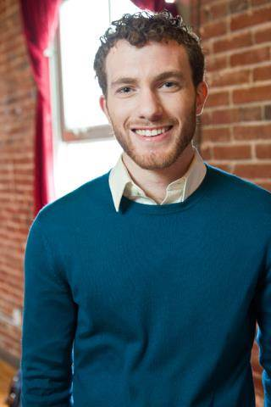
Vice President Education

Slide 79
Role of the VP Education
Maintains a schedule of club meetings
  At least 3 to 4 meetings in advance
Submits education awards
Manages mentor program
Base Camp

Slide 80
Next Steps as VP Education
Evaluate how the year is going
Ask the members what else they need for their goals
Start mentoring your replacement

Slide 81
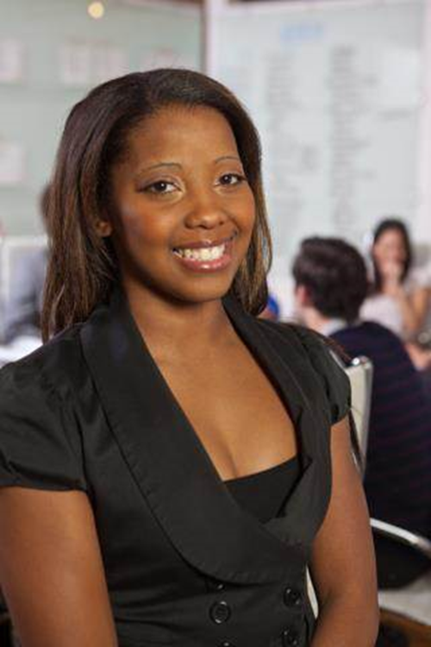
Vice President Membership

Slide 82
Role of the VP Membership
Assists guests
Recruit new members

Slide 83
Next Steps as VP Membership
Evaluate how the year is going
Schedule open houses for the next few months to finish the year strong
Start mentoring your replacement

Slide 84

Vice President Public Relations

Slide 85
Role of VP Public Relations
Publicizes the club
Keep club website current

Slide 86
Next Steps as VP Public Relations
Evaluate how the year is going
Look for new ways to promote your club
Start mentoring your replacement

Slide 87
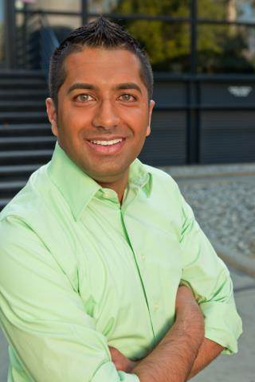
Secretary

Slide 88
Role of the Secretary
Takes minutes at all meetings
Maintains files and make any changes needed
Base Camp

Slide 89
Next Steps as Secretary
Evaluate how the year is going
Make sure the club roaster is current
Start mentoring your replacement

Slide 90
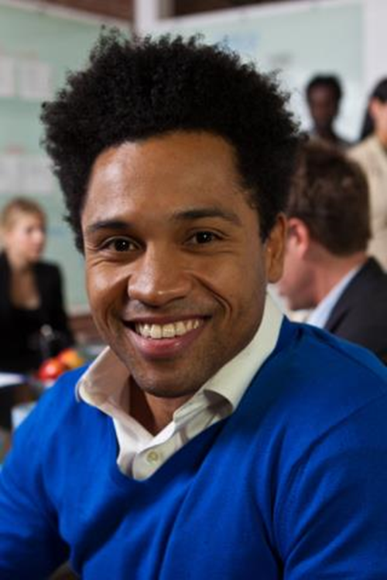
Treasurer

Slide 91
Role of Treasurer
Creates budget
  A plan for the club’s income & spending
Maintains bank account(s)
Pay dues on or before October 1st and April 1st.

Slide 92
First Steps as Treasurer
Evaluate how the year is going
Remind members to pay dues
Start mentoring your replacement

Slide 93
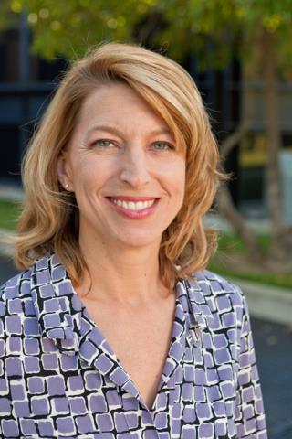
Sergeant at Arms

Slide 94
Role of Sergeant at Arms
Sets up meeting space on time
Responsible for club property

Slide 95
Next Steps as Sergeant at Arms
Evaluate how the year is going
Help with open houses
Start mentoring your replacement

Slide 96
Agenda
Officer roles and impact to club
Distinguished Club Program
Pathways
Open house with quality meetings
Effective Evaluations
Marketing the club to potential members
Wrap-up

Slide 97
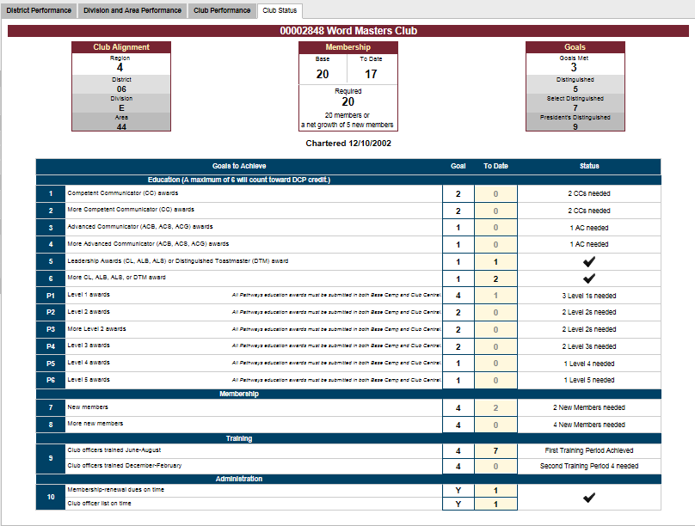
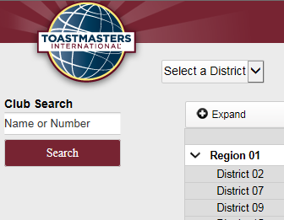
DCP Dashboard
http://dashboards.toastmasters.org/

Slide 98
DCP Program
Traditional Education Program
  Two Competent Communicator (CC) awards
  Two more CC awards
  One Advanced Communicator Bronze (ACB), Advanced Communicator Silver (ACS) or Advanced Communicator Gold (ACG) award
  One more ACB, ACS or ACG award
  One Competent Leader (CL), Advanced Leader Bronze (ALB), Advanced Leader Silver (ALS) or Distinguished Toastmaster (DTM) award
  One more CL, ALB ALS or DTM award

Slide 99
DCP Program
Toastmasters Pathways Learning Experience
    P1. Four members complete Level 1
    P2. Two members complete Level 2
    P3. Two more members complete Level 2
    P4. Two members complete Level 3
    P5. One member completes Level 4
    P6. One member completes Level 5
MEMBERSHIP
      Four new members
      Four more new members

Slide 100
DCP Program
TRAINING
  A minimum of four club officers trained during each of the two training periods*
ADMINISTRATION
  On-time payment of membership dues accompanied by the names of eight members (at least three of whom must be renewing members) for one period
  and
  on-time submission of one club officer list*

Slide 101
Agenda
Officer roles and impact to club
Distinguished Club Program
Pathways
Open house with quality meetings
Effective Evaluations
Marketing the club to potential members
Wrap-up

Slide 102



Slide 103
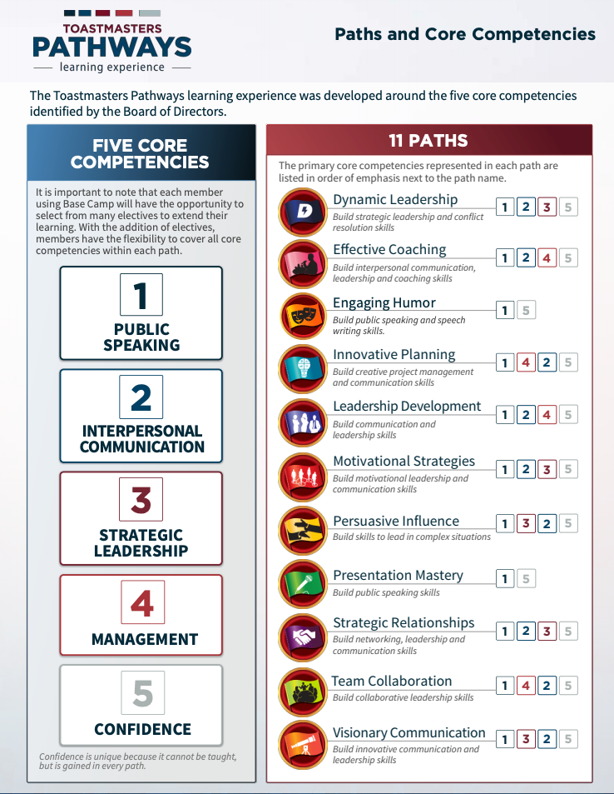

Slide 104
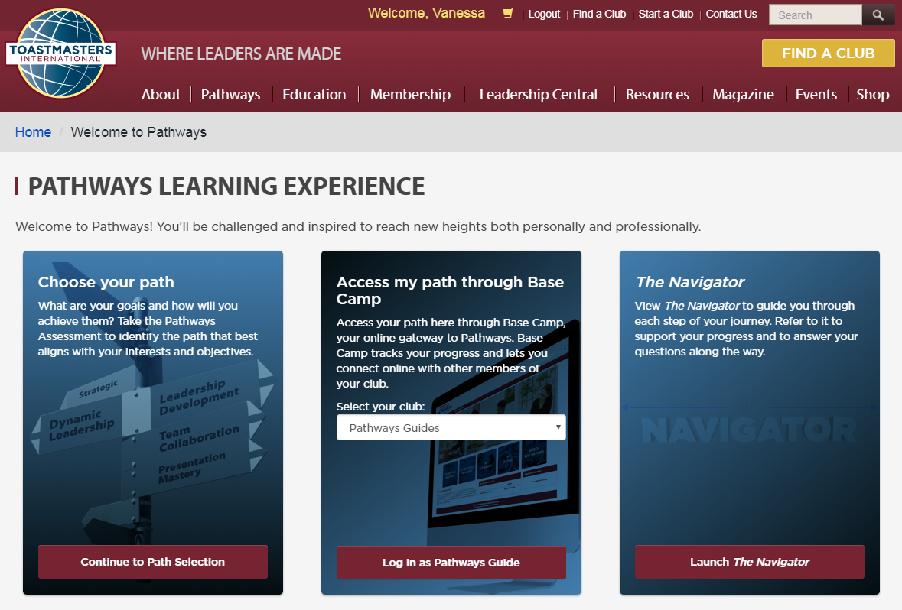
Getting Started

Slide 105
Base Camp Managers
Check frequently for requests from members
Validate each project as it is completed

Slide 106
Base Camp Managers
Validate the level
Printing Certificates when level is completed

Slide 107
Base Camp Managers
For DCP credit enter level into club central

Slide 108
Base Camp Managers
Resources
Resources are fellow club officers
District Officers
Toastmasters International

Slide 109
GROUP ACTIVITY
Split into 3 groups…
1. Presidents and VP/ED
2. VP/M and VP/PR
3. Secretary, Treasurer, and SAA

Slide 110
10 Minute Break

Slide 111
Toastmaster Club Mission:
We provide a supportive and positive learning experience in which members are empowered to develop communication and leadership skills, resulting in greater self-confidence and personal growth.

Slide 112
Agenda
Officer roles and impact to club
Distinguished Club Program
Pathways
Open house with quality meetings
Effective Evaluations
Marketing the club to potential members
Wrap-up

Slide 113

Quality Meetings
Meetings are scheduled in advance
confirm meeting roles (Communication Tree)
Members attend and prepared for their roles
Speeches: Pathways project or manuals
Table Topics
Effective evaluations are given

Slide 114
Open House
Welcome friend to your meeting
Welcome co workers to your meeting
Advertisement of the meeting
Speeches from Pathways projects/manuals
Talk about speeches as presentations
Listen to the guest: What's is in for them?

Slide 115
Large Group Discussion
Why are quality meetings important when you have an open house?

Slide 116
Large Group Discussion
Do you use the
“What is in it for me?” method to listen to your guests?

Slide 117
Large Group Discussion
How many guests do you manage to convert to members?

Slide 118
Large Group Discussion
If your conversion rate of guest to member is low. What may be the problem?

Slide 119
Agenda
Officer roles and impact to club
Distinguished Club Program
Pathways
Open house with quality meetings
Effective Evaluations
Marketing the club to potential members
Wrap-up

Slide 120

Effective Evaluations
Treat an evaluation as a short speech
Express things YOU noticed
Pay attention to the objectives of the project

Slide 121
Effective Evaluations
Note use of rhetorical devices (alliteration, triads, etc.), grammar, and unique language
Be sure to provide 1 or 2 items for improvement
Be sure to begin and end with things you liked about the speech

Slide 122
Effective Evaluations
Evaluate as you would want to be evaluated
Remember Evaluations are for member’s growth
View Tutorial in Pathways if you have a question on how to evaluate

Slide 123
Agenda
Officer roles and impact to club
Distinguished Club Program
Pathways
Open house with quality meetings
Effective Evaluations
Marketing the club to potential members
Wrap-up

Slide 124
Small Group Discussion
Split into small groups, each group answer one of the following questions:
How are you using Pathways to grow your club?
Discuss ways to invite a guest to your club.

Slide 125
Small Group Discussion
Split into small groups, each group answer one of the following questions:
A guest is attending a meeting for the first time and thinking about joining. What do you do?
You’re talking to a guest who doesn’t know a lot about Toastmasters. What is most important for them to know?

Slide 126
Small Group Discussion
Split into small groups, each group answer one of the following questions:
There’s a member of your club who just finished their Competent Communicator manual and they may not renew their membership. How do you convince them to stay a member?

Slide 127
Small Group Discussion
Does your club use the “What’s in it for me?” (WIIFM) approach?
  One-on-one feedback from visitor
  A Club representative LISTENS to the visitor –
  “Thank you for attending today – what made you decide to attend today’s meeting?”
  Let the visitor tell you what they’re looking for, take note of their “needs,” match what Toastmasters offers to their needs, and then share what we offer and how we can help by putting it in their words.

Slide 128
Bonus Discussion!!
If there’s time…
Why should we visit your club?
2 to 3 people (or more…) will be asked to stand and, in 30 seconds or less, share why a guest should visit their club! Table Topic on steroids!

Slide 129

Wrap up
  Who can explain impacts their officer role has on success/failure of their club?
  What is a part of a quality meeting?
  What’s one strategy for helping current members create quality meetings?
  How they are using Pathways to strengthen their club?

Slide 130
Thank You!!!
One of the ways your commitment to your club being a club of quality is displayed by attending
Club Officer Training.
We sincerely appreciate you taking time out of your busy schedule to attend!

Slide 131
NETWORKING LUNCH

Slide 132
District Executive Committee (DEC) MEETING
Ravi Rai, DTM, DD

Slide 133
DEC Meeting Agenda
PQD Report
CGD Report
District Budget
2020 – 2021 Leadership
Triple Crown Awards
Area Success Plans
October Dues Renewal

Slide 134
Triple Crown Awards
01287931 - Name unavailable
05977143 - Name unavailable
Barlas, Kari
Bateman, Sarah J.
Bathke, Laura S.
Dupris, Mike A
Hinton, Brian J.
Hove, Ryan M.
Kummer, Marvel Eileen
Luu, Deborah B.
Olsen, Betty Jo
Rai, Ravi K.
Rischmiller, Jane R.
Ruppert Madsen, Michelle Ann
Steen, Erika
Vu, John

Slide 135
October Dues Renewal – **Renewals not here**
SPH Toastmasters
New Ulm Club
West Bank Expressers Club
Lurie Toastmasters
Avocado Toast Masters
Dakota County Toastmasters
BI Worldwide Toastmasters
Willis Towers Watson
Flyin' Toasters
Bluff Country Toastmasters Club
Sales And Marketing Executives Club
Tongues Untied
Barr Toastmasters
Speaking In Bytes Toastmasters Club
Speech Recovery Club
Talking BS Bluestem Toastmasters

Slide 136
October Dues Renewal – Ineligible – Minimum requirement not yet met
Pearson Presenters
Positively Outspoken Club
Sherpa's Speak
The Lacek Group Speakeasy

Slide 137
October Dues Renewal – Low – Minimum requirement not yet met
Stillwater Toastmasters Club
Woodwinds Club
New Prague Area Toastmasters Club
Schwan Effortless Delivery Club
Community Spirit
TNT- Toastmasters - N - Technology
OracleDirect Toastmasters
SUPER Communicators
Redwood Area Toastmasters
Winona Toastmasters
Toastmasters of Pharmacy Services
Stagecoach Speakers-HMMC
Toro ProsE Toastmasters Club
Carver County Communicators
Class Act Speakers
Austin-nites Toastmasters
Fairmont Toastmasters Club

Slide 138
Q & A
District 6

Slide 139
Trivia
Ed Burke, SR3, Logistic Manager

Slide 140
Next DOT / DEC Meeting
Date: Saturday, January 11, 2020
Time: 9 AM
Where: HealthPartners,
      8170 33rd Avenue South, Bloomington, MN

Slide 141
Thank you!
District 6

