Slide 1
Area Governor Training
August 10, 2013
Still the Best Job Ever in Toastmasters!

Slide 2
Welcome to Training
Pat Croal
pcroal@juno.com
Joan Watson
toastmasterjoan@hotmail.com
Notes:
Pat

Slide 3
Training Agenda
Review June topics Contact clubs/plan visits, officer training, area council, plan contest date
Moments of Truth
Speech Contests
Club Visits
SWOT analysis by Division
Area Success Plan
District Recognition Program page 21

Slide 4
June TO DO’s Updates
Contact Clubs
Plan Club Visits
Officer Training
Area Council
Plan Area Contest Date
Notes:
Joan

Slide 5
Moments of Truth
Form 6 groups –we will decide
Each group will have one standard to discuss
Prepare a 1-2 minute report to share to the group
Notes:
Pat

Slide 6
Moments of Truth
First Impressions
Membership Orientation
Fellowship, Variety and Communication
Program Planning and Meeting Organization
Membership Strength
Achievement Recognition

Slide 7
Speech Contests
Judging
Rules
Process

Slide 8
Chief Judge – prepare Judges
Review the rules
Conduct training workshops for speech contest judges
Review Speech Contest Judges Training (Item 1190)
Direct contest judges to online resources: www.toastmasters.org/SpeechContestFAQ and the e-learning speech contest module (www.toastmasters.org/tlc)
Notes:
Pat

Slide 9
Chief Judge – prepare Judges
Select contest judges carefully-experienced & has completed judging module
Expect contests judges to know contest rules, procedures, responsibilities, and duties
Conduct a judges briefing before every contest.
Review the Judge’s Guide and Ballot (Item 1172).
Discuss bias and fairness (back of judging form)

Slide 10
Chief Judge – prepare Judges
Choose fair and impartial judges. Train contest officials.
Issues related to judging often arise at the club & area level, because of a lack of training.
Many contest judges don’t understand their role. They need your experience & training.
The chief judge chooses contest judges and prepares them for the role:
How to use the Judge’s Guide and Ballot (Item 1172)
How to choose a winner without evaluating the speeches

Slide 11
Stand Up & Stretch
Sit with your Division

Slide 12
Area Visits to Clubs
Review Club Visit Form in advance
Plan, Prepare, Set dates
Submit the Area Governor Club Visit Report online
A copy of the form will automatically be sent to your district leaders and the club president
Reports are due twice a year. Deadlines are November 30 and May 31
To submit an online Area Governor's Club Visit Report log in to toastmasters.org/members.
Follow the link to District Central and click "Submit Area Visit Report." (Area Governor's have access to this feature only.)
Notes:
Joan

Slide 13
Club Visits
Plan ahead
Contact Club President
Set a date to attend the club
Tell Club President what information you need
Review their Distinguished Club Plan
Be a resource for the officers & club
Notes:
Joan

Slide 14
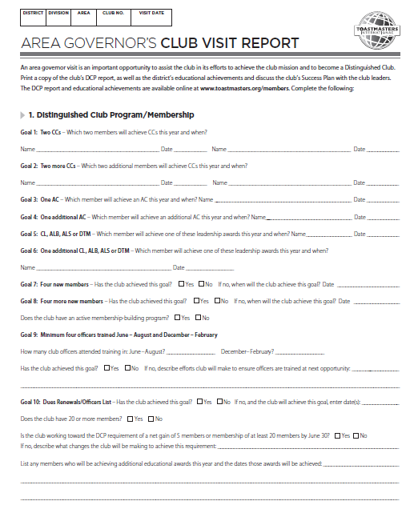

Slide 15
SWOT Analysis Strengths, Weaknesses, Opportunities, Threats
Each Area Governor completes the SWOT worksheet for their Area
Area Governors share their Area analysis within others in the division (1-2 minutes)

Slide 16
Strength, Weakness, Opportunity, Threats
For your analysis, consider the following:
Clubs in danger of folding
New club opportunities
Officer training attendance
Dues, membership (current & history)
DCP status (past & present)
Level of officer/member engagement (manual projects, educational accomplishments)
Notes:
Joan

Slide 17
What’s Next in November
Distinguished Clubs
Area SWOT (strengths, weaknesses, opportunities, threats)
Building New Clubs
Area Council Meetings
Plan for Mid-Winter Club Officer Training

Slide 18
Conclusion Thank you for attending!

