Slide 1
AREA GOVERNOR
TRAINING
November 9, 2013
Today’s Theme: Know Your Numbers
206CP

Slide 2
Session Agenda
SWOT – picture of club status
Quality Clubs
Strategies for mid-year club officer training (December – February)
Area Council Meetings
  Resources for virtual meetings
Notes:
Intro: Welcome back …how is it going? AGs mixed up after SWOT – 5 minutes.
SWOT: 15 minutes
Quality clubs: discussion in groups (10 min) & report out (2 min * 6 groups) 25-30 mins
Club officer training: discussion in groups (10 min) & report out (2 min * 6 groups) 25-30 mins
Area Council meetings: 10 minutes (joan to check on resources for virtual meetings).

Slide 3
Session Objectives
Know your numbers
Define club quality and a positive member experience
    Examine what contributes to club quality and
    a positive member experience
    Propose solutions for club challenges
  Mid-year Club Officer Training Planning
  Area Council meetings
Notes:
Intro: Welcome back …how is it going? AGs mixed up after SWOT – 5 minutes.
SWOT: 15 minutes
Quality clubs: discussion in groups (10 min) & report out (2 min * 6 groups) 25-30 mins
Club officer training: discussion in groups (10 min) & report out (2 min * 6 groups) 25-30 mins
Area Council meetings: 10 minutes (joan to check on resources for virtual meetings).

Slide 4
SWOT - 15 minutes to focus
Notes:
SWOT: 15 minutes
Use numbers provided by Div Governors, data on TI, known club details regarding club officer training, club engagement, area visit, club leadership, commitment to being a Dist Club.

Slide 5
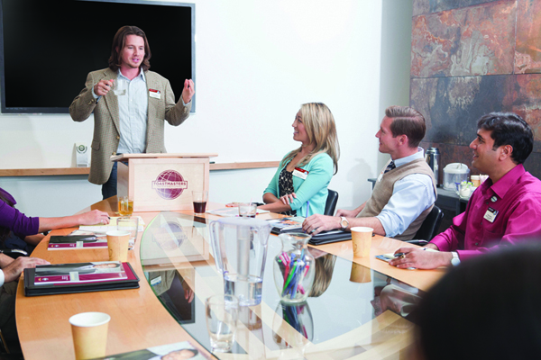
Club Quality

Slide 6
Club Quality: Member Experience
Quality club environments lead to membership retention
Great meetings make clubs successful
Quality club meetings are well planned, well attended, organized, and fun
Members improve their communication and leadership skills
Quality clubs give members an opportunity to learn and grow

Slide 7
Membership, Education, and Leadership
Membership
  How do clubs attract and retain members?
The Toastmasters education program
  How can the club help its members meet their personal and professional education goals?
Club leadership
  How do club officers affect club quality and the member experience?
Notes:
Break-out – From AG perspective: How do you work with clubs on each of the 3 key areas. Break-out two groups with each topic (10 min). Two minute report out = 30 mins. This can help guide next topic of “How to put together for club officer training” meeting the needs of the clubs/club officers.

Slide 8
Strategies for Mid-Year Club Officer Training
Know Your Resources
Work with other Area Governors in the division to implement strategies
Notes:
Put together training plan. Give them a grid – blank, so they can walk away with a plan (for further development). Another 30 minute session. Work together for 15 minutes. Report out for 1 minute (high level report). Everyone needs to be open eared…be ready to hear other ideas.

Slide 9
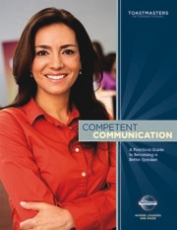
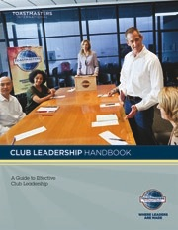
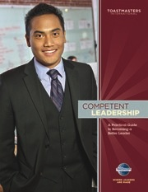
Resources
  TI Reports
  Rebuilding Clubs
  SWOT
  DCP
  Club Coach Program
    www.toastmasters.org/Members/OfficerResources/DistrictLeaderResources/DistrictTraining
  TI Annual Membership Program
    www.toastmasters.org/membershipcontests

Slide 10
Plan for Successful Mid-Year Club Officer Training
Work Together in Division Leadership Teams for plan to implement strategies
  Top 3-4 topics for mid-year training
  Who will cover the topic?
  Communicate training dates & expectations to clubs early (at least 2-3 weeks in advance)
  Keep session to 1 hour
  Ask clubs what they need – help them with resources
Notes:
Teams work together & then one area governor gives report for 3 topics to be covered at training:
Review Clubs DCP Progress & adjust as necessary, Membership Building (TI Program that includes Talk UP TM, Beat the Clock, Sponsor members), Educational Completions (entering early at TI) and Recognition.

Slide 11
Topics to Cover at Mid-Year Club Officer Training Sessions
Review Clubs DCP
Membership Building –TI
Educational Completions and Recognize Achievement for clubs
District Calendar/Resources/TI & District Web site

Slide 12
Area Council Meetings
De-brief
Resources for virtual meetings

Slide 13
Review of Today’s Topics
  Know the status of your area – know your numbers & your SWOT
  Examine what contributes to club quality and
  a positive member experience
  Plan for 2nd Round of Club Officer Mid-year training now
  Area Council meetings

Slide 14
Conclusion: Closing Remarks
Know your numbers – you improve what
you measure
SWOT: Area governors discuss how to help clubs with division governors.
Support clubs in creating a positive member experience.
Prepare for 2nd Round of Club Officer Training Now (decide dates by early December & communicate to clubs early & often!)

Slide 15


Distinguished 2014

