Slide 1
AREA AND DIVISION GOVERNOR TRAINING March 9, 2013
Today’s Theme:
Turn Up the Heat...
It’s Time to Lead Your Clubs to Distinguished !
206CP

Slide 2
Leadership Video
http://www.youtube.com/watch?v=Z7O8s6NgAck

Slide 3
Session Agenda
Review Past Session/Training Successes
SWOT Reports: Jean & Dan
SWOT working time:
Break-out session by Division (Drawing for prize)
Contests
Dates of Division Contests, Area Contest Dates must be set by now
Dues & follow up
Finishing & Finding: Visits by April 30
(post by May 31) & Finding New Leaders
Spring Convention: Business meeting, proxies
Notes:
Greeting & review: 5 minutes (Pat & Joan)
SWOT Reports: Joan introduces Jean & Dan (20 minutes) 10 minutes for each
SWOT Division Breakout: 50 minutes total: 30 for breakout – assemble SWOT (Joan & Pat work the room); Report out by Division 2 minutes each. Determine who should give the report?
Final comments on SWOTs
15 minutes for the remaining items in agenda:
Contests – comments, questions, concerns. Does anyone need a “contest mentor”?
Dues & Follow up
Finishing the Year strong: Area Visits, recognition and what to look for in finding new AG’s for 2013-14 - Give names to Sharon Rollefson for approval/appointment.
Spring Convention: attend, have fun, recognize, business meeting/proxies

Slide 4
Session Objectives
Turn up the heat…Know where you are now…what do you need to do assure Distinguished Clubs in your Area?
Review:
Execute Contests
Finish 2nd Round Club Visits
Your role in dues follow up
Finding New Leaders

Slide 5
Examples of SWOT Analysis
Eastern Division – Jean McAllister
Frontier Division – Dan Grundtner

Slide 6
It’s SWOT time!
Strengths
Which clubs will be distinguished?
New leader opportunities (Area Gov or cmte member)
Weaknesses
Clubs that didn’t get officer training goal or paid 1st round dues late
Clubs without at least 4 new members so far this year
Clubs 12 or under or that dropped below base
Opportunities
Engaged club officers that expect to be distinguished (but not quite there)
New leader opportunities (Area Gov or cmte member)
Threats
Clubs not meeting, not communicating, low or no dues from Oct, didn’t attend training

Slide 7
Contest Questions:
What is the date of your Area Contest?
Have you communicated details to your clubs so they can hold their contest in time?
Do you have a flyer with details posted on d6tm.org? Do you have awards & certificates?
Do the presidents know you need contestants & volunteers (judges, timers, greeters etc?) names in advance (give them a deadline)?
Do you have a Contest Chair, Toastmaster & Chief Judge named? Do they know the process & rules? Do you know the process & rules?

Slide 8
Spring 2013 Division Contests
Prairie Saturday April 6
Western Monday April 8
Central Tuesday April 9
Eastern Thursday April 11
International Saturday April 13
Frontier Tuesday April 16
Northern Wednesday April 17
Southern Saturday April 20
Metro Wednesday April 24
Rivers Thursday April 25
District 6 Spring Convention: May 3-4

Slide 9
Club Visits
Review form in advance, compare to round 1
Encourage & recognize club officers & members
Encourage goal completion towards DCP
Educational awards & membership growth
Look for new leaders
What are attributes to look for?
Give names of potential Area Governors to Sharon Rollefson

Slide 10
Dues & Follow Up
April 1: Dues are due at TI.
Club Presidents & Treasurer’s receive TI communication
April 9: Watch TI reports & begin follow up
Do they need help? Remind of April 10 goal deadline for TI credit.
April 10-30: follow up

Slide 11
Finding & Finishing
Finish:
Area Visits by April 30 (post by May 31)
Strong & celebrate!
Finding:
New Area Governor Leaders
What attributes to look for when looking for new leaders?

Slide 12
Conclusion: Your next steps
Hold Contests
Get clubs to attend…Communicate, communicate, communicate!
Complete 2nd round club visits
Coach to Distinguished & recognize achievements!
Know your SWOT’s
What will you spend your valuable time on during last few months?
Will your Area or Division be Distinguished?
Please say YES! You have accomplished a lot…thank you!!
How will you CELEBRATE?!!

Slide 13
May 18, 2013
Next District Training date
Transition meeting: Outgoing & Incoming Area & Division Governors
Year end financial reporting requirements
What will you accomplish between now & then?
Encourage the 2013-2014 AG/DG to attend

Slide 14
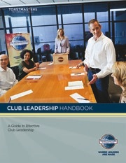
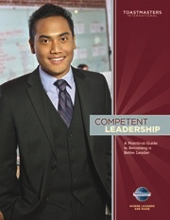
Resources
Your District Leadership Handbook
Achieving Success Standards
www.toastmasters.org/218A_pdf
Maintaining Strong Clubs
www.toastmasters.org/218A_pdf
Conducting Quality Contests
www.toastmasters.org/218E_pdf
Dues Renewals Resources
DCP Program www.toastmasters.org/1111
District Recognition Program
www.toastmasters.org/RecognitionManual

Slide 15
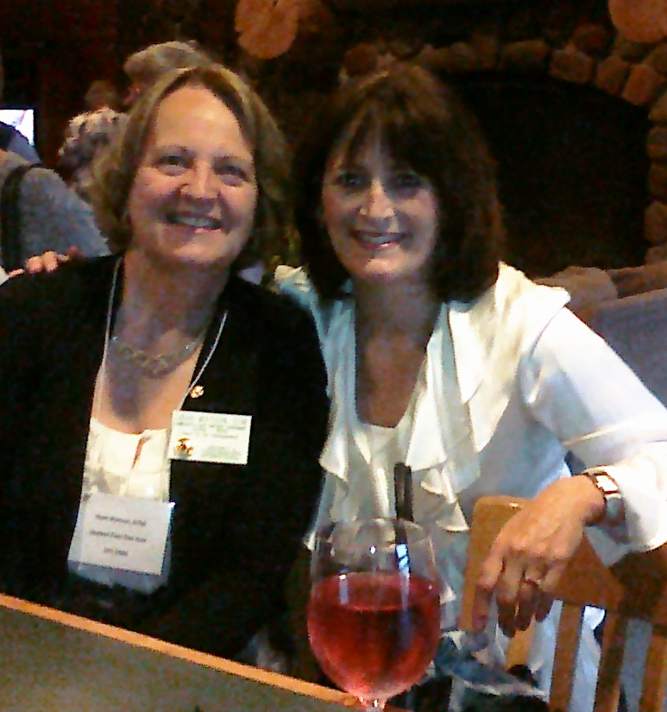
Celebrate…A Toast to YOU! Thank you for your service as an Area Governor this year!

