Slide 1
AREA AND DIVISION GOVERNOR TRAINING May 18, 2013
Today’s Theme:
Finish the Year Strong
206CP
Notes:
Work towards the end
Never give up

Slide 2
Session Agenda
TMOY
Transition
Clubs Updates
Dues & Follow-up with clubs
Finishing Strong
Notes:
Finishing the Year strong: Area Visits, recognition and what to look for in finding new AG’s for 2013-14 - Give names to Sharon Rollefson for approval/appointment.

Slide 3
Session Objectives
Keep the focus…Know where you are now…what do you need to know to assure Distinguished Clubs in your Area?
Review:
Your role in dues follow up
Finding New Leaders
Educate the New Leaders on clubs

Slide 4
TMOY:
Area Governors remind your clubs about TMOY for their club at the end of May
Area Governors need to select their TMOY by mid June
Division Governors need to select before end of June
Complete the D6 TMOY form

Slide 5
Transition
Reminders
Outstanding Issues
Any concerns that are sensitive for each club
Who is someone you need to manage
Any updates on where clubs are- is there security – anything that you had to learn the hard way
Share what you know about your clubs in your area
Who is the go to person in each club
Any one in particular that stands out as someone you can count on

Slide 6
Club Updates
Encourage goal completion towards DCP
Educational awards & membership growth
Elect club officers and turn them in to TI
You don’t have a replacement AG?
Ask someone you think would be interested
Give names of potential Area Governors to Sharon Rollefson
Rally your clubs to succeed by the end of the year

Slide 7
Clubs
April 1: Dues were due at TI.
Have all your clubs dues been paid?
Can you facilitate getting your clubs that have not paid their dues to do so?
Recognize your clubs with something they have done well this year
Have a speech night so members can complete education awards
Celebrate your clubs success with a party and food

Slide 8
Finishing Strong
Club visits end of April – enter until end of May
Transition to New Area Governor
Check on Club Officer list by end of June
Assist the incoming AG with Officer training
HPL project is complete and ready to submit

Slide 9
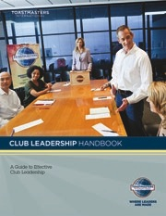
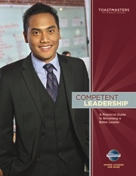
Resources
Your District Leadership Handbook
Achieving Success Standards
www.toastmasters.org/218A_pdf
Maintaining Strong Clubs
www.toastmasters.org/218A_pdf
Conducting Quality Contests
www.toastmasters.org/218E_pdf
Dues Renewals Resources
DCP Program www.toastmasters.org/1111
District Recognition Program
www.toastmasters.org/RecognitionManual

Slide 10
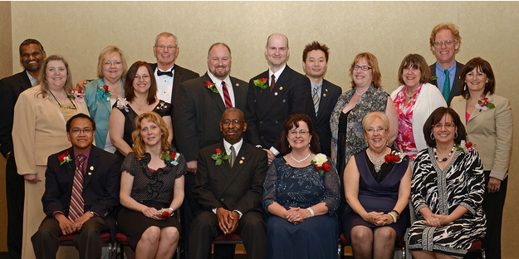
Thanks for your Service and Leadership 2012-2013

Slide 11
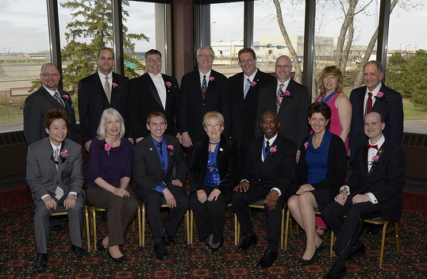
Welcome the 2013-2014 team who will lead District 6 to Distinguished

