Slide 1
Reach
Out
Sharing
Energy
Be A District 6 ROSE

Slide 2
District Executive Committee (DEC) Division & Area Gov.Training
District 6
March9, 2013

Slide 3
United States Pledge of Allegiance
I Pledge Allegiance
To the Flag
Of the United States of America
And to the Republic
For Which it Stands
One Nation
Under God,
Indivisible,
With Liberty
And Justice
For All

Slide 4
Toastmasters International Mission
We empower individuals to become more effective communicators and leaders.

Slide 5
District Mission
We build new clubs and support all clubs in achieving excellence.

Slide 6
Club Mission
We provide a supportive and positive learning experience in which members are empowered to develop communication and leadership skills, resulting in greater self-confidence and personal growth.

Slide 7
District Purpose
The purpose of the District is to enhance the performance and extend the network of clubs, thereby offering greater numbers of people the opportunity to benefit from the Toastmasters educational program by

Slide 8
Focusing on the critical success factors as specified by the District educational and membership goals.
Ensuring that each club effectively fulfills its responsibilities to its members.
Providing effective training and leadership development for club and district officers

Slide 9
District Leaders
Welcome -
Dru Jorgensen, DTM District Governor
Update
Golden Tickets
1 + 1 Membership Campaign
State of the District

Slide 11
District Leaders Update
Sharon Rollefson,
Lt Governor Education & Training
Clinton Hunt,
Lt Governor Marketing
Don Rollefson,
Treasurer

Slide 12
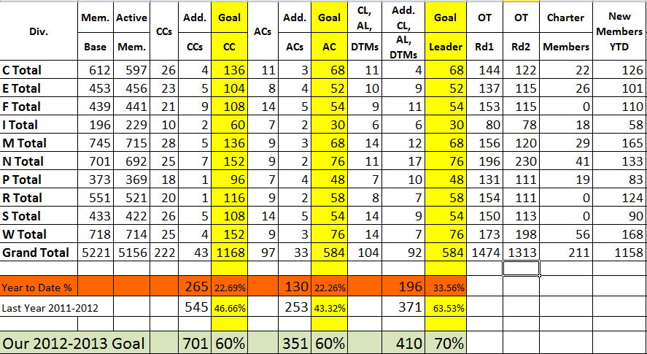
District Summary as of 3/6/13

Slide 13
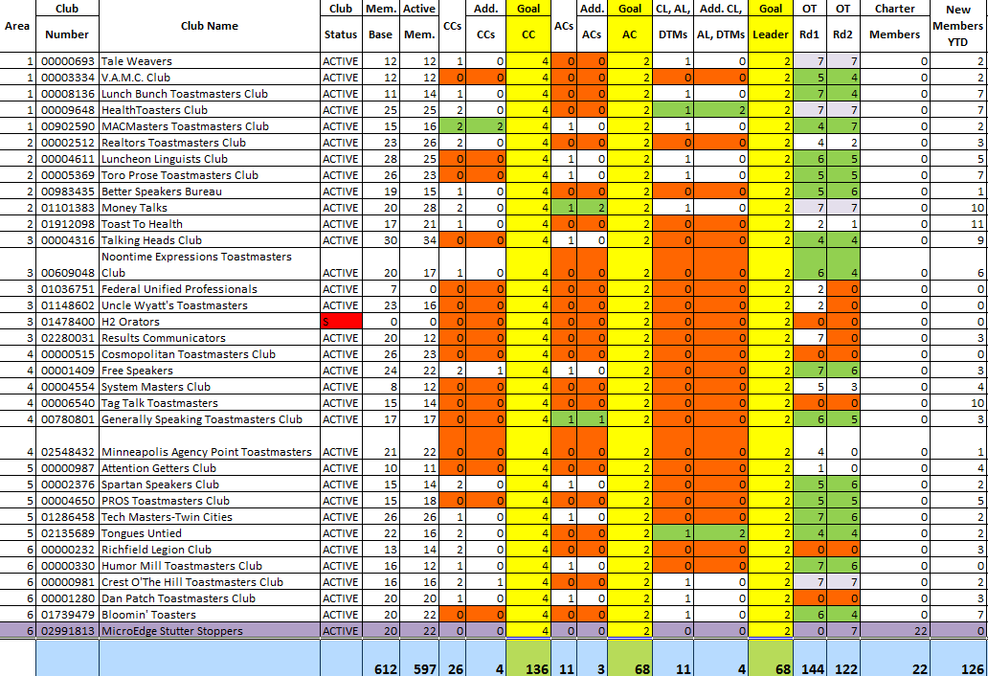
Central Division – Eric McBrayer

Slide 14
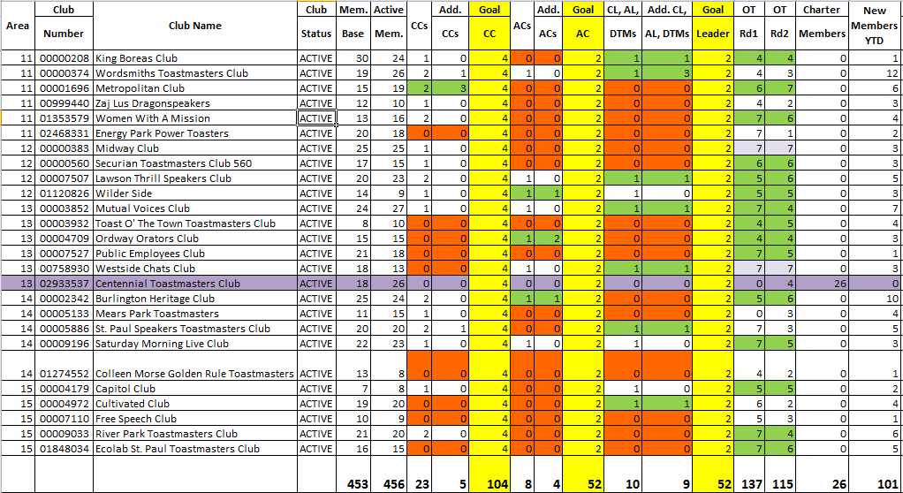
Eastern Division-Jean McAllister

Slide 15
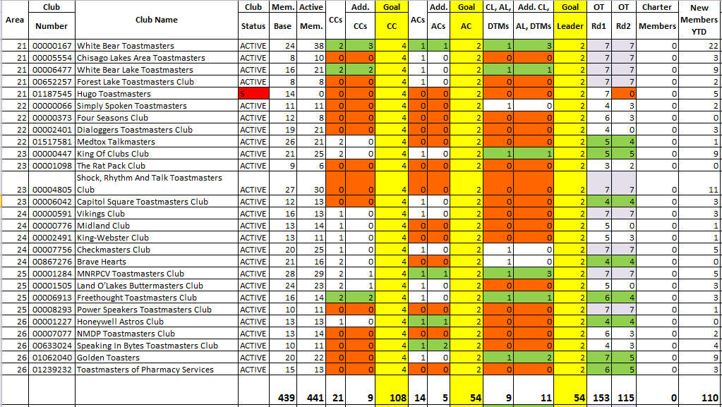
Frontier Division-Dan Grundtner

Slide 16
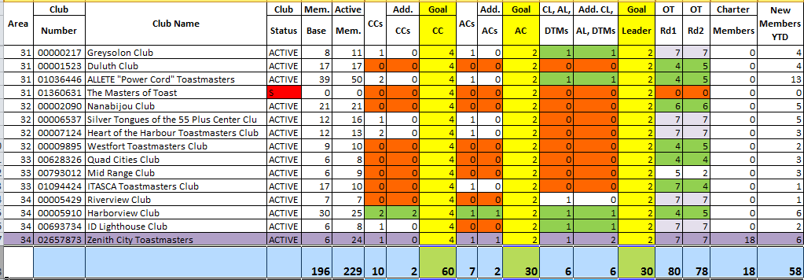
International Division-Sue McCoy

Slide 17
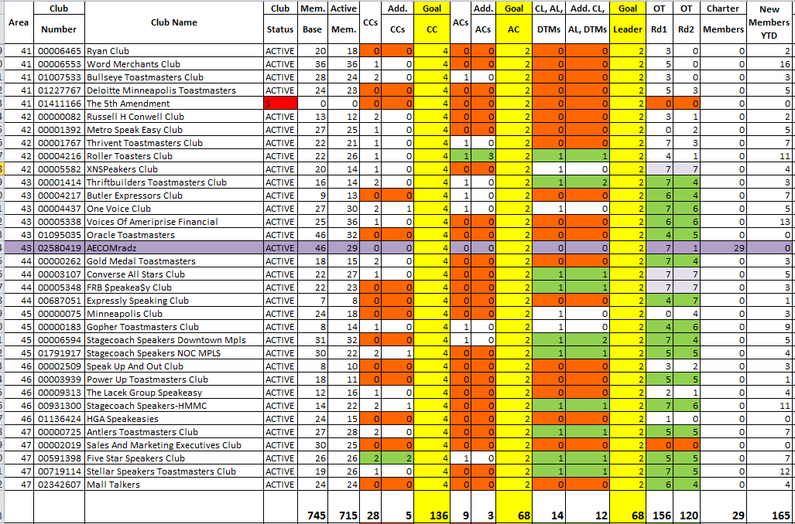
Metro Division-Glen deGuzman

Slide 18
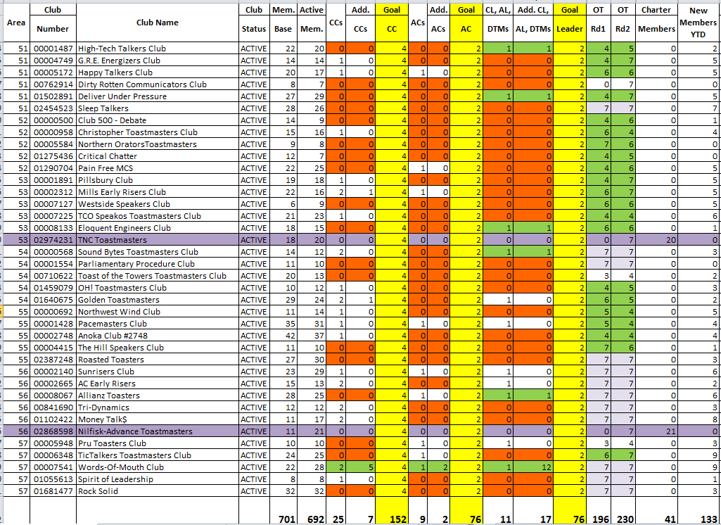
Northern Division-Colbert Fong

Slide 19
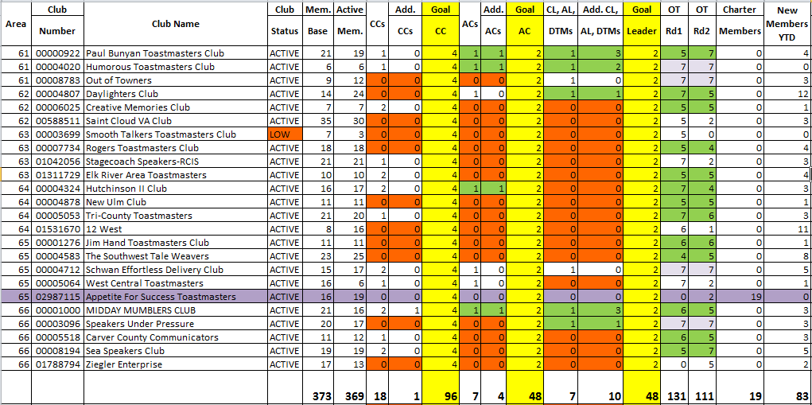
Prairie Division-Jon Chalmers

Slide 20
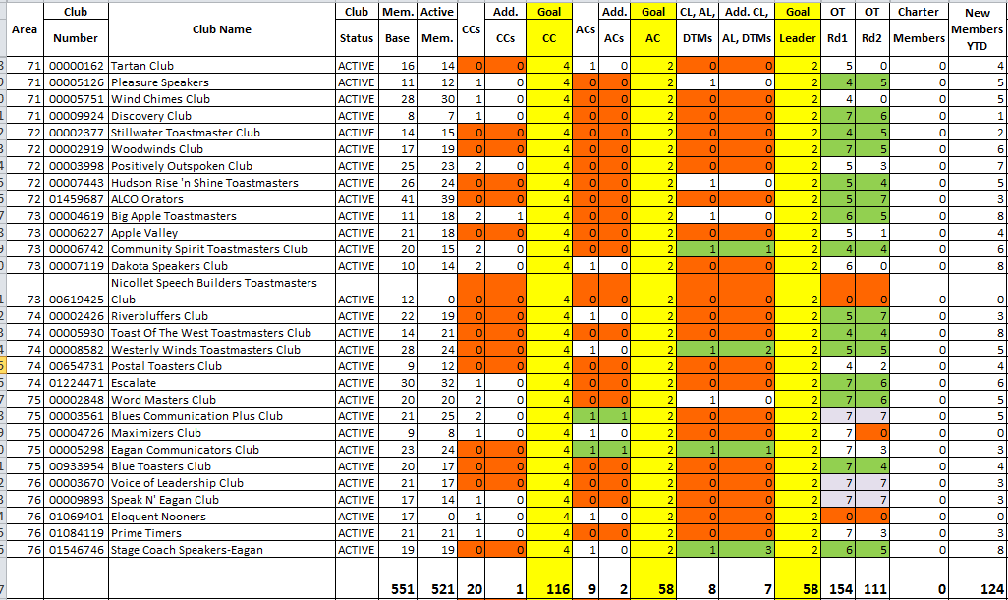
Rivers Division-Laurie Buchberger

Slide 21
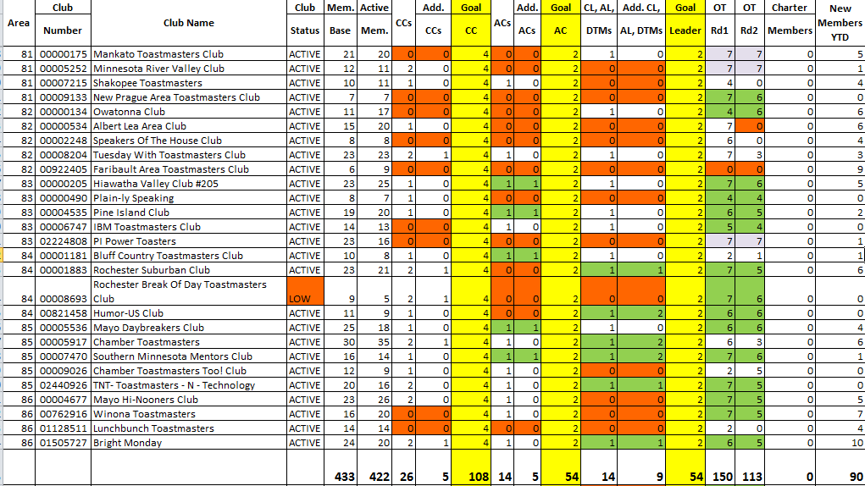
Southern Division-Jean Pearson

Slide 22
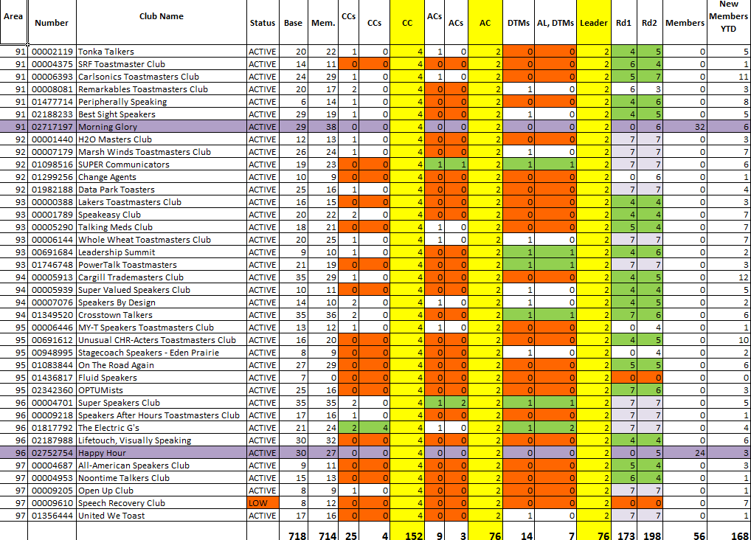
Western Division-Colleen Hamilton

Slide 23
Membership Building Workshop
Stephen Shaner, DTM, PDG, Region 4 Advisor

Slide 24
District Leader Training
Pat Croal, DTM
Joan Watson, DTM

Slide 25
D6tm.org
Larry Marik, DTM

Slide 26
Wrap Up
What’s Next

Slide 27
Division Council Meetings
High Performance Leadership – guidance committee meetings
Spring Convention Committee Meeting
3:00 Depart the building

Slide 28
Reach Out Sharing Energy express passion and take action by…
Turn up the fire in your clubs and Areas to earn/submit their Education Awards
1 + 1 and Gold Ticket = Growth
Advanced & Specialty Clubs – see handouts
Volunteer at National United States Academic Decathlon on 4/25
Stop and smell the roses--
enjoy growing and learning

