Slide 1
AREA AND DIVISION GOVERNOR TRAINING January 18, 2014
Today’s Theme:
On the Road to Distinguished…
Do You Know Where You Are?
206CP

Slide 2
Session Objectives
Where are you? (SWOT)
Mid-year Club Officer Training Execution
Contest Dates & Review 2014 Rulebook
Change Management for Leaders
2nd Round Club Visits
Notes:
Opening – what’s working, what are challenges, what do you need today? 15 mins Joan & Pat
SWOT –Review SWOT - Breakout work with team, then report from each group 15 + 10 min =25 min - Joan
Officer training – 10 minutes (what’s working, review plan from Nov/Dec, topics to include, DCP) - Joan
Contest Date Review – 5 mins – schedule separate time to plan contests - Pat
Change Management for Leaders – 15 minutes – Pat
Club Visits – 5-10 minutes - Joan
Next Steps & What’s next for March? 5 minutes - Joan
Questions, comments? 5 minutes – Pat & Joan

Slide 3
Mid-Year Club Officer Training
Know Your Resources
Work with other AGs in the division to implement strategies
Communicate training dates & expectations to clubs early
Help them be successful
Cover the DCP – be creative & informative
Keep session to about 1 hour
Help them get to Distinguished
Encourage officers to attend training (rather than AG delivering training for just one club)

Slide 4
Topics to Cover at Mid-Year Club Officer Training Sessions
Review Clubs DCP
Membership Building –TI Program
Educational Completions and Recognize Achievement for Clubs
District Calendar/Resources/TI & District Web site

Slide 5
Contest Judging
Know the rules for 2014
updates from previous years notated by the in rule book
Read the rule book in advance of contest:
Area & Division Governors
Contest Toastmaster
Chief Judge & all judges, timers, counters
Contestants

Slide 6
Spring 2014 Division Contests
International Saturday March 29
Western Wednesday April 9
Prairie Saturday April 19
Central Saturday April 12
Northern Wednesday April 16
Metro Monday April 21
Frontier Tuesday April 22
Eastern Thursday April 24
Southern Saturday April 26
Rivers Wednesday April 30
District 6 Spring Convention – May 2-3

Slide 7
Club Visits
Review form in advance, compare to round 1
Encourage & recognize club officers & members
Encourage goal completion towards DCP
Educational awards & membership growth
Look for new leaders
Give names of potential Area Governors to Sharon Rollefson & Clinton Hunt
Visit deadline is April 30 (posted by May 31)

Slide 8
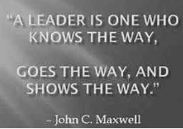
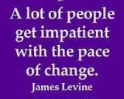
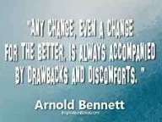

Slide 9
What is Changing?
Minimum number of members per club
Revitalized Educational Program
?
?
?
?
"When patterns are broken, new worlds emerge."
Tuli Kupferberg

Slide 10
Change Leadership Two components for every change:
Business dimension of change
People dimension of change
Notes:
The business dimension of change includes the typical project elements.
Business need or opportunity is identified.
Project is defined (scope and objectives).
Business solution is designed (new processes, systems and organizational structure).
New processes and systems are developed.
Solution is implemented into the organization.
These are the standard elements of a business change that managers feel most comfortable managing.
People dimension of change
Research shows that problems with the people dimension of change is the most commonly cited reason for project failures. In a study with 248 companies, effective change management with employees was listed as one of the top-three overall success factors for the project. Helping managers be effective sponsors of change was considered the most critical success factor overall.
Effective management of the people dimension of change requires managing five key goals that form the basis of the ADKAR model:
You can think of organizational and personal change in the context of the ADKAR model. If you are deploying a major change in your organization, then a critical step in change management is organizational awareness of the reasons for change. Desire to change at the employee level must be addressed as resistance will be a natural reaction to change. As the change moves into implementation, your will need to develop knowledge about the change and the ability to implement new skills and behaviors. Once the change is in place, you will need to reinforce the change to avoid moving backwards to old behaviors. Each element of the ADKAR model represents a business goal for managing change. This results-oriented model helps guide change management activities for both organization and individual change management.

Slide 11
ADKAR Model For Change Leaders
Awareness
Desire
Knowledge
Ability
Reinforcement
http://www.change-management.com/tutorial-adkar-overview.htm
Notes:
Awareness of the need to change
Desire to participate and support the change
Knowledge of how to change (and what the change looks like)
Ability to implement the change on a day-to-day basis
Reinforcement to keep the change in place

Slide 12
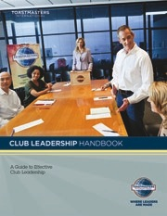
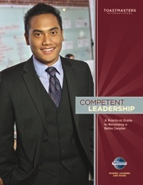
Resources & Links
District Leadership Handbook
http://www.toastmasters.org/Members/OfficerResources/DistrictLeaderResources.aspxDisting
Distinguished Club Program (DCP)
Club Leadership Handbook http://www.toastmasters.org/Members/OfficerResources/ClubOfficerResources.aspx
Contest Rulebook
http://www.toastmasters.org/2013rulebook
Rebuilding Clubs http://www.toastmasters.org/HowtoRebuildaToastmastersClub.aspx
TI Annual Membership Program
www.toastmasters.org/membershipcontests

Slide 13
Conclusion: Your next steps
Complete Club Officer Training
Deadline February 28, 2014
Plan Contest, set date & get the word to clubs!
Choose your officials
Read & know the rules…and contest order
Complete 2nd round club visit
Involve your clubs in contest planning – make it fun!
Review your SWOT
Know what it will take to be Distinguished
Next training date: Sat March 8, 2014
What will you accomplish between now & then?

Slide 14
Upcoming Topics for March: Finalizing Contests (Area & Division) Leading Clubs to Distinguished Finding New Leaders Finishing Strong

