Slide 1
AREA AND DIVISION GOVERNOR
TRAINING
January 26, 2013
Today’s Theme:
On the Road to Distinguished…
Do You Know Where You Are?
206CP

Slide 2
Session Agenda/Objectives
SWOT for clubs in Area
Officer Training
Area Contests & Judging Workshop
    Dates of Division Contests
Club Visits
Don’t Take This Personally!
    List of Resources
Q & A Panel
Notes:
SWOT – 15 min - Joan
Officer training – 10 minutes (what’s working, review plan from Nov/Dec) - Pat
Judging Workshop – 15 minutes – Roman or Sharon (I didn’t ask Roman)
Club Visits & Contest dates review – 5-10 minutes - Joan
Conflict Resolution “Don’t take this personally” – 15 minutes – Pat
Q & A Panel – 20 minutes

Slide 3
Session Objectives
  Where are you? (SWOT)
  Mid-year Club Officer Training Execution
  Contest Dates & Judging – Review New Rulebook
  Conflict Resolution for Leaders
    “Don’t take this personally”
  2nd Round Club Visits
  Q & A Panel

Slide 4
Strategies for Mid-Year Club Officer Training
Know Your Resources
Work with other Area Governors in the division to implement strategies
Communicate training dates & expectations to clubs early.
Help them be successful
Cover the DCP – be creative & informative!
Keep session to about 1 hour
Ask clubs what they need – help them get to Distinguished!

Slide 5
Topics to Cover at Mid-Year Club Officer Training Sessions
Review Clubs DCP
Membership Building –TI Program
Educational Completions and Recognize Achievement for Clubs
District Calendar/Resources/TI & District Web site

Slide 6
Contest Judging
Know the rules for 2013
  & the updates from previous years notated by the in rule book
Read the rule book in advance of contest:
  Area & Division Governors
  Contest Toastmaster
  Chief Judge & all judges, timers, counters
  Contestants

Slide 7
Spring 2013 Division Contests
Prairie Saturday April 6
Western Monday April 8
Central Tuesday April 9
Eastern Thursday April 11
International Saturday April 13
Frontier Tuesday April 16
Northern Wednesday April 17
Southern Saturday April 20
Metro Wednesday April 24
Rivers Thursday April 25
District 6 Spring Convention – May 3-4

Slide 8
Club Visits
Review form in advance, compare to round 1
Encourage & recognize club officers & members
Encourage goal completion towards DCP
  Educational awards & membership growth
Look for new leaders
  Give names of potential Area Governors to Sharon Rollefson
Visit deadline is April 30 (posted by May 31)

Slide 9
Don’t take this personally!
Conflict Resolution for Leaders

Slide 10
Types of Conflict
Contentious Personalities
Misunderstanding
Issues
Style of Leadership

Slide 11

Methods for Resolving Conflict
Ignore it
Smooth it over
Force
Compromise
Collaboration

Slide 12
Facilitate Collaboration
Find the root cause
Allow all parties to speak
Suspend your emotions
Keep a respectful, empathetic and caring attitude towards everyone
Stay away from blame & accusations

Slide 13

Facilitate Collaboration
Encourage all to listen
Identify areas of disagreement
Identify areas of agreement
Search for solutions
Reach a consensus

Slide 14
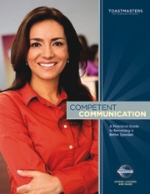
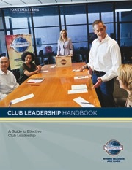
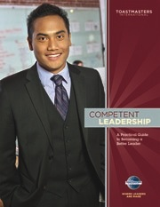
Resources
  Toastmasters International
  TI Reports
  Distinguished Club Program (DCP)
  Club Officer Manual
  Contest Rulebook - link
  District Leadership Manual
  Leadership Excellence – Conflict Resolution
  Rebuilding Clubs
  TI Annual Membership Program
    www.toastmasters.org/membershipcontests

Slide 15
Conclusion: Your next steps
Execute 2nd Round of Club Officer Training
  Deadline February 28, 2013
Set Spring Contest date – get the word to clubs! Choose your officials
  Read & know the rules…and contest order
Schedule 2nd round club visit
  Involve your clubs in contest planning – make it fun!
Review your SWOT…Know what it will take to be Distinguished
Next District Training date: Sat March 9, 2013
  What will you accomplish between now & then?

Slide 16
Stump the Panel!
Ask any question…

