Slide 1
AREA AND DIVISION GOVERNOR TRAINING November 3, 2012
Today’s Theme: Know Your Numbers
206CP

Slide 2
Session Agenda
Quality Clubs
Strategies for mid-year club officer training (December – February)

Slide 3
Session Objectives
Know your numbers (SWOT)
Define club quality and a positive member experience
Examine what contributes to club quality and a positive member experience
Propose solutions for club challenges
Mid-year Club Officer Training Planning

Slide 4
Club Quality

Slide 5
Club Quality: Member Experience
Quality club environments lead to membership retention
Great meetings make clubs successful
Quality club meetings are well planned, well attended, organized, and fun
Members improve their communication and leadership skills
Quality clubs give members an opportunity to learn and grow

Slide 6
Club Quality: Membership, Education, and Leadership
Membership
How do clubs attract and retain members?
The Toastmasters education program
How can the club help its members meet their personal and professional education goals?
Club leadership
How do club officers affect club quality and the member experience?

Slide 7
Strategies for Mid-Year Club Officer Training
Know Your Resources
Work with other Area Governors in the division to implement strategies

Slide 8
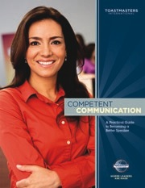
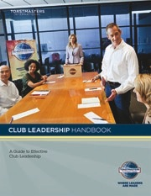
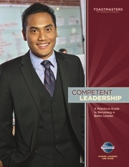
Resources
TI Reports
Rebuilding Clubs
SWOT
DCP
Club Coach Program
www.toastmasters.org/Members/OfficerResources/DistrictLeaderResources/DistrictTraining
TI Annual Membership Program
www.toastmasters.org/membershipcontests

Slide 9
Plan for Successful Mid-Year Club Officer Training
Work Together in Division Leadership Teams for plan to implement strategies
Top 3-4 topics for mid-year training
Who will cover the topic?
Communicate training dates & expectations to clubs early (at least 2-3 weeks in advance)
Keep session to under 1 hour
Ask clubs what they need – help them with resources
Notes:
Teams work together & then one area governor gives report for 3 topics to be covered at training:
Review Clubs DCP Progress & adjust as necessary, Membership Building (TI Program that includes Talk UP TM, Beat the Clock, Sponsor members), Educational Completions (entering early at TI) and Recognition.

Slide 10
Topics to Cover at Mid-Year Club Officer Training Sessions
Review Clubs DCP
Membership Building –TI
Educational Completions and Recognize Achievement for clubs
District Calendar/Resources/TI & District Web site

Slide 11
Review of today’s topics
Know the status of your area – know your numbers & your SWOT
Examine what contributes to club quality and a positive member experience
Plan for 2nd Round of Club Officer Mid-year training now

Slide 12
Conclusion: Closing Remarks
Know your numbers – you improve what
you measure
SWOT: Area governors discuss how to help clubs with division governors.
Support clubs in creating a positive member experience.
Prepare for 2nd Round of Club Officer Training Now (decide dates by early December & communicate to clubs early & often!)
Division Governors to send Pat & Joan the second round club officer training topics by end of November.

