Slide 1
It’s All About You!
Notes:
Congratulations on your election to secretary!
In this position, you facilitate the smooth operation of the club by maintaining vital records.
MAIN POINT TODAY – clubs are required to maintain writted records.
You maintain the club’s written history so that future club
officers will have this important information.

Slide 2
Key Goals
EXPLORE the idea that every Toastmaster is “in” a Public Relations position
UNDERSTAND the Public Relations goals of Toastmasters
APPRECIATE the Toastmasters Brand Promise and your role in protecting it
TAKE AWAY actionable ideas to help your club achieve its goals

Slide 3
EXPLORE the idea that every Toastmaster is “in” a Public Relations position

Slide 4
Moments of Truth
When anyone comes in contact with any aspect of Toastmasters, the person forms an impression.
These decisive times when initial impressions are formed are known as Moments of Truth.
3

Slide 5
www.toastmasters.org/resources/moments-of-truth
3

Slide 6
UNDERSTAND the Public Relations goals of Toastmasters

Slide 7
What is Public Relations?

Slide 8
For whom?

Slide 9
What is the club mission?
We provide a supportive and positive learning experience in which members are empowered to develop communication and leadership skills, resulting in greater self-confidence and personal growth.
How does every Toastmaster help the club achieve its mission?
Notes:
ASK
▪ What is the essence of the secretary role?
▪ Maintaining and managing club records, files, and
correspondence
▪ Ensuring the club is organized and up to date
ASK
▪ What are the responsibilities of the secretary?
* Take notes
▪ Maintain files
▪ Report new officers
▪ Base Camp Manager
TELL secretaries they can find information about their role in the Club
Leadership Handbook (Item 1310). LINK:

Slide 10
APPRECIATE the Toastmasters Brand Promise and your role in protecting it

Slide 11
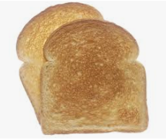
Toastmasters!!!!
What’s the BIG deal about BRAND???

Slide 13
What’s a Brand Manual?

Slide 14
If that’s too much…

Slide 15
Pretty, Pretty PLEASE…

Slide 17
How to apply our colors…
Branding is FUN!

Slide 18
How to apply our colors…
Branding is FUN!

Slide 19
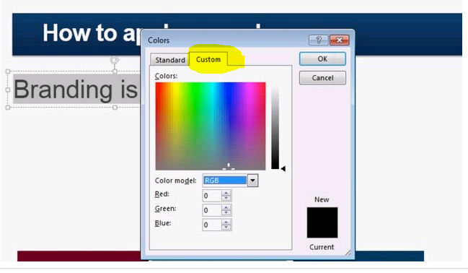
How to apply our colors…
Branding is FUN!

Slide 20
I need my space

Slide 22
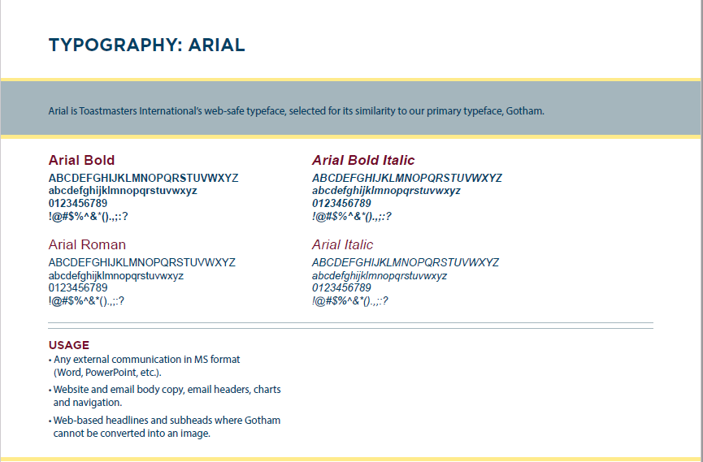

Slide 23
Let the World Know
https://www.toastmasters.org/resources/let-the-world-know-publicity-and-promotion-handbook

Slide 24
TI -- Leadership Central

Slide 25
TI -- Resources

Slide 26
TAKE AWAY actionable ideas to help your club achieve its goals

Slide 27
Thanks and have a great year!
Kari.Barlas@d6tm.org

