Slide 1
Marketing, Membership, and Open Houses
January 12, 2018

Slide 2
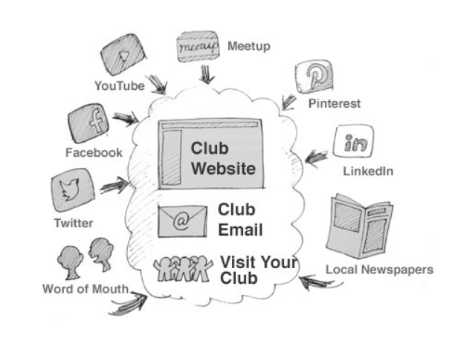
Marketing
Start with a Quality Meeting
Find your Movers and Shakers
Get the Word Out
Signs / Posters
Local Media
Facebook, Meetup, Social Media
Word of Mouth
District Calendar
Flyers and Marketing material

Slide 3
Corporate Club Marketing
Identify how your club can support the company
Human Resources contact
New Hires
Employee Development Programs
Invite Management to give a presentation
Company Newsletters, bulletin boards, inhouse social media.

Slide 4
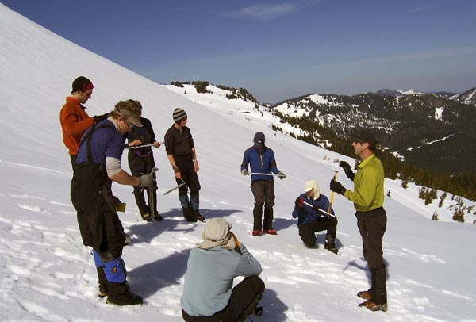
Community Club Marketing
Visit Chamber of Commerce
Newsletter
List of businesses nearby
Public Library
Coffee Shops
Local Newspaper
Gyms
Local Businesses

Slide 5
Membership Building
Start with a Quality Meeting
If you’re not growing, you’re shrinking
Make sure you are taking care of existing members
Plan a membership event
Identify membership opportunities
Corporate Club : Employee Based
Community Club: Look to nearby opportunities.
Get the word out: see marketing

Slide 6
Membership Building
Start with a Quality Meeting
If you’re not growing, you’re shrinking
Make sure you are taking care of existing members
Plan a membership event
Identify membership opportunities
Corporate Club : Employee Based
Community Club: Look to nearby opportunities.
Get the word out: see marketing

Slide 7
Where we are
Where we want to be
How do we get there
Implement the plan

Slide 8
Taking Care of Existing Members
Educational Presentation at every meeting
High Quality Mentorship Programs
Ask what the club can do for the member
Plan meeting themes around member needs
Proactive VP Education
Schedule Meeting Roles in advance
Remind members to bring manuals
Plan Social events outside of meeting location
Celebrate Achievements

Slide 9
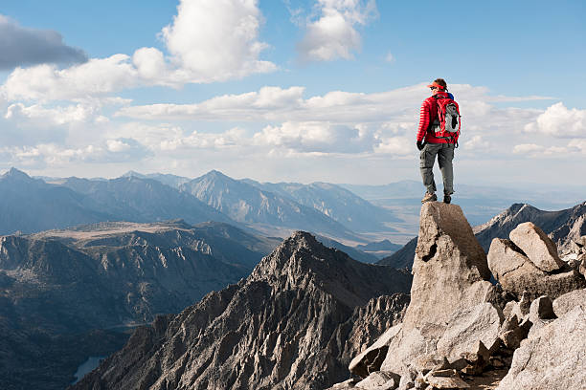
Planning A Special Event
Open House
Build Meetings specific to your members needs
Job interview boot camp
Speech-a-thon
Club Contest preparation meeting
Effective Evaluations
Judging
Extemporaneous Speaking

Slide 10
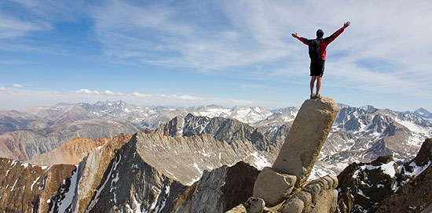
Celebrate Achievements
Hand out certificates in meeting
Pins, Ribbons
Half CC Certificate
End of year awards ceremony
Most Memorable Speech
Wizard of Ahs.
True Table Topics Master

Slide 11
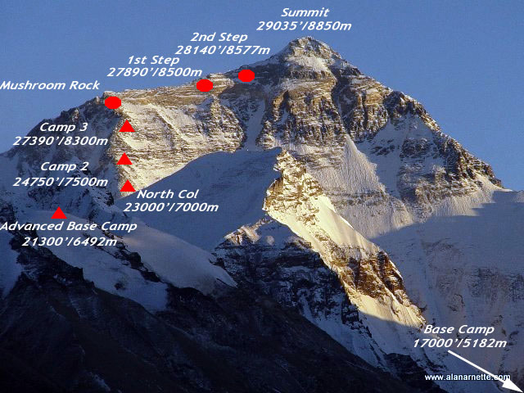
Plan a Membership Event
Make it a competition between members
Have a set period of time
Set a Goal
Have Quality meetings planned.
Membership Booth at Community Event
Plan a happy hour

Slide 12
Open Houses
Start with a Quality Meeting
Plan a special event
Invite a Guest Speaker
Provide refreshments
Invite Guests
Notify Area Director
Publish on District Calendar
Create a flyer
Publicize on Social Media before and after
Take Pictures

Slide 13
Questions to ask Guests
What are you looking for?
What do you already know about Toastmasters?
What do you hope to gain?
Would you like information on how to join?
Did you enjoy the meeting?
How could it have been better?

Slide 14
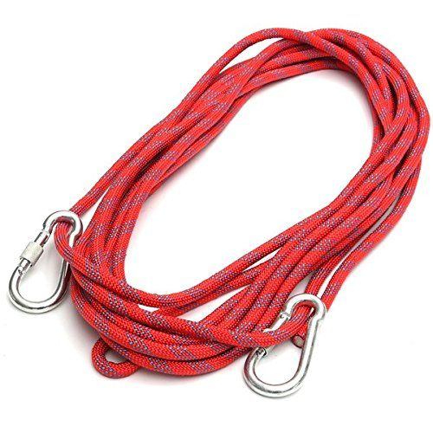
Questions to ask New Members
What do you hope to achieve?
When would you like to schedule your orientation with your Mentor?
Would you like to give your Ice Breaker Speech at the next meeting?
Is there anyone else who you think would enjoy this with you?

