Slide 1
Pathways Base Camp
Jamie Ogborn, DTM

Slide 2
Notes:
With Pathways we need to train all new members on how to login at Toastmasters International.
They will need their Member ID (which was emailed to them when they first joined, and is in the club roster in Club Central. Note that only club officers can view the roster.)

Slide 3
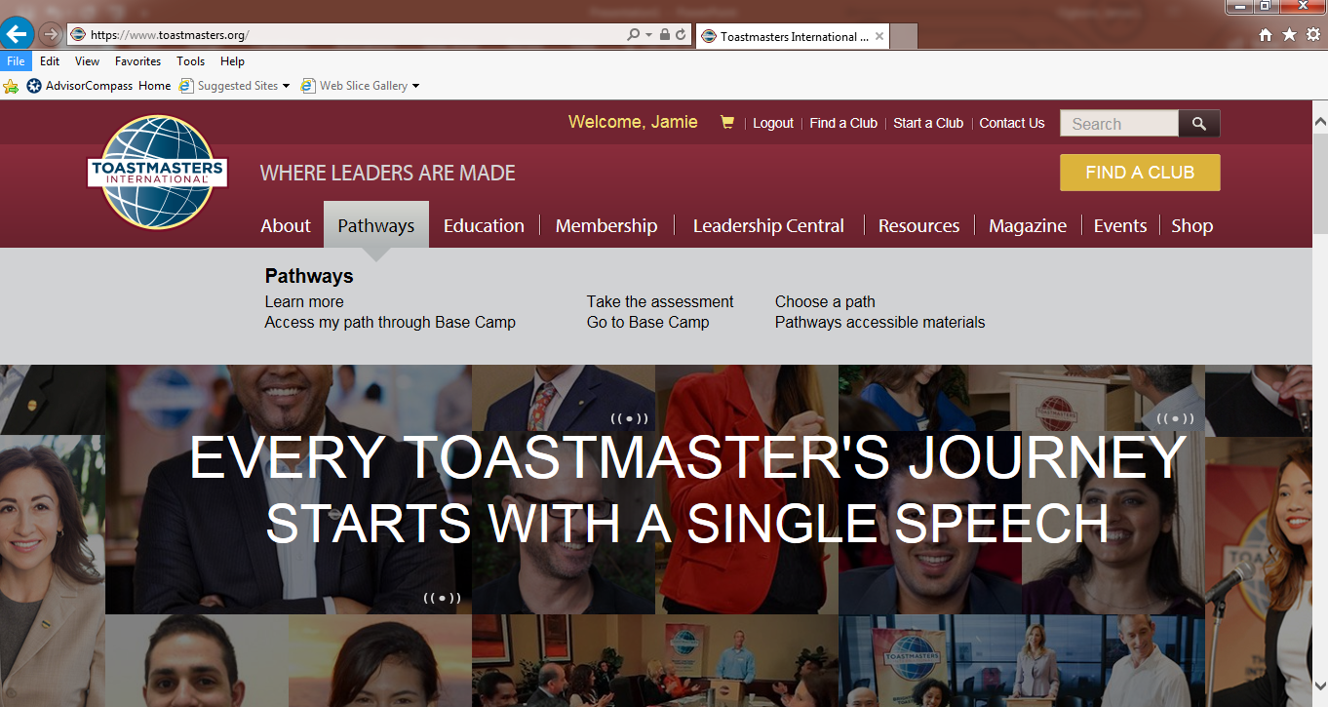
Notes:
When logged in they will want to go to Pathways- Go to Base Camp.

Slide 4
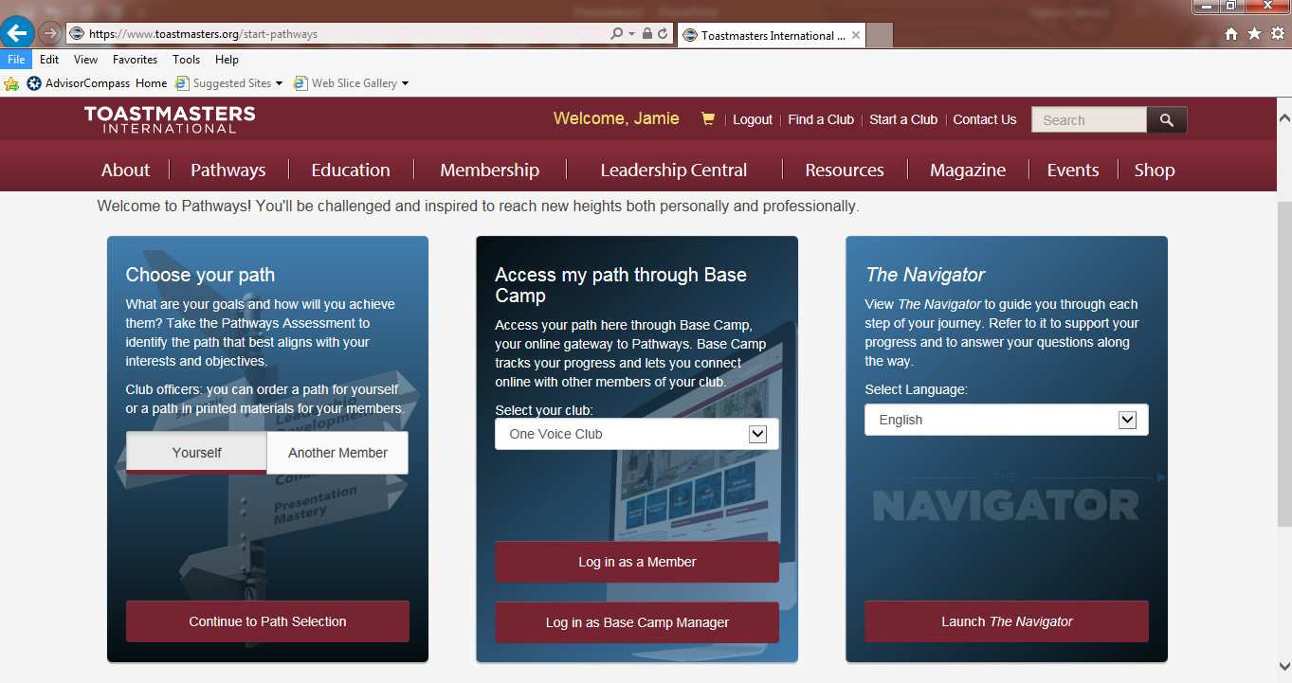
Notes:
If they haven’t selected a path yet they will use the box to the left. (Note that club members can complete this on behalf of another member if any of your club members needs assistance. All club mentors should be trained on this.)
If they have selected a path they will look at the middle section.
Note that if they have multiple clubs there will be a drop down to select the club they want to be under for the level they are working on.
Also note that there is a 2nd red button on the bottom for base camp managers.

Slide 5
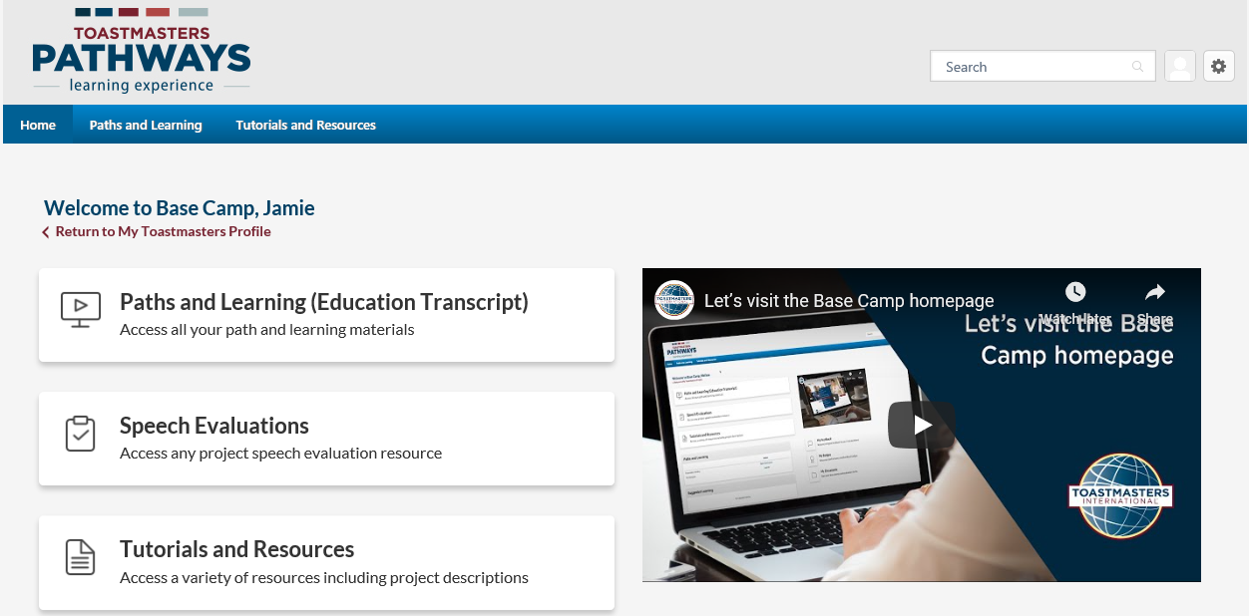
Notes:
When you are in Pathways you have three options and a video tutorial.
We will start with the first button.

Slide 6
Paths and Learning
Notes:
This will open up any Paths that you are enrolled for and any projects that you were working on.
You will click on open curriculum to get into the projects.

Slide 7
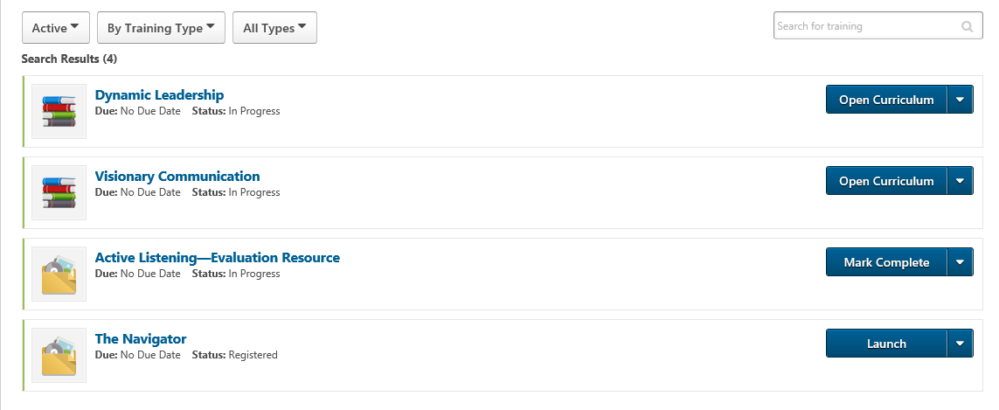
Notes:
Here is view of what it looked like for me when I scrolled down.

Slide 8
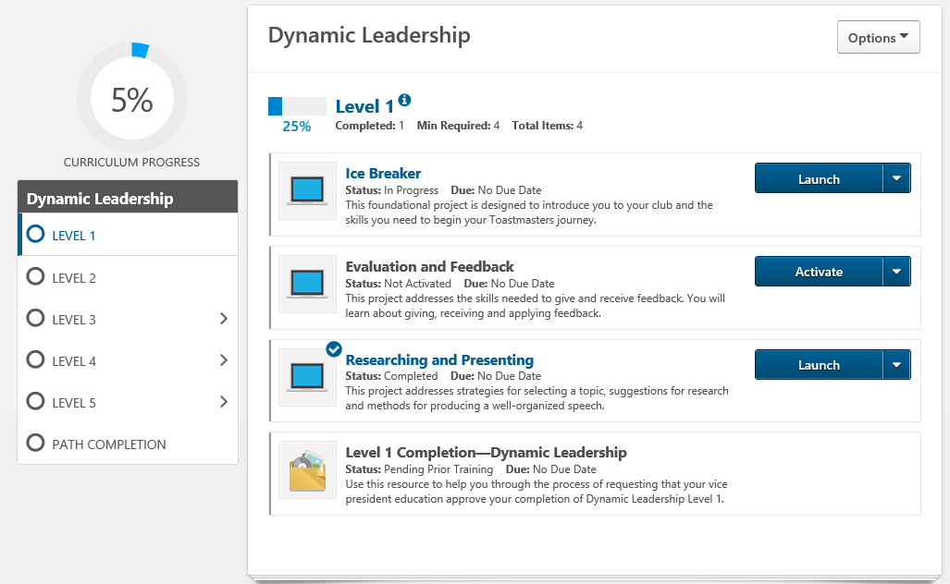
Notes:
You’ll select the project that you want to work on and hit launch.

Slide 9
Notes:
Each project starts with a navigation page. You can click the arrows on either side to go forward or back or click on the drop down at the bottom to select a specific page.

Slide 10
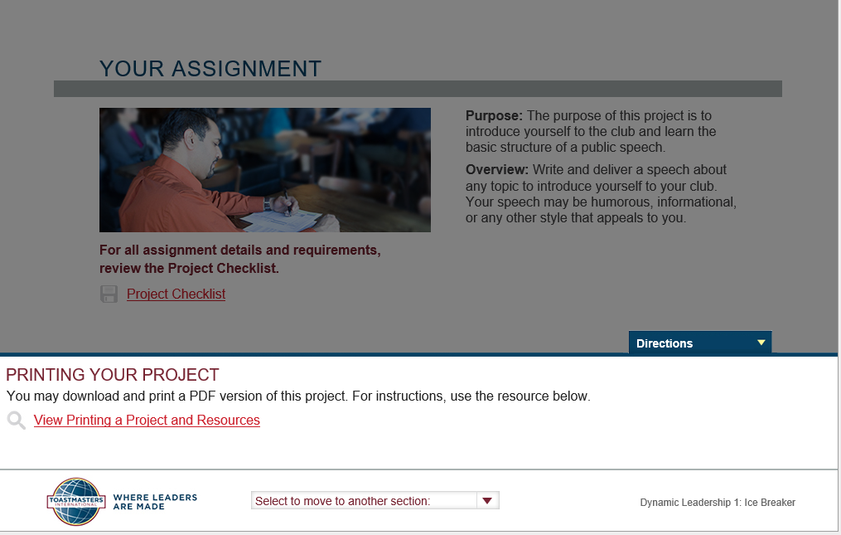
Notes:
Every project also has the option to view and print the project and resources for members that want a printed copy, but didn’t want to pay for it all in print.
Note that for those that just want the evaluation page there will be another link that just has the evaluation piece.

Slide 11
Notes:
At the beginning of every project there will be a pre assessment, then you will have the project resources and instructions.
At the end you will do an after assessment and hit submit in order to get to this screen.
Note that there is no requirement to upload your written evaluation. You can upload it and I’ll show you where later, but it is not required.

Slide 12
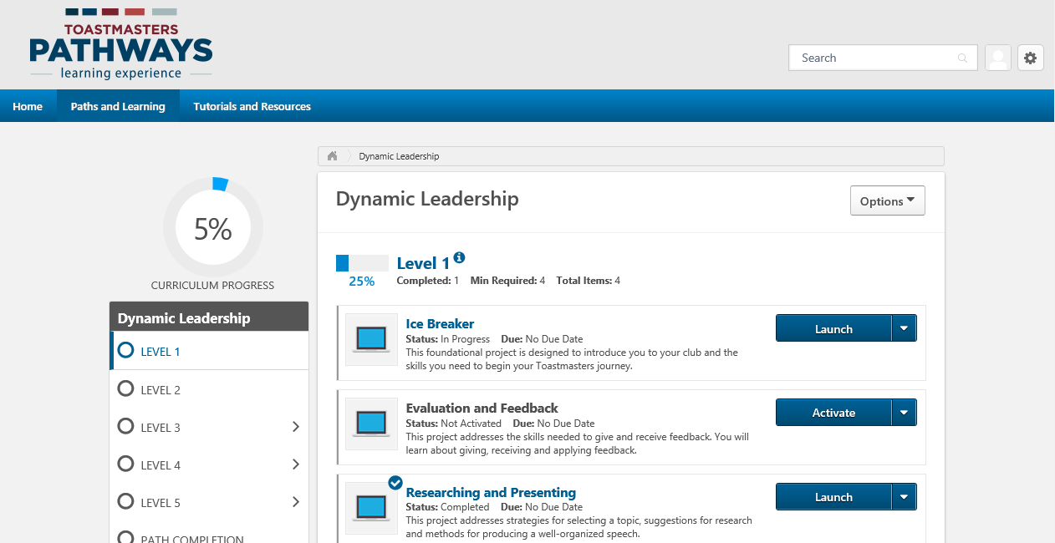
After you have completed a project you will close out of this tab.
This was a pop up, therefore the next tab you will see is curriculum tab
Notes:
When you’re done you’ll go back to the Paths and Learning Page.

Slide 13
Notes:
You can hover over the home on the upper left then click on the home that appears in the drop down to get back to this page.
Next we will look at speech evaluations.

Slide 14
Speech Evaluations
Notes:
When you first get in you won’t see the evaluations, you’ll see a page like this.
Scroll down.

Slide 15
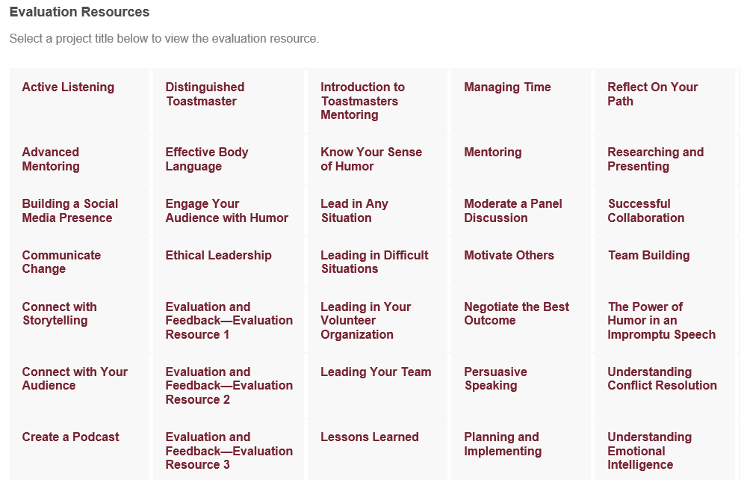
Notes:
You’ll see evaluation sheets for all of the projects in Pathways in Alphabetical order.
You can pull the appropriate one up if you are evaluating another member, but I highly recommend the speaker pull up their evaluation and send it to anyone that they want a written evaluation from.

Slide 16
Notes:
After going back home the last option is Tutorials and Resources.

Slide 17
Tutorials and Resources
Notes:
This has several short videos to help with anything in Pathways that you are looking for assistance on.

Slide 18
Notes:
If you are on the home page and scroll down…

Slide 19
My Feedback or My Documents
Notes:
There are also some pieces on the right side that help you keep track of feedback and progress.
Click on My Feedback

Slide 20
Click on E-Portfolio
Notes:
When in My Feedback you can electronically send members a request to give feedback.
You can also click on e-portfolio.

Slide 21
Documents
Notes:
This is similar to my documents on you computer. It allows you to save any written evaluations (you can save it as a word document, PDF or take a picture of it. You can also save any speech information that you have.

Slide 22
Notes:
It gives you several folders to break it out if you wish.

Slide 23
Resources:
Basecamp Navigator
YouTube
Other Toastmasters
Your club President and VP of Education
Your area director
Toastmasters International
Toastmasters International Facebook Group

