Slide 1
How to be the Best Club President Ever?
Agenda Item | Duration
Set The Stage | 5-10 Min
7 Steps for Success | 35-40 Min
Best Practices | 5-10 Min
Q&A | 5 Min
Club President Education
Toastmasters Leadership Institute

Slide 2
You just became CEO
Step # | Objective | What it Means
1 | Know what you don't know | Spend first 30-60 days understanding everything about the company
2 | Find Your Feet | Talking to the board & stakeholders in coming up with what is expected of you
3 | Know where you stand & Where you need to be | Understanding where you stand & Adjust expectations if necessary
4 | Make an annual plan | Make an annual plan through consensus and commit to the board / investors
5 | Create Governance Committee | Set up governance process with Sales, Marketing, Operations and other function heads
6 | Monitor & Control | Intervene as needed to make the course correction
7 | Celebrate Success | Recognize & Reward Success

Slide 3
You just became CEO
Step #
Objective
What it Means
1
Know what you don't know
Spend first 30
-
60 days understanding
everything about the company
2
Find Your Feet
Talking to the board & stakeholders in
coming up with what is expected of you
3
Know where you stand & Where you
Understanding where you stand &
need to be
Adjust expectations if necessary
4
Make an annual plan
Make an annual plan through
consensus and commit to the board /
investors
5
Create Governance Committee
Set up governance process with Sales,
Marketing, Operations and other
function heads
6
Monitor & Control
Intervene as needed to make the
course correction
7
Celebrate Success
Recognize & Reward Success

Slide 4
You just became CEO
Objective | Real World CEO | TM Club President
1 - Know what you don't know | Spend first 30-60 days understanding everything about the company | Educate Yourself on Your Responsibilities – Club Officer Training (COT)

Slide 5
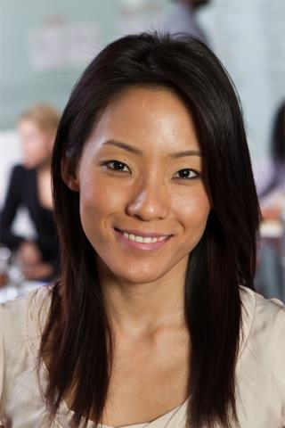
The Role - President

Slide 6
President Responsibilities
The Club Meeting
Outside the Club Meeting
The Executive Committee

Slide 7
The Club Meeting
Before Club Meetings
Upon Arrival at Club Meetings
During Club Meetings

Slide 8
Before Club Meetings
Ask VPE about special recognition or member inductions.
Plan the business portion of the meeting.
Review parliamentary procedure.

Slide 9
Upon Arrival at Club Meetings
Review the meeting agenda.
Greet guests and members.

Slide 10
During Club Meetings
Call the meeting to order.
Introduce guests.
Explain the meeting’s events.
Conduct the business portion of the meeting.
Provide information for next meeting.
Make any announcements.
Adjourn the meeting.

Slide 11
Outside the Club Meeting
Attend and vote at council meetings.
Attend and vote at the Annual Business Meeting.
Appoint and chair the audit committee.
Appoint the nominating committee.

Slide 12
Outside the Club Meeting
Receive official correspondence from World Headquarters.
Schedule and chair executive committee meetings.
Develop and improve club leadership.
Oversee Club administration.

Slide 13
Outside the Club Meeting
Advance club and member achievement.
Interact effectively with other organization levels.

Slide 14
The Executive Committee
Oversee the executive committee.
Ensure the executive committee completes its duties

Slide 15
Executive Committee Duties
Create a club budget.
Compete a Club Success Plan.
Strategize for success in the Distinguished Club Program.
Create and oversee other club committees as necessary.

Slide 16
Read the Fantastic Manual!

Slide 17
You just became CEO
Objective | Real World CEO | TM Club President
2 - Find Your Feet | Talking to the board & stakeholders in coming up with what is expected of you | Understand Distinguished Club Program (DCP)

Slide 18
5 of 10 – Distinguished
7 of 10 – Select Distinguished
9 of 10 – President’s Distinguished

Slide 19
You just became CEO
Objective | Real World CEO | TM Club President
3 - Know where you stand & Where you need to be | Understanding where you stand & Adjust expectations if necessary | Member Survey through Moments of Truth

Slide 20
Moments of Truth
Self-evaluation of the club in the following areas:
First Impressions
Membership Orientation
Fellowship, Variety, and Communication
Program Planning and Organization
Membership Strength
Achievement Recognition

Slide 21
You just became CEO
Objective | Real World CEO | TM Club President
4 - Make an annual plan | Make an annual plan through consensus and commit to the board / investors | Work with Club Executive Committee to create Club Success Plan

Slide 22
Club Success Plan
A planning tool for your team:
Who is on your team?
What are the club’s values?
What are the club’s principles?
What are the club’s potential obstacles?
How will the club’s officers work to overcome obstacles?
How will decisions be made?
What DCP goals will the club attain?

Slide 23
You just became CEO
Objective | Real World CEO | TM Club President
5 - Create Governance Mechanism | Set up governance process with Sales, Marketing, Operations and other function heads | Work with CEC to put monthly officer meeting schedule, agenda etc.

Slide 24
CEC Agenda
Reports from all officers
Club Officer List
Club Officer Training Status
Budgets
Membership Dues
Educational Awards
CSP & DCP
PR Plans
Club Needs (Stationary, branded Material etc)
Membership contests
Smedley Award
Talk Up Toastmasters!
Beat the Clock
Future Agenda Items
Speech Contests
TMOY
Accounts Audit
Annual Conference

Slide 25
You just became CEO
Objective | Real World CEO | TM Club President
6 - Monitor & Control | Intervene as needed to make the course correction | Track Performance using tools like dashboards, reports

Slide 26
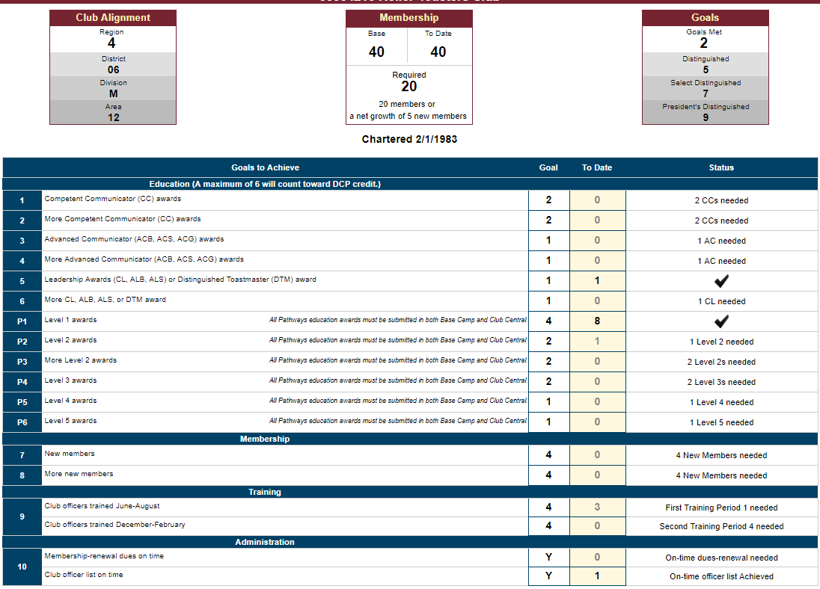
You just became CEO
Objective | Real World CEO | TM Club President
5 - Create Governance Mechanism | Set up governance process with Sales, Marketing, Operations and other function heads | Work with CEC to track Performance

Slide 27
You just became CEO
Objective | Real World CEO | TM Club President
7 – Celebrate Success | Recognize & Reward Success | Recognize Individual & Club Performance

Slide 28
Celebrate Success
Individual Success
Ice Breaker
Educational Achievements
Finishing a Path / DTM
Group Success
Open House Success Recognition for VP-PR & team
Membership Drive Success for VP-Membership & team
Club Success
Celebrate Milestones like Distinguished levels
Celebrate Membership awards
Special Events
Independence Day
Viewing party for International contest
Holiday Party (Summer / Winter)

Slide 29
Be the Best Club President Ever
Step # | Objective | Real-World CEO | TM Club President
1 | Know what you don't know | Spend first 30-60 days understanding everything about the company | Recognize Individual & Club Performance
2 | Find Your Feet | Talking to the board & stakeholders in coming up with what is expected of you | Understand Distinguished Club Program (DCP)
3 | Know where you stand & Where you need to be | Understanding where you stand & Adjust expectations if necessary | Member Survey through Moments of Truth
4 | Make an annual plan | Make an annual plan through consensus and commit to the board / investors | Work with Club Executive Committee to create Club Success Plan
5 | Create Governance Committee | Set up governance process with Sales, Marketing, Operations and other function heads | Work with CEC to put monthly officer meeting schedule, agenda etc.
6 | Monitor & Control | Intervene as needed to make the course correction | Track Performance using tools like dashboards, reports etc.
7 | Celebrate Success | Recognize & Reward Success | Recognize Individual & Club Performance

Slide 31
Best Practices Examples
Use member skills to create sub-groups like Social media Team
Lead the executive team and empower the members to lead their own area
Listen to member needs, preferences, and complaints
Reach out to other nearby clubs to hang out and interact with them
Don't do it all. Lead your team into action.
Remember you are the Leader of the team. You are not their boss
Set example with your actions and behavior consistently
Genuinely care about the members
Embrace change

Slide 32
Q&A

Slide 33
This concludes the session
Club Officer Training
Club President
Thank You So Much for Attending!!
Amit Maheshwari
Division Director – Division M
Toastmaster.Amitm@Gmail.com
763.234.7243

