Slide 1
The Leadership Excellence Series
Resolving Conflict

Slide 2
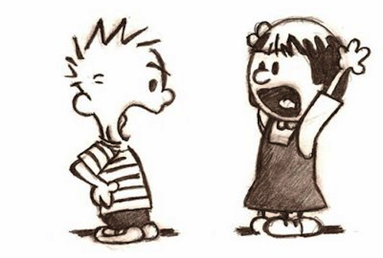
Definitions
Conflict is what you get when two or more people have differences,
real or perceived, that are not resolved.

Slide 3
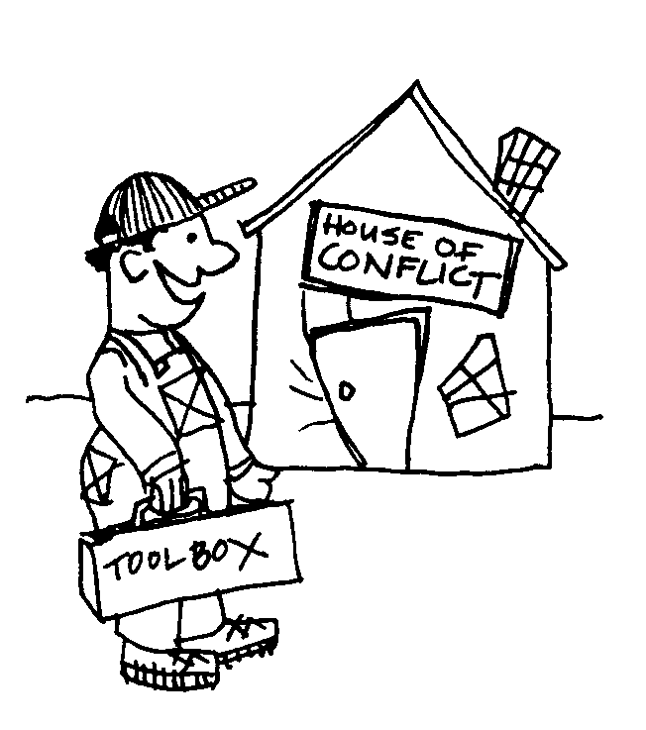
Definitions
Conflict resolution is what we do to identify and address conflict in a mature and respectful way.

Slide 4
Overview
Today we’ll be covering these 3 topics:
Resolving Conflict
Non Violent Communication
Effective Communication through Email

Slide 5
Causes of Conflict
1. Contentious Personalities
2. Misunderstanding
3. Issues
4. Styles of Leadership

Slide 6
Styles for Resolving Conflict
1. Accommodating Style
2. Avoiding Style
3. Collaboration Style
4. Competing Style
5. Compromising Style
Notes:
After this slide, take Conflict Management Assessment

Slide 7
Facilitate Collaboration
1. Find the root cause.
2. Allow all parties to speak.

Slide 8
A Word of Caution
A Word of Caution
Do not allow negative emotions to consume the parties involved.
Keep a respectful, empathetic, and caring attitude toward everyone.
Stay away from blame and accusations.

Slide 9
Facilitate Collaboration cont…
3. Encourage all parties to listen.
4. Identify areas of disagreement.
5. Identify areas of agreement.
6. Search for solutions.
7. Reach a consensus.
Notes:
After this slide, do Conflict role play

Slide 10
Non Violent Communication (NVC)

Slide 11
Non Violent Communication
NVC Process
The actions we observe that affect our well-being
How we feel in relation to what we observe
The needs, values, etc. that create our feelings
The actions we request in order to enrich our lives
By Marshall Rosenberg

Slide 12
Distinguishing Observations from Evaluations
Communication
1. Use of verb to be w/o indication that evaluator takes responsibility for evaluation
Example of observation with evaluation mixed in
You are too generous.
Example of observation separate from evaluation
When I see you give all your lunch money to others,
I think you are being too generous.

Slide 13
Distinguishing Observations from Evaluations
Communication
2. Use of verbs with evaluative connotations
Example of observation with evaluation mixed in
Doug procrastinates.
Example of observation separate from evaluation
Doug only studies for exams the night before.

Slide 14
Distinguishing Observations from Evaluations
Communication
3. Implication that one’s inferences about another person’s thoughts, feelings, intentions, or desires are only ones possible
Example of observation with evaluation mixed in
She won’t get her work in.
Example of observation separate from evaluation
I don’t think she’ll get her work in

Slide 15
Distinguishing Observations from Evaluations
Communication
4. Confusion of prediction with certainty
Example of observation with evaluation mixed in
If you don’t eat balanced meals, your health will be impaired.
Example of observation separate from evaluation
If you don’t eat balanced meals, I fear your health will be impaired.

Slide 16
Distinguishing Observations from Evaluations
Communication
5. Failure to be specific about referents
Example of observation with evaluation mixed in
People don’t take care of their property.
Example of observation separate from evaluation
I haven’t seen the family next door shovel the snow on their sidewalk.

Slide 17
Distinguishing Observations from Evaluations
Communication
6. Use of words denoting ability without indicating that an evaluation is being made
Example of observation with evaluation mixed in
Hank Smith is a poor soccer player.
Example of observation separate from evaluation
Hank Smith has not scored a goal in 20 games.

Slide 18
Distinguishing Observations from Evaluations
Communication
7. Use of adverbs and adjectives in ways that do not indicate an evaluation is being made
Example of observation with evaluation mixed in
Jim is ugly.
Example of observation separate from evaluation
Jim’s looks don’t appeal to me.

Slide 19
Email Blues

Slide 20
Effective Communication through Email
Not responding isn’t the same as ignoring
Find each team member’s preferred method of communication
A clear subject line, and one that indicates action, is more likely to get read
Have only one ask, or request, in most emails
Use bullet points/numbering of points in longer emails
Be sure you create value-added emails
Big 3

Slide 21
10 Email Rules
Respect Recipients’ Time
Short or Slow is Not Rude
Celebrate Clarity
Quash Open-Ended ?’s
Slash surplus cc’s
Save our in-boxes! http://emailcharter.org

Slide 22
10 Email Rules cont’ . . .
Tighten the Thread
Attack Attachments
Give these Gifts: EOM, NNTR
Cut Contentless Responses
Disconnect!
Save our in-boxes! http://emailcharter.org

Slide 23
Conclusion
A leader must use effective communication to resolve conflict!

