Slide 1
Secretary
Club Officer Training
Notes:
Congratulations on your election to secretary!
In this position, you facilitate the smooth operation of the club by maintaining vital records.
MAIN POINT TODAY – clubs are required to maintain writted records.
You maintain the club’s written history so that future club
officers will have this important information.

Slide 2
Agenda
Distinguished Club Program (DCP)
Moments of Truth (MoT)
Pathways
Club Officer Training -- Secretary

Slide 3
Distinguished Club Program

Slide 4
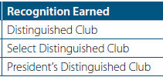
Goals and Recognition Levels
Education
Membership
Training
Administration

Slide 5
DCP Goals

Slide 6
www.toastmasters.org/resources/distinguished-club-program-and-club-success-plan-english

Slide 7
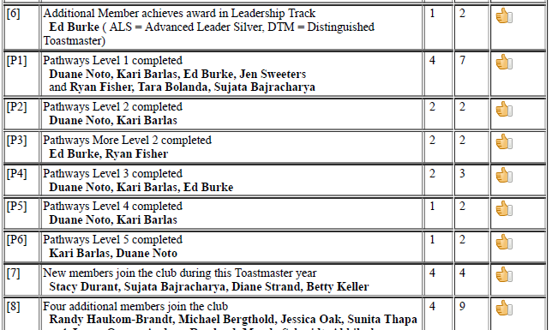
healthtoasters.toastmastersclubs.org/Club_Achievements.html

Slide 8
Moments of Truth

Slide 9
Moments of Truth
When anyone comes in contact with any aspect of Toastmasters, the person forms an impression.
These decisive times when initial impressions are formed are known as Moments of Truth.
3

Slide 10
www.toastmasters.org/resources/moments-of-truth
3

Slide 11
www.toastmasters.org//-/media/files/department-documents/club-documents/290b-moments-of-truth-chart.ashx
3

Slide 12
Pathways

Slide 13
http://d4tm.org/pathways/paths-and-projects.html#dynamic-leadership

Slide 14
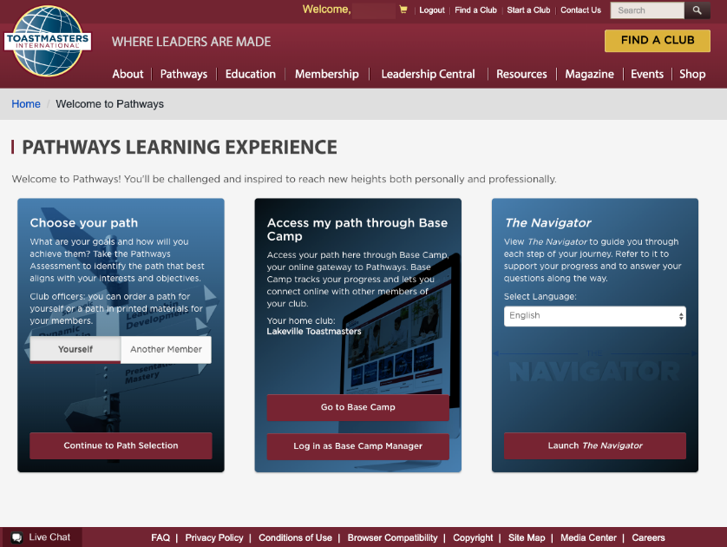

Slide 15
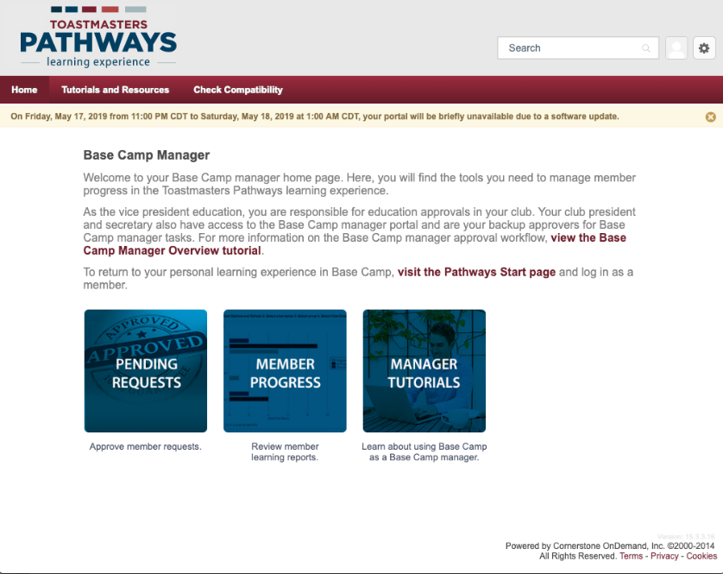

Slide 16
Secretary Training

Slide 17
Agenda
Secretary Role
Secretary Responsibilities
Secretary Resources

Slide 18
What is the club mission?
We provide a supportive and positive learning experience in which members are empowered to develop communication and leadership skills, resulting in greater self-confidence and personal growth.
How does the secretary help the club achieve its mission?
Notes:
ASK
▪ What is the essence of the secretary role?
▪ Maintaining and managing club records, files, and
correspondence
▪ Ensuring the club is organized and up to date
ASK
▪ What are the responsibilities of the secretary?
* Take notes
▪ Maintain files
▪ Report new officers
▪ Base Camp Manager
TELL secretaries they can find information about their role in the Club
Leadership Handbook (Item 1310). LINK:

Slide 19
What are the secretary’s responsibilities?
Record and post meeting minutes
Maintain files
Report new officers
Base Camp Manager
Notes:
ASK
▪ What is the essence of the secretary role?
▪ Maintaining and managing club records, files, and
correspondence
▪ Ensuring the club is organized and up to date
ASK
▪ What are the responsibilities of the secretary?
* Take notes
▪ Maintain files
▪ Report new officers
▪ Base Camp Manager
TELL secretaries they can find information about their role in the Club
Leadership Handbook (Item 1310). LINK:

Slide 20
Meeting Minutes
Club name
Meeting date
Type of meeting (club/executive)
Meeting location
Attendees
Notes:
ASK
▪ What is the essence of the secretary role?
▪ Maintaining and managing club records, files, and
correspondence
▪ Ensuring the club is organized and up to date
ASK
▪ What are the responsibilities of the secretary?
* Take notes
▪ Maintain files
▪ Report new officers
▪ Base Camp Manager
TELL secretaries they can find information about their role in the Club
Leadership Handbook (Item 1310). LINK:

Slide 21
HealthToasters Template

Slide 22
HealthToasters Tracker

Slide 23
Maintain Files
Materials Length of time
Addendum of Standard Club Options Always
Membership applications Always
Club policies Always
Club charter Always
Distinguished Club Performance Reports Always
Meeting Minutes and attendance records Always
Legal, controversial or important correspondence Always
Club rosters Always
501c3 Club Employer ID and Number EIN Always
Cancelled Checks 7 Years
Bank Statements & Financial Statements 7 Years
Journals & Audits 7 Years
Internal Reports & Correspondence 3 Years

Slide 24
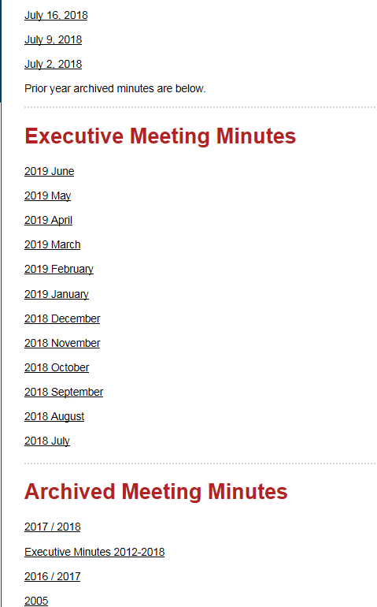
healthtoasters.toastmastersclubs.org/Meeting_Minutes.html

Slide 26
Club Proxy
Vote at international business meetings.
http://www.d6tm.org/designating-club-proxy/

Slide 27
Club Leadership Handbook
https://www.toastmasters.org/-/media/files/department-documents/translations/clh-translations/1310-club-leadership-handbook.ashx

Slide 28
Thanks and have a great year!
Kari.Barlas@d6tm.org

