Slide 1
Self-Motivation and You
DEC Meeting, Saturday, March 12, 2016
Ben Smith, DTM

Slide 2
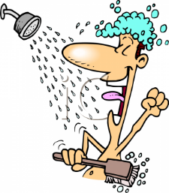
“People often say that motivation doesn’t last. Well, neither does bathing-that’s why we recommend it daily.”
Zig Ziglar

Slide 4
March DEC Attendees-Homework Opportunity
Hello Leaders!
Please fill out the attached document and return to me (Ben) at:
bensmithtm@gmail.com
Regards,
Ben Smith, DTM

Slide 5
SMART Goal Setting
Specific
Measurable
Attainable
Relevant
Timely

Slide 6
District Recognition Program
Distinguished Area Program
Distinguished Division Program

Slide 7
Zig Ziglar’s Timeless Guide to Motivation
1 Keep the motivation up
A. Start your day spending 3 minutes remembering your successes
B. Make a list of upsides for the task at hand

Slide 8
Zig Ziglar’s Timeless Guide to Motivation
2 Failure is not permanent
3 Learn what you can from your low points
4 Look at your world and the people in it through an open and positive lens
5 Get the ball rolling today

Slide 10
Conclusion
Clear Communication
SMART Goals
Motivation & Bathing don’t last, perform daily
Start with Why to find Inspiration

