Slide 2
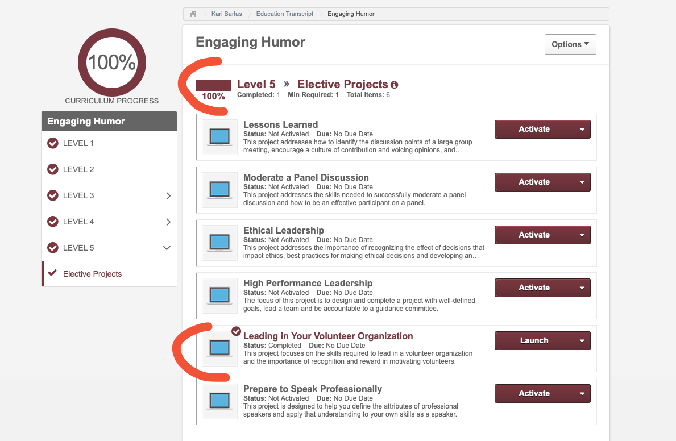

Slide 3
Leader
Group
Member
Group
Succession
Planning

Slide 4
Most Important Takeaway
In a volunteer organization, the people you lead follow because they choose to follow.

Slide 5
Leading VOLUNTEERS
Volunteering is a choice.
Leaders in a volunteer organization cannot force members to contribute.
Yet…
We are dependent on members to reach our goals.
The challenge for leaders is making sure members want to engage and contribute.

Slide 6
Leading Volunteers SUCCESSFULLY
What are the unique leadership skills required?
How can you motivate volunteers?
What type of environment fosters success?
People join an organization because they believe in the vision. They stay because of what they gain. Leaders must provide value.

Slide 7
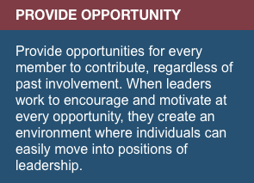
Developing Leadership Skills
Maintain a “servant leader” philosophy
We put the needs of the members first and help them develop and perform as highly as possible.
Model behavior
Leaders with a high level of commitment will encourage the same in members of their teams.
Provide a sense of belonging
Members contribute because they have a desire to be part of something larger than themselves.

Slide 8
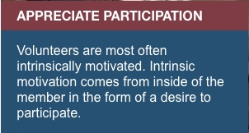
Motivating Volunteers
Respect
When members feel respected, they engage at a higher level.
Encourage member participation
Developing a sense of community motivates and inspires.
Acknowledge and reward member contributions
Successful members become successful leaders.

Slide 9
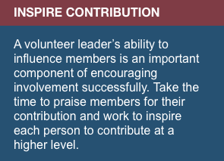
Setting the Tone
Lead with integrity
Building trust requires a combination of competency, integrity, and communication.
Identify “what’s in it for them”
Combine a member’s potential for growth with opportunities for them to experience joy.
Recognize potential
Identify individuals most likely to move from the member group to the leader group

Slide 10
Succession
Planning
Is VITAL

Slide 13
THANK YOU Ravi, Susan, Deb and the entire 2019-20 Leadership Team We appreciate you and all you’ve done for District 6!

Slide 14
