Slide 1
Toastmasters
District 6 Training
March 10, 2012

Slide 2
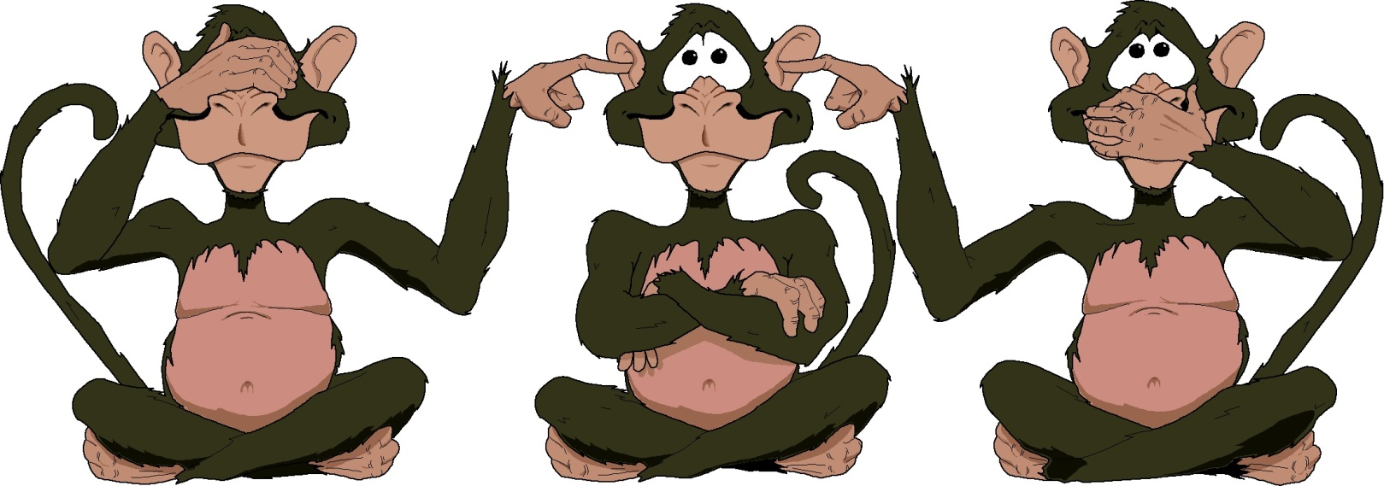
See No Evil, Hear No Evil, Speak No Evil

Slide 3
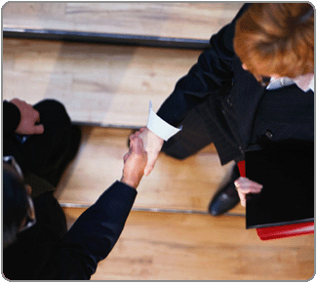
Club Visits
2nd round Jan1- April 30
Review Club DCP
Their goals
Progress in DCP
Are they striving to be Distinguished?
Membership building
DUES! Due by April 1st… No Fooling!

Slide 4
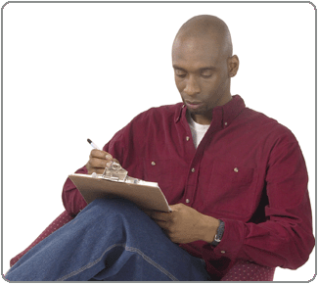
Club Visits
Today is March 10th…..51 days left to complete your visits
Your visit is not completed until you submit your online Area Governor Visit Report
Reports due May 31
Copy of visit report automatically sent to district leaders and club president.

Slide 5
Speech Contest
Contest
Table Topics
International, must have completed 6 Speeches in Competent Communicator manual
Trophies/Awards
Eligibility forms

Slide 6
Speech Contest
Contest Roles:
Chair
Toastmaster
Chief Judge
Judges
Timers
Ballot counters
Sergeant at Arms

Slide 7
Toastmaster of the year
Club TMOY
Due to AG by May 31
Area TMOY
Due to DG by June 15
Notify winner by June 30
Division TMOY
Due to District Governor by June 22
District TMOY announced at TELI in July

Slide 8
Transition
Identify prospective future leaders
Talk about leadership opportunities
Club officer list due to TI by June 30
Remember officer Training begins June 1 for new officers

Slide 9
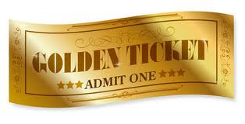
Golden Ticket
What your club needs to do:
Between Feb 1st & Feb 29th hang or distribute fliers or posters promoting your club, a club open house or special event.
Take a note of the date the poster went up, who hung the poster and where the poster was placed.
Send this list to your Area Governor by March 1, 2012.
Each Area Governor has two Golden Tickets that will be given to the club in his/her area that hangs the most posters.

Slide 10
Your Trainers
Jim Miller
toast9893@aol.com
952-890-7547
Margaret Brunner
toastmastermargaret@hotmail.com
651-633-2587

