Slide 1
Train the Trainer
Welcome Leaders!
Tools for Planning and Executing
Effective Club Officer Training
Toastmasters International Resource: Training Club Leaders
https://www.toastmasters.org/Resources/Resource-Library?c=%7b5DDAB023-91F8-40E5-898C-EC02074AA20A%7d&page=3

Slide 2
Objectives
Understand requirements for training club officers
Learn expectations for Round 1 & Round 2 Training Sessions
Learn how to choose trainers and engage them in planning.
Learn about a variety of training techniques
Planning and communicating Club Officer Training sessions to your clubs
Notes:
As a Toastmaster, we have been trained to inform, influence and inspire our audience. Trainers aim to transfer knowledge and skills through training.

Slide 3
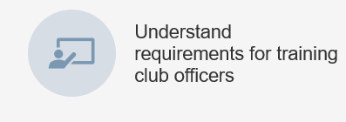
Training Club Officers
Two training sessions per year:
Round 1: June 1- Aug 31
Round 2: Dec 1 – Feb 28
Minimum of 4 Club Officers trained each session for training credit

Slide 4
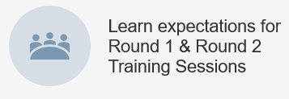
Round 1 Club Officer Training Sessions Download materials: https://www.toastmasters.org/Resources/Resource-Library?c=%7b5DDAB023-91F8-40E5-898C-EC02074AA20A%7d https://www.toastmasters.org/leadership-central/club-officer-tools/club-officer-tutorials
Minimum for COT credit is top two sessions – plan for 2-hour sessions
Creating a Quality Club – required session
~ 1 hour
This training teaches club officers about the importance of the member experience, the Toastmasters brand, Moments of Truth and the Distinguished Club Program.
Club Officer Breakouts – required session
~ 1 hour
Club officers learn about their role within the club. Then, they identify the responsibilities of their role within club and club executive committee meetings. To conclude, club officers find specific resources to help them fulfill their responsibilities.
Leading the Club to Success - optional
~ 1 hour
The purpose of this session is to teach club officers the skills they need to lead their club to goal achievement.
Building a Healthy Team - optional
~ 1 hour.
This training teaches club officers the traits of a healthy team, how to identify behavioral styles and how to build trust.
Membership Building “Finding New Members for your Club”
https://www.toastmasters.org/resources/finding-new-members-for-your-club
Pathways – Overview and more! https://www.toastmasters.org/pathways-overview

Slide 5
Round 2 Club Officer Training Download materials: https://www.toastmasters.org/Resources/Resource-Library?c=%7b5DDAB023-91F8-40E5-898C-EC02074AA20A%7d
Building on Achievement for Continued Success
This training has club officers reflect on their clubs’ challenges and opportunities for Moments of Truth and their Club Success Plan.
Enhancing Evaluations
This training teaches club officers the importance of quality feedback and using evaluation criteria based on objectives from manuals, as well as providing steps to effective coaching in an evaluation.
Club Officer Breakouts
Club officers learn about their role within the club. Then, they identify the responsibilities of their role within club and club executive committee meetings. To conclude, club officers find specific resources to help them fulfill their responsibilities.

Slide 6
Round 2 Club Officer Training
Benefits:
Training for Clubs that plan for or experience mid-term turnover of officers
Club officers have an opportunity to discuss any problems they may be having
District officers have the opportunity to follow up with performance challenges.
Club officers have the opportunity to meet with officers of other clubs and share best practices for improving their own clubs.
When building the curriculum for this second training, be sure to provide opportunities for club officers to discuss problems and network with other officers.

Slide 7
Select the Training Format
Traditional
Typically delivered by Area and Division Directors
Planning is required for sessions & training activities
Suitable for make-up training sessions
Toastmasters Leadership Institute (TLI)
Multiple presenters with larger audiences, larger facility
Great way to have concurrent sessions
Club Officers can choose electives
Can supplement TI programs with other sessions
Schedule offers more flexibility
One to two trainers train all club officers as a group, session length 3-4 hours
Advance planning required

Slide 8
Choosing Trainers
Who your trainers are is just as important as the training curriculum.
You want trainers who are:
Experienced. Ideally, trainers should have outstanding presentation skills and some experience in training.
Knowledgeable. Trainers should have special skills or expertise in some area, such as an accountant who has served as club treasurer or a past club president who led the club to President’s Distinguished Club.
Entertaining & positive!
Committed to using the Toastmasters International training materials.
Able to personalize the training and engage the audience
Past District Officers, Past Club Officers

Slide 9
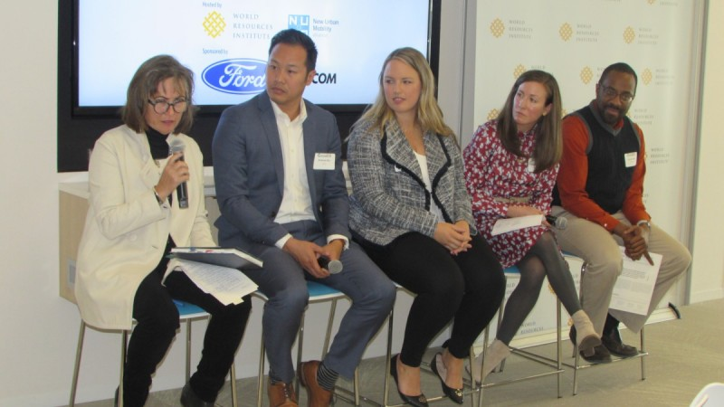
Trainer Techniques
Be Organized and on time
Engage them right away – set a positive tone
Use learning objectives – what can the learner expect to learn?
Check learning often – ask them if they got what they needed
Choose a variety of training techniques that engage participants
Create participatory learning situations – hands on, small group break outs, table topics
Use a variety of presentation styles, media, exercises and activities to keep interest
Change pace/activity every 30 minutes
Change location of seating arrangements if possible
Use examples that participants can relate to their jobs/club/situation
Encourage participants to contribute their experiences, successes, ideas
Notes:
Stop & ask: Share your ideas for training techniques and tools that you thought were especially good, interesting, fun and engaging

Slide 10
Training Techniques
Trivia/Quizzes
Games – adapt to training objectives
Round table discussions (with topic/facilitator)
Panel of Experts with Q&A
Creative Brainstorming – choose a topic and let the group go
Small group share – capture ideas on post-it notes, flip chart or white board
Demonstration - example: “how to ask a guest to join the club”
Role Play – Leading a Club Officer meeting or Club Business Meeting
Personalize powerpoint slide decks
Case Studies/Stories
Ask open ended questions “What questions do you have? Or “What are your ideas?”

Slide 11
Planning & Logistics
This Photo by Unknown Author is licensed under CC BY-SA

Slide 12
Planning Your Club Officer Training
Plan
Work with Division Director and other Area Directors in your Division to offer a variety of dates & locations
Will your session be live, virtual or a combination?
Assign planning roles & follow up
Communicate
Communicate training dates to clubs multiple ways & follow up to assure they register and share with club officers
Prepare
Plan for audiovisual needs, flip charts & printed materials as necessary
Read & understand training materials and Club Officer Manual
Prepare Agenda with objectives
Keep
Keep it simple: light refreshments
Use signage to direct people
Contact District Finance Manager for Budget allotment, if any
Event Day
Greet people with enthusiasm.
Take attendance: name, club & officer role
Start on time, end on time!
Notes:
Look at your calendar & plan dates now with your Division Director. Determine whether your training session will be live, virtual (via Zoom) or a combination.

Slide 13
Advertise Well in Advance
District newsletter : Provide information on dates, places and the schedule of courses offered. Publish it in at least the two issues prior to the training.
Get the word out early & often. Send update if extra sessions are scheduled. Create a sense of curiosity and urgency.
Use email to connect with incoming club officers giving them information about the training. Follow up with reminders.
Get the word out on social media…Instagram, Facebook, LinkedIn and more. Ask for RSVPs
Publish training information on the District Calendar on the District web site.
Provide information and details during district executive committee meetings and during visits to clubs.
Personal telephone invitations often can be the deciding factor in a new officer’s decision to attend training.
This Photo by Unknown Author is licensed under CC BY-NC

Slide 14
Final Steps
Present attendance sheets immediately to Division Director
Attendance sheet: link
They will ensure credit is given
Get immediate feedback from attendees before they leave: Ask “What did you learn?”; “What will you take away?”; “How will you apply this to your role”
Great way to learn & improve for next time
Recognize your trainers & other assistants

Slide 15
Resources & Links
TI Resource Library – Training slide desks, manuals
https://www.toastmasters.org/Resources/Resource-Library?c=%7b5DDAB023-91F8-40E5-898C-EC02074AA20A%7d
Pathways - overview & a wealth of videos & training
https://www.toastmasters.org/pathways-overview
District 6 Toastmasters – Club Officer Training – SOON to be updated for new year 2020-2021
http://www.d6tm.org/cot-training-2019-2020/
Questions?
Deb Luu, DTM – Program Quality Director
Pat Croal, DTM or Kari Barlas, DTM – District 6 Training Directors

Slide 16
Thank you for attending “Train the Trainer” Go forth & present awesome training to your clubs!
______________
Certified Trainer 5/22/2020

Slide 17
Upcoming Events & Timeline
1 June
Club Officer Training begins, Club TMOY due to AD
15 June
Area TMOY due to Division Director
20 June
DEC Training 2020-2021 District Team
30 June
New Club Officer List due & Toastmaster Year Ends
1 July
New Toastmaster Year Kick-off
11 July
Toastmasters Leadership Inst (TLI) – Online via Zoom
Training, Education and Year End Awards
August
Toastmasters International Convention TBD
30 August
Round 1 Club Officer Training Ends

