Slide 1
District 6 Toastmasters
Train the Trainer
June 15, 2013
Presented by District Trainers: Joan Watson & Pat Croal
Tools for Trainers Who Train Club Officers
Notes:
joan

Slide 2
Tell me and I forget, teach me and I remember, involve me and I learn.
-Benjamin Franklin

Slide 3
Toastmasters International “From Speaker to Trainer” Success Communication Module
The entire 4 ½ hour module covers the following learning objectives & exercises:
Conducting warm-up exercises
Determining participants’ expectations
Conducting a gap analysis
Writing training objectives
Identifying the characteristics of an effective trainer
Conducting an effective role-play
Determining presentation styles
Preparing a lesson plan
Handling difficult behavior
Applying your skills

Slide 4
Agenda/Objectives
Learn effective ways to present the DCP
(Distinguished Club Plan)
Learn valuable training tools Learn methods for how to effectively train club officers using exercises, games, roundtable format and more
Receive a certificate certifying you as a Trainer for club officer training sessions.

Slide 5
As a Toastmaster, we have been trained to inform, influence and inspire our audience. Trainers aim to transfer knowledge and skills through training.
Notes:
Pat

Slide 6
Items to Know as a Trainer:
DCP must be covered at all club officer training sessions
Minimum 4 trained officers/club for DCP goal
First Round objective: learn officer roles
July 20 TLI: Crowne Plaza – Big training opportunity for club officers
Club Officer Training deadline: August 31

Slide 7
Speaking vs. Training
Speaking:
Inform
Entertain
Inspire
Motivate
Training:
Inform
Entertain
Inspire
Motivate
…even more preparation

Slide 8
Speaking vs. Training
Speaking:
Capture audience’s “passive” attention
Teaching:
Evoke interest
Training:
Must engage participants enough to follow instructions and per form complex activities

Slide 9
Training Goal
In your participants…see a learned, observable behavior that they learn to apply to their daily (or training) tasks.
As trainers, you are training club officers to lead their clubs by demonstrating leadership and an understanding of the “tasks” required for each officer position.

Slide 10
Give them something of Value Right Away
Get them engaged…
Ideas for training the Distinguished Club Plan
Notes:
Small groups, report ideas for training DCP. Joan 3-5 people one minute report

Slide 11
Engage the Participants
Create participatory learning situations
Use a variety of presentation styles, media, exercises and activities to keep interest
Change pace/activity every 30 minutes
Change location of seating arrangements
Use examples that participants can relate to their jobs/club/situation
Encourage participants to contribute their experiences
Use humor
Keep everyone alert!
Notes:
Joan

Slide 12
Adult Learners learn in a variety of ways…
Know learning styles & how to engage each area:
Auditory – listening to the message
Visual – seeing, demonstrations
Tactile – hands-on learning…”doing”, practicing
Notes:
Skip

Slide 13
Characteristics of Adult Learners
Self directed
Have more life experiences & knowledge
Need material to be relevant
Practical

Slide 14
Andragogy
Process of helping adults learn
Focused on the learner, not the teacher
Understanding the Adult Learner
Learn differently from children
Require different approaches
Effectiveness = Understanding how adults learn

Slide 15
Trainers…
Determine which skills are needed by participants to reach their stated goals and provides opportunities for developing those skills.
Suggestions:
Role Plays
Exercises
Case Studies
Demonstrations
Quizzes/Trivia
Notes:
Pat

Slide 16
Know Generational Differences & Personality Types…and how they learn
Gen X Directives
Gen Y’s Amiables
Baby Boomers Helpers
Extroverts Technical
Introverts Talkers
Other types

Slide 17
Techniques for Effective Training
Change up activities every 8-10 minutes to strategically appeal to different learning types.
Ask a question
Show something “attention-grabbing” on screen
Offer a hand-out
Offer challenges: quizzes or break-out groups
Games, trivia, competition

Slide 18
Preparation for Club Officer Training
Know your audience
Know subject area (specific officer role)
Prepare, read & know training content
Organize resources: officer manuals, power point presentation, handouts
Create an agenda with objectives and activities for learning.

Slide 19
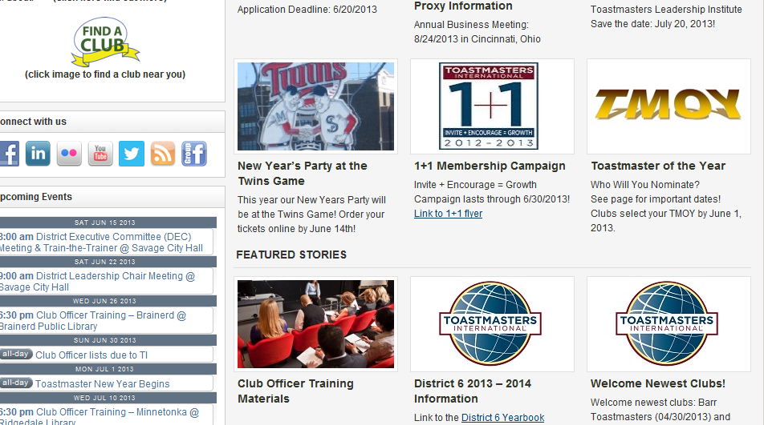
Club Officer Training Home page www.d6tm.org
Notes:
joan

Slide 20
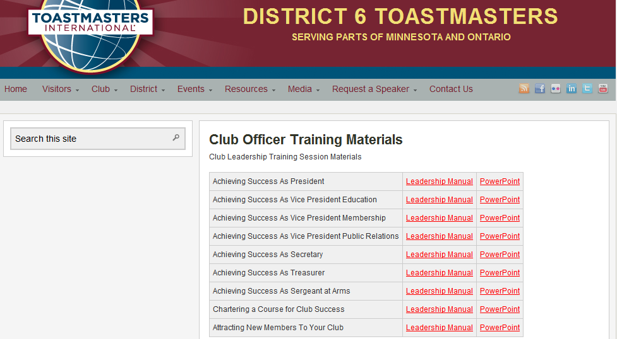
Presentations & Manuals

Slide 21
During the Training Session
Ice breaker activity – tie it to learning the DCP. Set the tone for the training…interactive training yields more understanding.
Engage audience & keep energy level high…creates desire to learn more.
Check learning with participants. Did they learn something? Did they get what they needed?
Notes:
pat

Slide 22
Conclusion
What did you learn?
What will you take away?
How will you apply this to your training session?
Notes:
Pat and joan

Slide 23
Tools for Continued Learning Training Club Officers
Club Leadership Handbook
Distinguished Club Plan
Club Officer Training Manuals and Power point training for each club office:
http://www.d6tm.org/club-officer-training-materials/
Module “From Speaker to Trainer”, available from Toastmasters International (4.5 hr workshop) – A Success Communication Module

