Slide 1
Round 2 Club Officers Training 2020-2021
District 6

Slide 2
Housekeeping
Please Rename Yourself by putting Your Officer Role in Front of your Name.
Cell Phones on Silence or Off during Training.
10 Minute Break after DCP Plan.
Any Questions: Please put them in the Chat.

Slide 3
Club Mission
We provide a supportive and positive learning experience in which members are empowered to develop communication and leadership skills, resulting in greater self-confidence and personal growth.

Slide 4
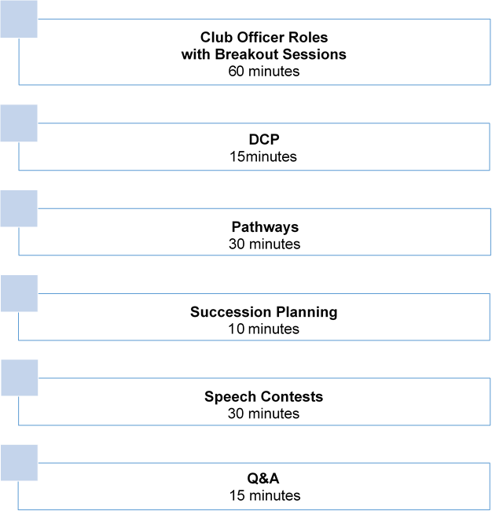
Agenda

Slide 5
Club Officer Training
Club Officer Breakouts
Building on Achievement for Continued Success

Slide 6
Breakout Sessions
President
VP Education
VP Membership
VP Public Relations
Treasurer
Secretary
Sergeant At Arms

Slide 7
A High-Quality Club – discuss in Club Officer Breakouts
Encourages and Celebrates Member Achievement.
Provides a Supportive and Fun Environment.
Offers A Professionally-organized Meeting with Variety.
Club Officers are Trained in All Aspects of Club Quality.
Members have Access to a Formal Mentoring Program.
Members are Provided Evaluations that Help Them Grow.
Members are Motivated to Achieve their Goals.

Slide 8
Other Discussion Topics
What is going well?
Each Officer pick 3 things that are Challenges and Discuss with the whole group on HOW to Succeed.

Slide 9
Distinguished Club Program (DCP)

Slide 10
Distinguished Club Program
WHY Do We Care?
Notes:
The Distinguished Club Program is a way that Toastmasters International measures the success of your club. Are the members learning and growing by earning education awards. Are you gaining new members to bring in fresh ideas? Are you club officers attending training to bring back ideas to help the members?

Slide 11
Distinguished Club Program (DCP)
Members, who have the Opportunity to Earn Education Awards, are Reaching THEIR Goals.
Membership
With Enough Members, EVERYONE’S Experience is Enhanced because Leadership is Provided and Meeting and Committee Assignments are Filled.
Training
Trained Club Officers are BETTER ABLE to Serve and Support Your Club.
Administration
Fulfilling Administrative Duties Helps Your Club Run More Smoothly, which Benefits Members.
Education

Slide 13
How do you look up your DCP?
http://dashboards.toastmasters.org/district
Club Performance
Notes:
Explain what this shows or you can have a live screen. Then say to be distinguished the membership to date must be 20 or a net growth of 5. Must have atleast 5 goals met.

Slide 14
Current Status of Pathways Adoption Rate
Pathways Champion
Resources

Slide 15
Pathways Adoption Rate
Total Adoption Rate: Proportion of active members who have selected a path.
Officer Adoption Rate: Proportion of officers who have selected a path. Club officers must be engaged in Pathways, lead by example. This will influence members to be engaged in Pathways.
New Member Adoption Rate: Proportion of new members who have selected a path. New members are defined as members who have joined within the last six months. Ideally, this rate should be 100%, as new members may only participate in Pathways.

Slide 16
Club Pathways Adoption Rate as of 10-31-2020
Notes:
This is an example of a report available to district leaders at Toastmasters International website. The goal is for all categories: Members, officers, and new members to be 100% enrolled in Pathways

Slide 17
Pathways Adoption Rate Club Level Calculation
On Club Central Check Club Roster to See who is/is not enrolled in Pathways.
To Calculate Total Members enrolled,
Divide total members enrolled by total members in your club to get percentage Pathways adoption rate. You can do the same for club officers and new members.
Aim is 100% for all three.
Notes:
You can calculate the adoption rate for your club by going to the club roster.

Slide 18
At Least One Pathways Champion in Each Club
All Club Officers should be enrolled in Pathways and know how to maneuver around in it.
At least one Club Officer should be able to help any member enroll in Pathways, help them chose their path, and help them understand how to work through the projects. These Club Officers will be known as a Pathways Champion.
President, VPE and Secretary need to know how to approve levels in Pathways as Base Camp Managers. VPE is the primary Base Camp Manager with the President and Secretary back up

Slide 19
Resources
Pathways Member Quick Start Guide
Pathways Fast Start
Base Camp Manager Duties
Base Camp Manager Quick Start Guide
Power Point Presentation by Jamie Richter, DTM
Notes:
All of these will be available at the District 6 website, 2020-2021, Pathways

Slide 20
Succession Planning
Now is the Time to Start!

Slide 21
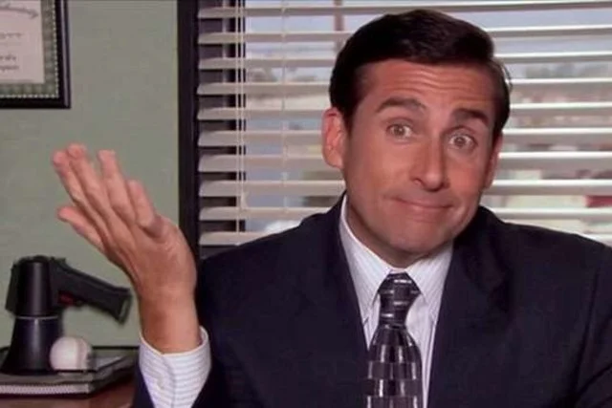
What?
What is Succession Planning?
Notes:
Succession Planning is where leaders plan for who will succeed them, who will be the next leaders.

Slide 22
Why?
Why do we need Succession Planning?
Notes:
We want to give members a chance to experience leadership at the club level. Also, we want to have new officers to bring in fresh ideas on how to provide value for the members.

Slide 23
How?
How do we plan for the next leaders?
Notes:
Start mentoring club members that you see as a potential leader now so when it is time for elections you are not scrambling around begging members to take on a club officer role.

Slide 24
Club Online Speech Contests
District 6

Slide 25
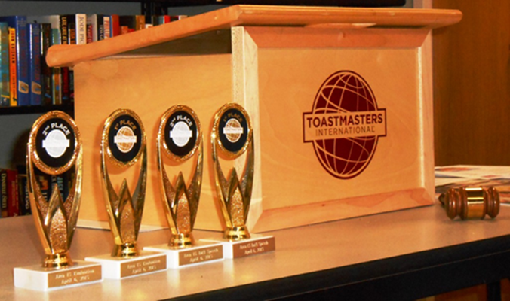
Speech Contests for 2020-2021
Table Topics
International
All Contests will be Online

Slide 26
Speech Contest Dates
District 6 Speech Contests April 17, 2021
Division Contests
Division C March 30
Division D April 3
Division E April 1
Division F March 27
Division M March 18
Division N March 24

Slide 27
Area Contests
Please contact your Area Director to find out the Date of the Area Contest.
Clubs should Schedule their Club Contest 2-3 weeks before the Area Contest
Since Area to Division Contests will be crossing over a dues period (March 31), please make sure your Club Contestants are Members in Good Standing and your Club is in Good Standing as well (8 paid members).

Slide 28
Club Speech Contests
Need Breakout Rooms for:
- Judges Briefing
- Contestants Briefing
- Table Topics Contestants
Preferable 2 Breakout Rooms OR The Toastmaster can Brief the Contestants in the Main Room.
Link on D6 Virtual Contest Help page to www.Random.org to get Speaking Order for Contestants

Slide 29
Only the Host can set up Breakout rooms
Enable Breakout Rooms in Settings.
Click on Button for How Many Breakout Rooms.
Only the Host can Assign Participants to Breakout Rooms.
Click Open All Breakout Rooms to send People to their Rooms
People can manually leave Breakout Room when Ready and return to the Main Room or the Host can Close the Breakout Room when Briefings are Done.
For Table Topics: The Host/Co-Host can join a Breakout Room to pull out the Contestant to the Main Room or have a SAA in the Breakout Room.
Notes:
Recommend Club Online Meeting Platform Host practice setting up breakout rooms and putting members in and taking them out. A SAA is recommended to man the breakout room for the contestants. Via text the Toastmaster of the contest can let then know when a contestant should leave the breakout room and return to the main room.

Slide 30
D6 Virtual Contest www.d6tm.org/virtual-contest-2020-spring/
Zoom Tutorials | Link
Zoom Breakout Rooms | Link
Zoom Registration Tutorial | Link
Zoom Meeting Help Document (Thanks Ansley) | Link
Zoom Tips for Spectators (Thanks Cathi) | Link
Successful Online Meeting Tips (Thanks Diane) | Link
Best Practices in Zoom to Prevent Zoombombing (Thanks Jamie) | Link
Helpful Tips for Judges (Thanks Linda) | Link
Judges Email Template (Thanks Linda) | Link
Contest Toastmaster Script (Thanks Cathi) | Link
Chief Judge Contest Script (Thanks Jamie) | Link
Chief Judge Training Video (Courtesy of Jamie & Linda) | Link
Division Contest Script (Thanks Cathi) | Link
International Contest – Judge ballot – Excel (thanks Amit) | Link
International Contest – Tie Breaker Ballot – Excel (thanks Amit) | Link

Slide 31
D6 Virtual Contest www.d6tm.org/virtual-contest-2020-spring/
Counter Tally Sheet – Excel (Thanks Amit) | Link
Drawing For Speaking Order: www.Random.org | Link
Speaker’s Eligibility & Originality | Link
Contestant Bio | Link
Judge’s Eligibility | Link
Online Timer: www.tmtimer.cablegrove.com | Link
Online Timer 2: www.toastmastertimer.com | Link
Placement Certificate V1 (Thanks Amit) | Link
Placement Certificate V2 (Thanks Amit) | Link
Speech Contest Time Record Sheet and Instructions for Timers | Link

Slide 32
Helpful Resources
1310 Club Leadership Handbook
District 6 Website
www.d6tm.org/district-6-2020-2021/
- Pathways
- Speech Contest Information
- Club Officer Training Materials

Slide 35
Thank YOU for Attending! Thank You for Helping:

