Slide 1
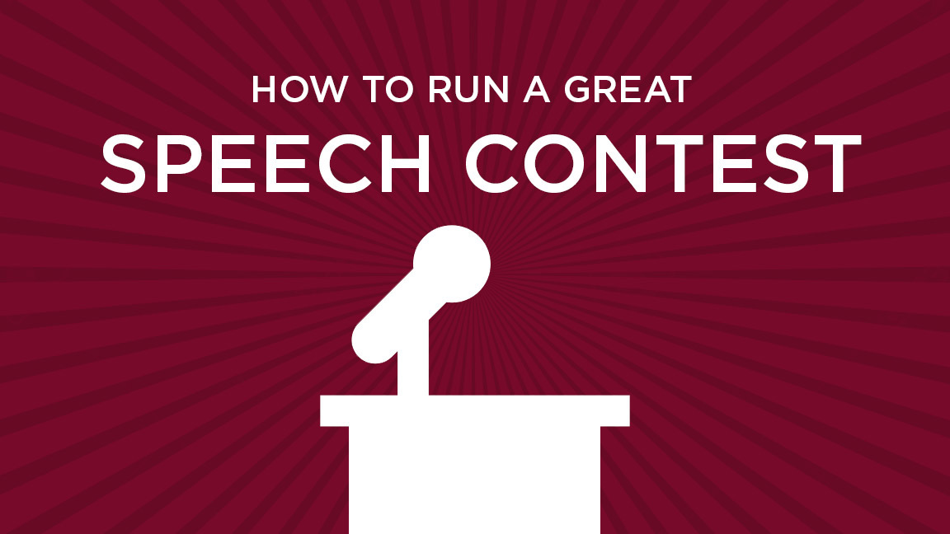
Virtual Club Speech Contest Training
District 6

Slide 2
Agenda
Welcome/Club Mission
TT and International Speech Contests
How to set up Zoom with Breakout Rooms
Toastmaster and Chief Judge Scripts
Electronic Ballots
Awards
Thank you!

Slide 3
Club Mission
We provide a supportive and positive learning experience in which members are empowered to develop communication and leadership skills, resulting in greater self-confidence and personal growth.

Slide 4
Contest Spring 2021 District 6
Table Topics
International Speech Contest
Need Breakout Rooms for:
- Judges Briefing
- Contestants Briefing
- Table Topics Contestants
Preferable 2 Breakout Rooms or the Toastmaster can Brief the Contestants in the Main Room.
Link on D6 Virtual Contest Help page to www.Random.org to get Speaking Order for Contestants

Slide 5
How to Set Up Breakout Rooms
Enable Breakout Rooms in Settings.
Host or Co-Host can See.
Click on Button for How Many Breakout Rooms.
Only the Host can Assign Participants to Breakout Rooms.
Set Timer for Amount of Time until the Breakout Rooms Shut Down.
Click Open All Breakout Rooms to send People to their Rooms.

Slide 6
What can a Co-Host do?
Start Closed Captioning and assign someone or a third-party to provide closed captioning.
Start Live Streaming.
End Meeting for all Participants.
Start Breakout Rooms or move Participants from one Breakout Room to another.
Start Waiting Room (Co-Hosts can place participants in Waiting Room or admit/remove Participants from the Waiting Room).
Co-Hosts also cannot start a meeting. If a Host needs someone else to be able to start the meeting, they can assign an Alternative Host.

Slide 7
How to get to Breakout Rooms
On the Bottom or Top of Screen in Zoom Menu
– only the Host and Co-Host can view Breakout Room button.
Click on Breakout Rooms

Slide 8
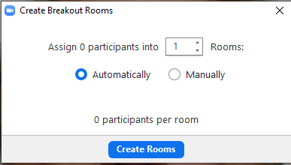
Create Breakout Rooms
1 or more, Click on Create Rooms.

Slide 9
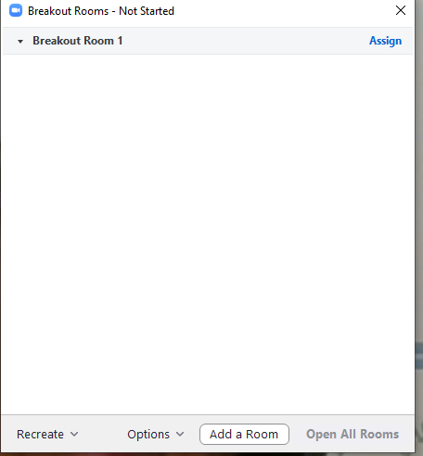
Next Screen
Set Up Breakout Room Timer / Open Breakout Rooms.

Slide 10
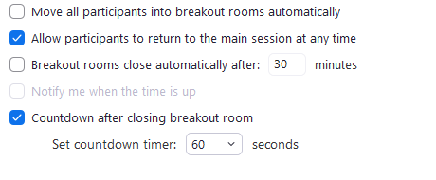
Set Timer to Shutdown Breakout Rooms
Click on Options to Set Timer / Countdown to shut Breakout Rooms

Slide 11
Electronic Ballots for Judges
Ballots allows you to type in Contestants Names
Put in score for individual criteria
It will add total score for each Contestant and place
the top scores 1,2 and 3 on the bottom of the ballot.

Slide 12
Ballot Counter Tally Sheet

Slide 13
Timer Sheets

Slide 14
D6 Virtual Contest Help Page on D6tm.org
2020-2021 Speech Contest Rulebook | Link
Zoom Tutorials | Link
Zoom Breakout Rooms | Link
Zoom Registration Tutorial | Link
Zoom Meeting Help Document (Thanks Ansley) | Link
Zoom Tips for Spectators (Thanks Cathi) | Link
Successful Online Meeting Tips (Thanks Diane) | Link
Best Practices in Zoom to Prevent Zoombombing (Thanks Jamie) | Link
Judge Helpful Tips (Thanks Linda) | Link
Judges Email Template (Thanks Linda) | Link
Chief Judge Contest Script (Thanks Mary) | Link
Speech Contest Script (Thanks Mary) | Link
Speech Contest FAQ (Thanks Mary) | Link
Speech Contest Roles (Thanks Mary) | Link
Chief Judge Training Video (Courtesy of Jamie & Linda) | Link
Division Contest Script (Thanks Cathi) | Link
International Contest Ballot - Excel (Thanks Amit) | Link
International Contest - Tie Breaker Ballot - Excel (Thanks Amit) | Link
Table Topics Contest Ballot (Thanks Amit) | Link
Table Topics Contest Tiebreaking Ballot - Excel (Thanks Amit) | Link

Slide 15
D6 Virtual Contest Help Page on D6tm.org
Ballot Counter Tally Sheet | Link
Drawing for Speaking Order: www.Random.org | Link
Speaker's Eligibility & Originality | Link
Contestant Bio | Link
Judge's Eligibility | Link
Online Timer: www.tmtimer.cablegrove.com | Link
Online Timer 2: www.toastmastertimer.com | Link
Placement Certificate V1 (Thanks Amit) | Link
Placement Certificate V2 (Thanks Amit) | Link
Speech Contest Time Record Sheet and Instructions for Timers | Link

